Slide 1
Game Changer: BHCG’s Wisconsin Solution – A Template for Fixing U.S. Health Care?
October 1, 2024

Slide 2
Welcome
Jeffrey Kluever
Executive Director
Business Health Care Group

Slide 3
2024 Commonwealth Fund Report
More than 100 million Americans – 41% of adults – are mired in medical debt
More than 26 million Americans remain uninsured
One of every four working adults in this country are underinsured

Slide 4
2023 Insurance Company Revenue & Profits in Wisconsin*
UnitedHealthcare
            WI net income: $1.24 Billion
            WI total revenue: $17.9 Billion
Anthem Blue Cross Blue Shield
            WI net income: $148 Million
            WI total revenue: $922 Million
Dean Health Plan
            WI net income: $16 Million
            WI total revenue: $1.6 Billion
* Wisconsin Office of the Commissioner of Insurance

Slide 5
2023 Insurance Company Revenue & Profits in Wisconsin* (cont.)
Network Health
          WI net income: $25.3 Million
          WI total revenue: $443 Million
  Security Health Plan
          WI net income: $11 Million
          WI total revenue: $1.4 Billion

Slide 6

Thank You to Our Educational Sponsor

Slide 7
Agenda
Keynote Presentation: What Does It Take to Drive the Change Needed in Health Care?
  Cora Opsahl, Director, 32BJ Health Fund
Presentation: Delivering Health Care Value in Wisconsin
  Ashok Subramanian, CEO, Centivo
Panel Discussion: Supporting Positive Change in Health Care Delivery
  Cora Opsahl
  Ashok Subramanian
  Pam Hannon, Retirement and Healthcare Leader, Total Rewards, GE HealthCare
Panel Discussion: Physician Value Study 3.0 – New Opportunities to Impact Health Care Value
  Earl Steinberg, MD, MPP, Adjunct Professor of Medicine and Health Policy and Management, Johns Hopkins University; CEO, QC Health, LLC
  Wayne Jenkins, MD, Chief Medical Officer, Centivo
  Dana Richardson, CEO, Wisconsin Health Information Organization

Slide 8
Keynote Presentation: What Does It Take to Drive the Change Needed in Health Care?
  Cora Opsahl, Director, 32BJ Health Fund

Slide 9
What Does It Take to Drive the Change Needed in Health Care?
Cora Opsahl
32BJ Health Fund

Slide 10
Who is the 32BJ Health Fund?
32BJ Health Fund is a self-insured, multi-employer plan that provides health benefits to over 200,000 covered lives of 32BJ SEIU union members and their families in 11 states and Washington, D.C.
Union members are cleaners, property maintenance workers, doorpersons, security officers, window cleaners, building engineers, school and food services workers, and airport workers.
The Fund is jointly governed by the Union and the Employers, using contributions from 5,000 employers of all sizes to fund health benefits
The Fund provides high-quality health benefits with $0 monthly premiums, $0 in-network deductibles, and low in-network copays
It is the responsibility of the Health Fund to keep costs low while focusing on the member
Notes:
Now that you’ve seen the impact of the work we are doing, I want to share a bit more on who we are.
32BJ Health Fund is a self-insured, Taft-Hartley benefit fund that provides health benefits to nearly 200,000 union members and their families
Our members are essential workers who work in the real estate industry, security officers, school and food services workers and, most recently, airport workers
The Fund is jointly governed by the Union and the Employers, using contributions from 5,000 employers of all sizes to fund health benefits
The Fund provides high-quality health benefits with $0 monthly premiums, $0 in-network deductibles, and low in-network copays
It is the responsibility of the fund to solve the problem of healthcare affordability – not our members
*CLICK*

Slide 11
High and rising costs threatens our ability provide affordable healthcare
In 2023, the Health Fund spent $1.4B in healthcare
Inpatient and outpatient hospital costs make up 55% of Health Fund spend
Healthcare costs make up 37% of total compensation
In the past 10 years, wages have gone up 54% but healthcare has gone up 230%
Notes:
Let’s look at the impact of healthcare for the members of 32BJ
Since 2004, healthcare has risen from 17% of total compensation to 37% of total compensation
During that same time period, wages have gone up 54% but healthcare costs have increased a whopping 230%
To put that into a dollar amount, over the past 10 years our members could have had $5,000 more in annual wages had healthcare spend risen at the same rate of inflation.
*CLICK*

Slide 12
What Does It Take to Drive the Change Needed in Health Care?
Data
Programs
Tools
Courage
Policy

Slide 13
Data is What Drives Our Decisions
32BJ Health Benefit Spending, 2023
Total: $1.4 billion
Inpatient and outpatient hospital costs account for 44% of the average employer’s spend
$213 million
18%
$618 million
$571 million
52%
*Centers from Medicare and Medicaid
National Health Expenditures, 2019
30%

Slide 14
Why You Should Care About Your Data
Conduct a wide variety of analyses
Create meaningful visuals to share with all levels of the organization
Investigate different business questions using data
Proactively engage with the data to provide business leaders with key insights
Drive benefit decisions in a thoughtful and analytical manner

Slide 15
Win/Win Cost Containment Programs
Utilization Programs
Price Solutions

Slide 16
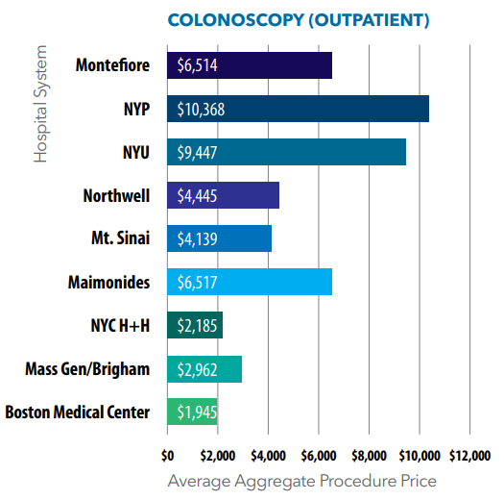
Create Programs that Save Money and Enhance the Member Experience
Utilization Programs
Price Solutions
No premium sharing
No in network deductibles
Innovative Programs
Centers of Excellence
Pharmacy Group Purchasing
Price comparison by procedure or hospital
Network Management

Slide 17
New Tools to Purchase Better
Healthcare Savings Calculator
Understand hospital price savings potential, if prices were lower.
Compare existing hospital spend to Medicare and commercial market break even benchmarks.
Healthcare Administrator Contract-First Template
Challenge the industry standard of accepting bidder contracts before negotiations.
Use as a mechanism for accountability with TPA bidders for their promised services as a vendor.
Available at 32bjhealthinsights.org/interactive-tools

Slide 18
The intersection of benefits and policy
Health Fund Network Design:
Health Fund Contracting:
Supported Legislation:
32BJ SEIU Union Public Campaigns:
32BJ Health Fund tiered and removed certain providers from its network to ensure fair cost sharing for participants.
32BJ Health Fund led an innovative RFP process for a new TPA that sought more protection against anti-competitive terms.
Supported the passage of New York City and State legislation that increases transparency and access to hospital price data.
Raise public scrutiny and awareness of irrational hospital prices.

Slide 19

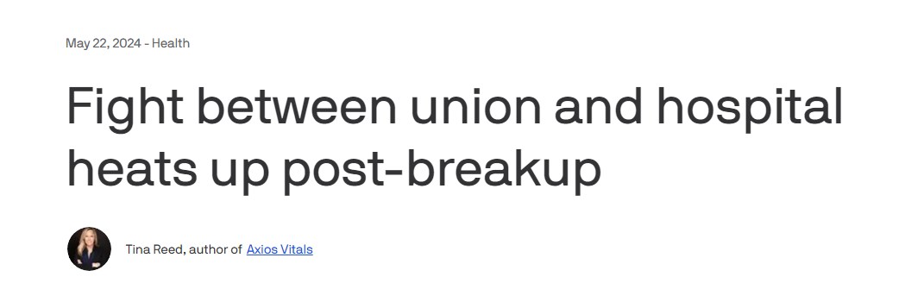

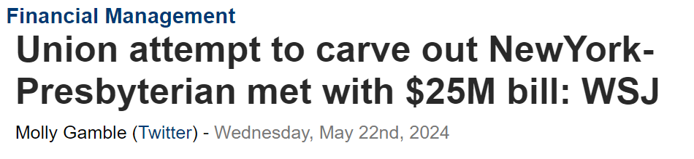

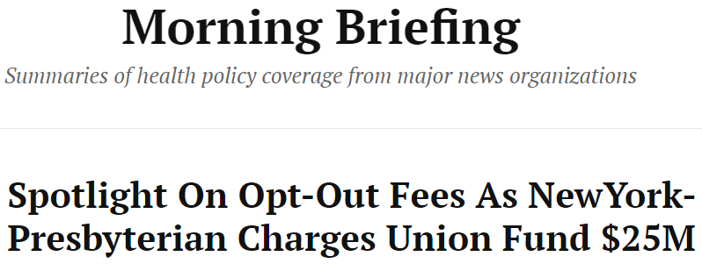

Slide 20
“The path to big, systemic change is collective action. That takes Sister Courage.”
—Gloria Feldt

Slide 21
Thank you
Email: copsahl@32bjfunds.com

Slide 22
Presentation: Delivering Health Care Value in Wisconsin
Ashok Subramanian, CEO, Centivo

Slide 23

BHCG + Centivo:
A partnership built for Wisconsin employees
Notes:
Customize with Employer Name

Slide 24
Healthcare under traditional employer plans remains inaccessible and unaffordable for most Americans
$23,698
AVERAGE ANNUAL FAMILY HEALTH INSURANCE PREMIUMS¹
56%
OF AMERICANS CANNOT AFFORD AN UNEXPECTED $1,000 EXPENSE WITHOUT GOING INTO DEBT²
28%
OF US ADULTS SKIPPED MEDICAL CARE DUE TO COST IN 2022³
$
A VICIOUS CYCLE:
High plan costs lead to delayed care that creates poor health outcomes, increasing healthcare costs even further.
26 days
AVERAGE TIME TO SCHEDULE A NEW PATIENT APPOINTMENT WITH A PHYSICIAN⁴
20%
OF US ADULTS DO NOT HAVE A PRIMARY CARE PHYSICIAN⁵
52%
ADDED FIRST YEAR EXPENSE OF TREATING STAGE II VS STAGE I BREAST CANCER⁶
1. KFF. 2.Bankrate.com. 3. KFF. 4. MHA 2022 Survey. 5. Yahoo News/Yougov. 6. Reddy et al
Notes:
Three main points –
We all know healthcare isn’t working, but we have a unique perspective on what this brokenness leads to, and we hone in on affordability
The HDHP’s that many people are on are unaffordable, most people don’t have $400 in their bank account, let alone $2,000 to pay for a deductible
This unaffordability also leads to accessibility problems, people don’t seek care in the right places or at the right time because of the financial barriers in front of them

Slide 25




Centivo + BHCG: Built for innovation and security
Primary care centered plan with high-performing PCPs
Affordable plan with enriched benefits
Local, high-quality network with significant unit cost savings
*Option for transitional parity with traditional carrier offerings for broad
network access using HPS in WI and Cigna elsewhere
High-Performance Plan offering
        18% average total cost of care savings
Transparent plan administration & Reporting
Intuitive Member app/portal
End-to-end Member service
Stop loss coverage (through partners)
Flexible payment options (including level funded)
Claims payment
Virtual care ecosystem
Transparent
PBM
Notes:
It is within this fractured environment that Centivo and BHCG can have a powerful impact. The plan that we’ve been taking to market here in WI is built on the conviction that employees and their families deserve the best care at the best prices, and that their employee’s need options to deliver that on their behalf.
And while we’ve been offering Centivo as a full replacement option for many employers, other employers have opted to use Centivo as a slice option. In both cases, we’re working to meet employers where they are in their quest to do better for their employees.

Slide 26





























































In under 3 years since launch…
PROVEN SUCCESS IN THE WISCONSIN MARKET
    49 BHCG employers, ~ 30,000 members
    Network of ~14,000 doctors and growing
*
    + Traditional Network options
*Serving greater Fund du Lac area
Notes:
What we’ve been able to accomplish together in 2 short years is staggering.
Since we launched arm-in-arm with BHCG, we’ve seen 37 different WI employers representing 23,000 members join our ranks. This means 23,000 human beings have access to the high-quality, affordable healthcare they deserve.
And our network is expanding in WI so we can reach more employers and more people—we now have proprietary, value-based care contracts with 14,000 doctors across the state, and that number is growing.

Slide 27
BHCG & Centivo are working at scale
WITH 49 CLIENTS AND 14,000+ PROVIDERS
2023 Wisconsin results speak for themselves...
18% total cost of care savings versus traditional health plans¹
30% increase in preventative visits¹
45% increase in primary care visits¹
30% reduction in ER and urgent care visits¹
...and emerging YoY trend is near 0% vs national PPO trend of almost 10%
1 Centivo / BHCG High Performance Plan Book of Business analysis (Med+Rx), mid-market clients, compared to moderately
managed benchmark, 2023 | 2023
Notes:
This isn’t just a concept, we have 120+ self-funded clients across many different industries.
Here’s what it looks like across our book of business:
- We’re changing story when it comes to affordability, decreasing health plan spend for employers, and saving money for employees
- We’re not doing that by cutting back on care, in fact the opposite. By pushing all care through the primary care doctor, yes you’ll spend more in primary care, we see an increase in primary care visits across our book of business. But as a result we also see much fewer ER visits

Slide 28


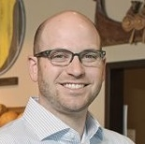
O&H Danish Bakery and Centivo
CASE STUDY
One of the biggest challenges that always weighed on me as an employer is taking care of my people. Inevitably in 2022, we ended up with a 28% renewal. That was the tipping point to needing to get more control.
PETER OLESEN
Vice President O&H Danish Bakery
        $400K
        TOTAL SAVINGS
        IN YEAR 1
        69%
        SAVINGS FOR THE EMPLOYEE
        77%
        OF MEMBERS HAVE <$100 IN OUT-OF-POCKET COSTS PER YEAR
        66%
        OF MEMBERS HAD AT LEAST 1 PCP OR ALTERNATIVE CARE VISIT
Notes:
And members aren’t the only ones having incredible experiences. Employers are seeing results that can impact their ability to support employees and their business.
[Discuss how the product has come together for O&H bakery]

Slide 29

WI MEMBER TESTIMONIAL
Living without healthcare stress and anxiety
Amelia became a Centivo member hoping for lower costs, easier access, and less overall stress and anxiety.
An unexpected health scare and surgery put her Centivo plan to the test.
Everything went smoothly and Amelia got the care she needed.
The result? A stress-free healthcare experience that allows Amelia to enjoy and live her best life.
“I feel so secure with Centivo. I don’t worry about my healthcare at all. It’s been a wonderful, wonderful thing in my life.”
Notes:
This story came directly from a WI employee and shows the power of Centivo’s health plan in the WI market. When talking about this story, it is critical to point out how transformative the Centivo health plan has been for Amelia.
Another component of this story is how grateful the member feels for her employer (Sendik’s) in offering such a great health plan. By offering Centivo, employers are dramatically improving the lives of their employees.
Full story below:
Amelia became a Centivo member hoping for lower costs, easier access, and less overall stress and anxiety. Having had negative experiences with insurance and healthcare in the past, she was cautiously optimistic that this time around would be different.
Nothing prepared her for how her healthcare experience would change with Centivo.
An unexpected health scare and surgery put her new plan to the test. When her PCP put in a referral for the surgery, Amelia braced herself for the worst and the kind of runaround she had become accustomed to in healthcare. Instead, everything went smoothly and Amelia got the care she needed.
The result? A stress free healthcare experience that allows Amelia to enjoy and live her best life.

Slide 30
Thank you

Slide 31
Panel Discussion/Q & A
Panel Discussion: Supporting Positive Change in Health Care Delivery
  Cora Opsahl
  Ashok Subramanian
  Pam Hannon, Retirement and Healthcare Leader, Total Rewards, GE HealthCare
  Moderated by: Dave Osterndorf, BHCG Strategic Consultant & Chief Actuary, Centivo

Slide 32
Panel Discussion/Q & A
Panel Discussion: Physician Value Study 3.0 – New Opportunities to Impact Health Care Value
  Earl Steinberg, MD, MPP, Adjunct Professor of Medicine and Health Policy and Management, Johns Hopkins University; CEO, QC Health, LLC
  Dana Richardson, CEO, Wisconsin Health Information Organization
  Wayne Jenkins, MD, Chief Medical Officer, Centivo
  Moderated by: Lisa Mrozinski, Managing Director, Director of Total Rewards, Baird

Slide 33
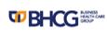

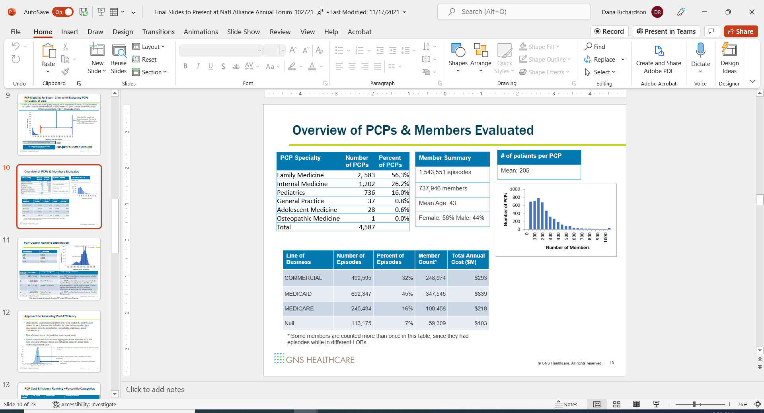

>100 employer members
5.36 M insured lives
Advanced analytics incl. AI
PCP focused network
Incentivize high value care
Support all stakeholders
High value specialty referrals
Casual analysis
WI Physician Value Study
HIGH VALUE HEALTH CARE

Slide 34
Physician Value Study Change Model
2019 Results
ID’d specific quality improvement opportunities
Quantified the dollar amount that could have been saved if the bottom 50% of PCPs had practiced similar to the to 50% of PCP’s.
“The data is no good.” led to a public review of the data and methods.
No provider organizations requested their report.
PVS Version 1, 2019
WHIO
Custom DataMart 2016-2017
Enhanced with Episode Treatment Groups, Episode Risk Groups, Normalized Prices and Evidence Based Measures
GNS Healthcare
Data analysis, including advanced AI
WHIO
Re-organized study results into provider organization reports
Offered reports to provider organizations
Multiple presentations on the methodology and results
PVS Version 2, 2021
WHIO
Custom DataMart 2018-2019
Episode Treatment Groups, Episode Risk Groups, Normalized Prices and Evidence Based Measures
GNS Healthcare
Data analysis, including advanced AI
WHIO
Re-organized study results into provider organization reports
Multiple presentations on the methodology
Offered reports to provider organizations
Centivo
Results used to create a “narrower” PCP network and provide financial incentive to members to see better performing PCPs
PCP’s had specialist quality scores available when making a referral
2021 Results
2nd data point re potential savings similar to 1st est. Increased understanding of the data and methods.
Employers begin using Centivo’s PCP network.
Seven provider organizations accessed their organization’s report from the WHIO.

Slide 35
Physician Value Study Continuing Evolution
PVS Version 3.0 can help understand:
Is physician performance consistent over time?
How much impact do the Social Determinants of Health have on physician performance?
What makes PVS results even more actionable for health care provider groups?
Can the results be replicated elsewhere?

Slide 36
Wisconsin Health Information Organization (WHIO)
Vision: Better health, health care, and health care value gained from objective information.
Mission: To create more health data and better information to advance actions.
In 2008, WI State Statute Chapter 153 requires the WI Department of Health Services (DHS) to create a voluntary participation, statewide administrative claims database. WHIO incorporated as a public-private partnership to fulfill this role on behalf of DHS.
    Purpose: To analyze and publicly report information on the cost, quality, and effectiveness of health care and maintain a centralized data repository.
  The WHIO is not a trade association and does not represent a stakeholder group.
  The WHIO providers data and information to all organizations that are interested in improving the health of Wisconsinites and Wisconsin’s health care delivery system.
As of December 31, 2023, WHIO data includes:
5.36 million insured lives
$375 billion in charges
866 million claims (medical and pharmacy)
Commercial, self-funded employers, Medicaid, and Medicare Advantage
Social and economic data (SERF)

Slide 37
Why claims data is used for the PVS
WHIO’s Data System
Claims Data
In use for over 30 years by many organizations
Gold standard for utilization and cost evaluations. Also used for quality process measures.
Highly standardized and structured data using nationally recognized ontologies (e.g., ICD10, CPT); training and audit processes are in place to minimize errors.
Initial short comings have been researched and addressed with nationally known methods and products.
When limited to a single payer, the claims data may not be geographically broad or robust enough for provider comparison.
  APCD data is an exception to this.
Payer 1
Data
Payer 2
Data
Payer 3
Data
Multiple automated and human data quality assessments
Claims Reconciliation updates and removes duplicate claims
WHIO ID creates a longitudinal patient record; de-identification
Provider Registry connects physicians to a provider organization
Provider A Results
Provider B Results
Provider C Results

Slide 38
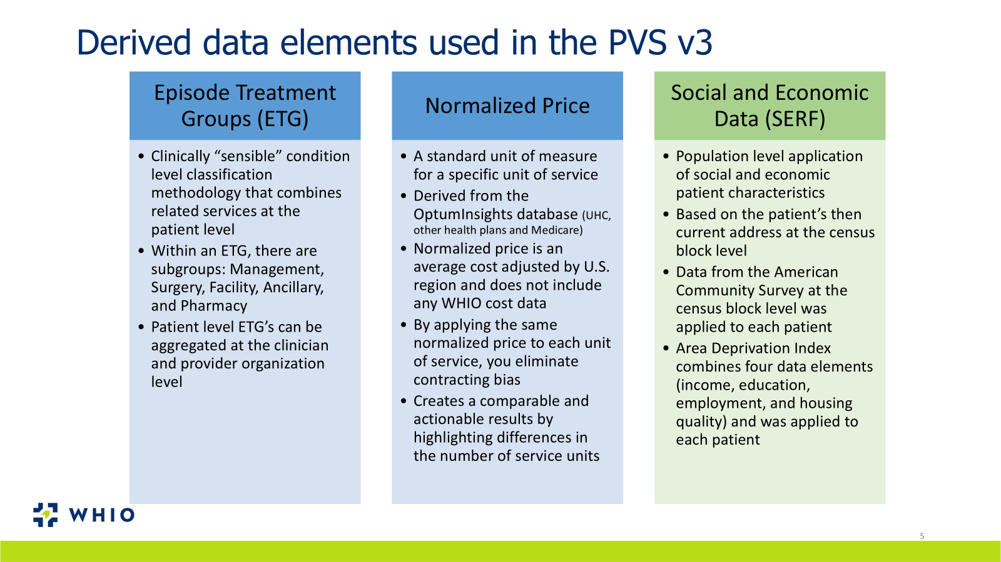
Derived data elements used in the PVSv3

Slide 39
Physician Value Study Objectives
Evaluate the quality and efficiency of each PCP
Provide PCPs with information re: the actions they can take to improve the quality of care they deliver
Quantify the amount of money that could be saved by a) moving patients to higher efficiency PCPs and/or b) improving the performance of lower performing PCPs
Assess which clinical care patterns differentiate higher and lower efficiency PCPs
Determine the savings potential among Specialists who perform a set of commonly performed procedures that comprise a substantial portion of the specialty care spending

Slide 40
Methods for V3.0
Data Source: WHIO, with data from 2021-2022, including runout
Patients will be included if they had both medical and pharmacy benefits throughout the entire time period
Attribution of patients to PCPs -Used assigned PCP if the patient had one, If no assigned PCP, will impute PCP (based on most cost)
Quality of care based on Evidence-Based Medicine quality measures (EBMs) from Optum Episode Treatment Groups (ETGs) that we believe are reasonably handled by a PCP; requires at least 30 ETG observations
Cost efficiency is based on average normalized allowed amounts as our measure of “cost of care” to determine cost efficient resource use
We will utilize Aitia’s causal learning platform to 1) predict the cost for each patient for each disease after adjusting for potential confounders (e.g., age, gender, complications, comorbidities, diagnoses, line of business etc.) and Optum’s Episode Risk Groups
Cost efficiency score = log(predicted_cost / actual_cost); aggregated to the attributed physician to show actual costs relative to predicted costs

Slide 41
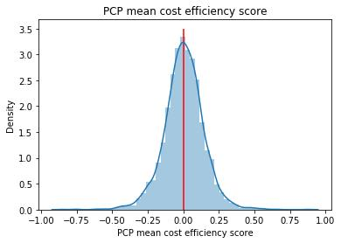
Methods (cont.)
If a PCP’s or Specialist’s actual episode costs = predicted cost, the efficiency score is zero
PCP’s and Specialists whose actual episode costs > predicted cost (lower performing)
PCPs and Specialists whose actual episode costs < predicted cost (higher performing)

Slide 42
We Will Take Account of Confidence Intervals Around Point Estimates When Developing Quality & Efficiency Rankings
PCP Ranking | Quality Ranking Name | Quality Ranking Description
1 | Outstanding Performers | we’re 80% confident these providers perform better than the 75th percentile
2 | Good Performers | we’re 80% confident these providers perform better than the 50th percentile, but not better than the 75th percentile
3 | Typical Performers | we’re neither 80% confident performance is better than the 75th percentile nor 80% confident performance is worse than the 50th percentile
4 | Below Average Performers | we’re 80% confident performance is worse than the 50th percentile

Slide 43
2018 and 2019 Combined Annual Cost & Potential Annual Cost Savings
 | Primary Care Physicians | 10 Specialist Procedures | PCPs + Specialist Procedures
Total Annual Cost | $810M | $681M | $1.49B
Potential Annual Savings | $324.7M (40%) | $57.65M (8.5%) | $382.35M (25.7%)

Slide 44
Thank You!
A recording of today’s webinar as well as presenter slides will be made available. Watch your inbox or visit bhcgwi.org.
For more information about BHCG programs and membership, please contact:
Jeffrey Kluever
262-875-3312 X1
jkluever@bhcgwi.org

