Slide 2

Today’s Agenda
Welcome, Retrospective & Our Bright Future
  Jeff Kluever, BHCG Executive Director
The Art of the Possible: Driving Change
  Ashok Subramanian, Founder & CEO, Centivo
Value Creation: The Key Role of Primary Care Panel
Views from a National Leader Driving Change: Observations, Reactions and Recommendations
  Keynote Address: Wendell Potter
Paul Purcell Leading Change Creating Value Award
  Presenter: Dianne Kiehl, BHCG Executive Director Emeritus
Wrap-Up and Thank you
  Jeff Kluever
Cocktail Reception

Slide 3
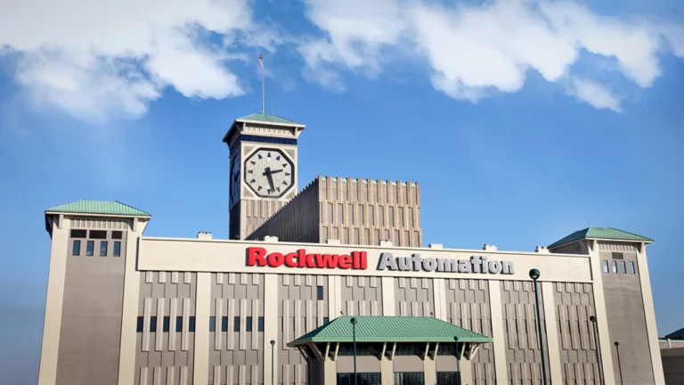
BHCG Founders
Don Davis, Jr.
  Chairman, President & CEO of Rockwell Automation
Mary Jane Hall
  Senior Vice President, Human Resources, Rockwell Automation

Slide 4
Driving Success of BHCG
C-Suite Champions
  Paul Purcell
  Steven Smith
  Keith Nosbusch
  Todd Teske
Dianne Kiehl, BHCG Executive Director Emeritus
Health systems & provider groups
Past Executive Steering Committee members
Current Executive Steering Committee members
Jennifer LaMere, crucial staff member
Other significant contributors

Slide 5
Collaboration Driving Success
Health systems & provider groups
Best in class strategic partners
  Navitus Health Solutions
  Quantum Health
  Artemis By Nomi Health
  Aitia
  Teladoc
  Centivo

Slide 6
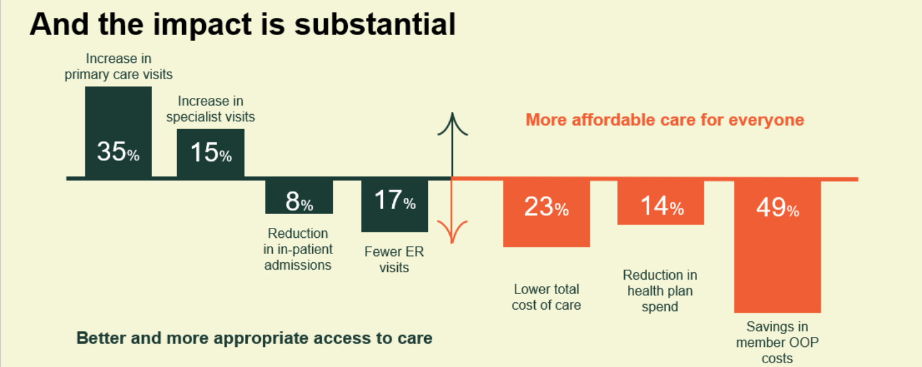
BHCG-Centivo Results Are In…

Slide 7

BHCG-Centivo Successes
Membership growth
  18% growth in covered lives (from 1/1/23 to 1/1/24)
  Significant growth expected for ’24-’25
WI provider network expansion

Slide 8



Change is Possible 2003-2023
COLLABORATION/EDUCATION/SUPPORT
RESPONSIBLE CORPORATE CITIZENSHIP/COMMUNITY
INCREASING HEALTH CARE VALUE

Slide 9



Change is Possible 2003-2023
CONSUMER ENGAGEMENT
EMPLOYER SOLUTIONS
DATA-DRIVEN STRATEGIES

Slide 10
At Centivo, we are committed to restoring healthcare affordability for American businesses and the workers who make them run—offering a proven alternative to traditional insurance carriers for self-funded employers.

Slide 11

This isn't our solution, it's YOUR solution.
A solution for Wisconsin employers
        A High-Performance
        Network Solution
        Centivo, a unique high-performance health plan, offers primary care-centered network solutions in the WI market.

Slide 12
















Built with the providers in your community
Power of partnership
    High-Performance Network, ~14,000 doctors and growing
*
    + Traditional Network options

Slide 13

















In <2 years since launch – 35 employers and growing...
Proven success in the Wisconsin market

Slide 14
Changing care consumption – 2X increase in primary care
Traditional
Centivo Partnership Plan
Top Performer*
* Plan sponsor with 6,000 Centivo lives; Risk score 0.99
Claims distribution changes include substantial increase in Primary Care spend as % of total
* Using the Milliman moderately managed plan as a benchmark
Notes:
Dave

Slide 15
Success to date
True savings for employers and employees
 | Benchmark | Centivo | vs. Bench
PMPM Employer Paid Amount | $418 | $360 | -14%
Average Annual Member OOP Cost | $700 | $554 | -21%
* Based on GSN scores
Notes:
Compared to members who visited preferred providers*, members who visited non-preferred providers cost approximately
15% more in primary care ($74 vs. $65 PMPM)
2.7x more in specialty care ($543 vs. $204 PMPM)
3.5x more in outpatient care ($834 vs. $240 PMPM)
4x more in inpatient care ($633 vs. $156 PMPM)”
*based on GSN scores

Slide 16
Going beyond traditional cost shifting strategies
Case Study
        Background
Manufacturing company
8 locations and 200+ employees
Implemented program with broker to incentivize employees for using high-quality, low-cost care; was looking for more sustainable way to administer on a larger scale
        Offering
            Centivo administered all plans: High Performance Plan, High Deductible Plan, Open HSA Plan
We wish we would have had Centivo earlier because it would have taken the work out of putting together our own program, and it's taken it to the next level.
        Results
            Actual Year 1 total spend of $547 PMPM represented 39% savings from projection of $900 PMPM¹ across all plans offered
            Members enrolled in the Centivo High Performance Plan paid an average annual cost share of $300
            Preventive visits 43% higher in Centivo Plans²

Slide 17
Member experience driven by removal of barriers to affordability...
Testimonials
    I am a Centivo lifer…it forced me to see my primary doctor multiple times this year (for the referral). My blood pressure is now down to 110/70 (Down from 145/ 110), my cholesterol has plummeted, and I have lost 40 pounds. I also would not have found out I had beyond early onset of prostate cancer without seeing my primary physician for something totally unrelated.
    My husband and I take the difference in what we used to pay for our premiums through [our previous plan] compared to what we pay now under Centivo, and we put it in a savings account that we use for vacations and stuff. We have over $1000 saved already.
    After years of not having a doctor, I chose the Centivo Partnership Plan and selected a primary care physician. To my surprise, I was diagnosed with chronic conditions including diabetes, high cholesterol, and high blood pressure. My doctor partnered with me to create a plan that helped me lose 20 pounds, and lower my cholesterol, A1C and blood pressure down to healthy levels. I am so thankful for the relationship and high-quality of care I received from my Centivo providers.
    Centivo Virtual Primary Care has been great. Everything is much easier with your help.

Slide 18
...and expanded patient access
Case Study
        Patient Background
Established patient called with a high fever 2 days after oral surgery
        Interaction with Virtual Primary Care
            Consulted with the oral surgeon to rule out operative complication
            Ordered lab tests to check for infection/sepsis
            Continued check-ins led to discovery of new symptom – shortness of breath
            Coordinated urgent care visit to perform a chest x-ray – patient was released without diagnosis
            Symptoms persisted so contacted patient’s local emergency department; all prior test results and summary of care were provided for efficient and non-redundant evaluation
        Results
            The patient was diagnosed with a tick-borne illness and treated
            Led to resolution of symptoms in 2 days

Slide 19

The bottom line
It works.

Slide 20
Value Creation: The Key Role of Primary Care
      Moderator: Lisa Mrozinski, Director of Total Rewards, Baird
      Panelists:
      Patricia Golden, DO, Clinical President, Ascension Medical Group Wisconsin
      Paul Pritchard, MD, Senior Vice President and Chief Quality Officer Prevea Health
      Mark Lodes, MD, President, Froedtert & MCW Community Physicians
      Wayne Jenkins, MD, Chief Medical Officer, Centivo

Slide 21
Keynote Address: Wendell Potter
Views from a National Leader Driving Change: Observations, Reactions and Recommendations

Slide 22
2023
Paul Purcell Leading Change, Creating Value Award
Presented by: Dianne Kiehl,
BHCG Executive Director Emeritus

Slide 23

2023 Paul Purcell Leading Change, Creating Value Award
Congratulations to:
Sojourner Family Peace Center
Accepted by: Carmen M. Pitre, President & CEO

Slide 24
2023: Milwaukee Business Journal
C-Suite Stars Award for Human Resources
Janet Lucas-Taylor, Senior Director Employee Benefits
Northwestern Mutual
Award criteria
  HR professionals making a difference within their companies or organizations
  Recognizing the important work these professionals do in making southeast Wisconsin firms successful
Remarks: Todd Smasal, Director, Total Rewards, Northwestern Mutual

Slide 25
Thank you for joining us to celebrate two decades of leading change & creating value!

