Slide 1
Celebrating 20 years of employer
community collaboration working toward a
better, more sustainable health care system!

Slide 2


Thank You to Our
Educational Sponsor

Slide 3


BHCG Founders
Don Davis, Jr.
Chairman, President & CEO
of Rockwell Automation
Mary Jane Hall
Senior Vice President, Human Resources, Rockwell Automation

Slide 4
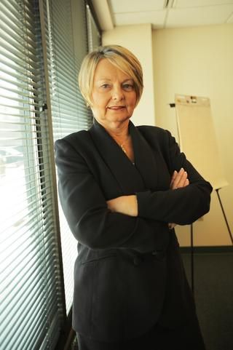
2003-2006: Formation of BHCG
2003
Concern about high health care costs and their impact on job growth/retention results in discussions among:
CEOs of major Wisconsin-based employees
11 corporations
BHCG founded in 2003 as member-owned Limited Liability Corporation (LLC) to explore alternatives to contain health care costs in the region
2006
First BHCG Executive Director Dianne Kiehl hired
Partners with Humana
Launches High Performance Network
Significant C-Suite support for the organization

Slide 5
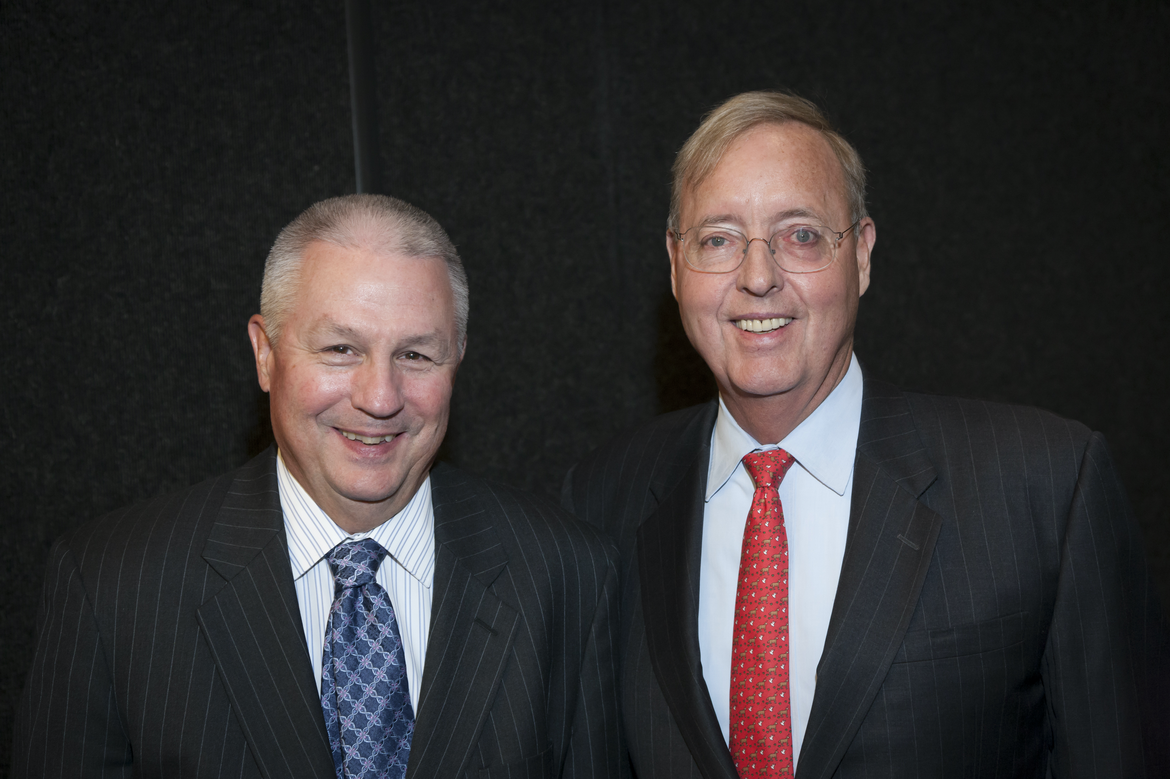
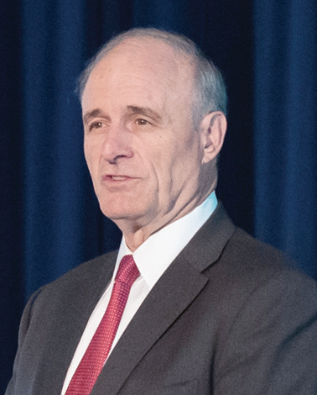
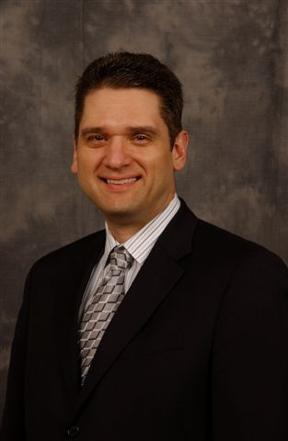
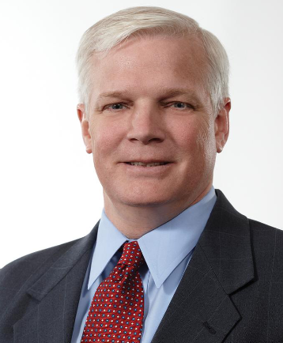
Early Years: Crucial CEO Support
Steven Smith
Journal Communications
Paul Purcell
Baird
Keith Nosbusch
Rockwell Automation
Todd Teske
Briggs & Stratton
Rich Meeusen
Badger Meter

Slide 6
2007 – 2012: Walking the Talk
2007
Develops online consumer health care education modules
2009
High Performance Network drives success
BHCG self-funded employers realize $32 million in aggregate cost savings over two-year period
2012
Partners with informed decision-making vendor Teladoc (formerly Best Doctors)
BHCG now represents more than 1,100+ employers with 100,000+ employees/dependents

Slide 7
2013 – 2017: Expanding Our Reach
2013
Celebrates 10th anniversary
2016
Replaces Humana with UnitedHealthcare
2017
Expands service area into nine northeast Wisconsin counties

Slide 8
2018 – 2020: Creating Health Care Value
2018
Partners with Navitus Health Solutions
Transparent, 100% pass-through pharmacy benefit manager
2019
Launches Delivering Value Series (DVS)
Symposiums designed to give employers and other stakeholders in-depth knowledge about innovative employer solutions in BHCG’s portfolio
Partners with Quantum Health
Consumer navigation and care coordination services
2020
BHCG membership exceeds 250,000 covered lives

Slide 9
2021: Reimagining Health Care
BHCG member employers using Navitus reduce pharmacy spending by more than
$2.5 million per year
Announces partnership with Centivo for the first high-performance, primary care-centered health plan solution in Wisconsin – effective 1/1/22
Conducts second Physician Value Study
Engages Aitia (formerly GNS Healthcare) to utilize WHIO database
Centivo uses Physician Value Study to build high-performance networks

Slide 10
2022 – 2023: Driving Positive Change
2022
BHCG-Centivo high-performance, primary care-centered solution launches on 1/1/22 with key early adopters
Selects Artemis By Nomi Health as benefits analytics strategic partner
2023
BHCG-Centivo high-performance, primary care-centered solution shows excellent results
Total medical spending in 2022 down 20-35% compared with national benchmarks
Substantial membership growth on 1/1/23

Slide 11
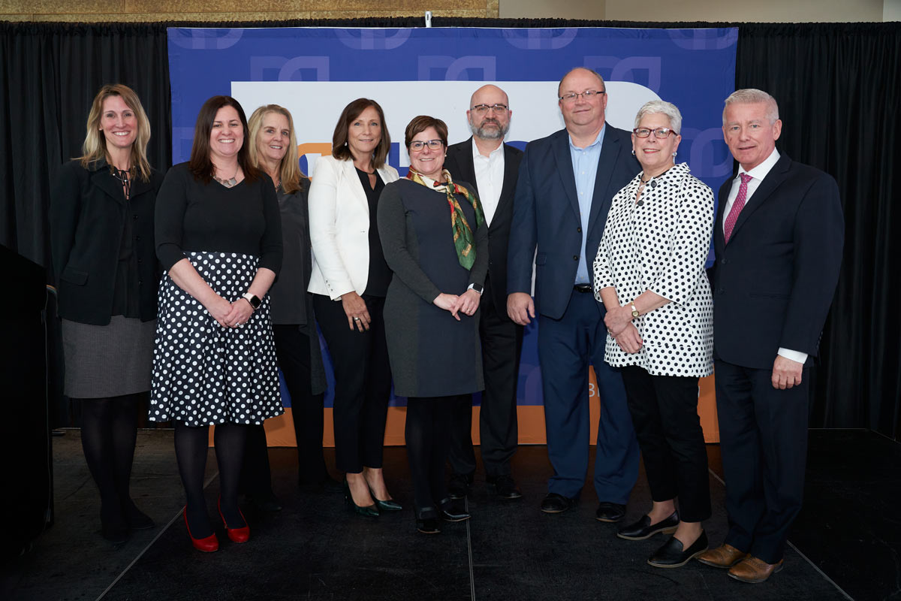
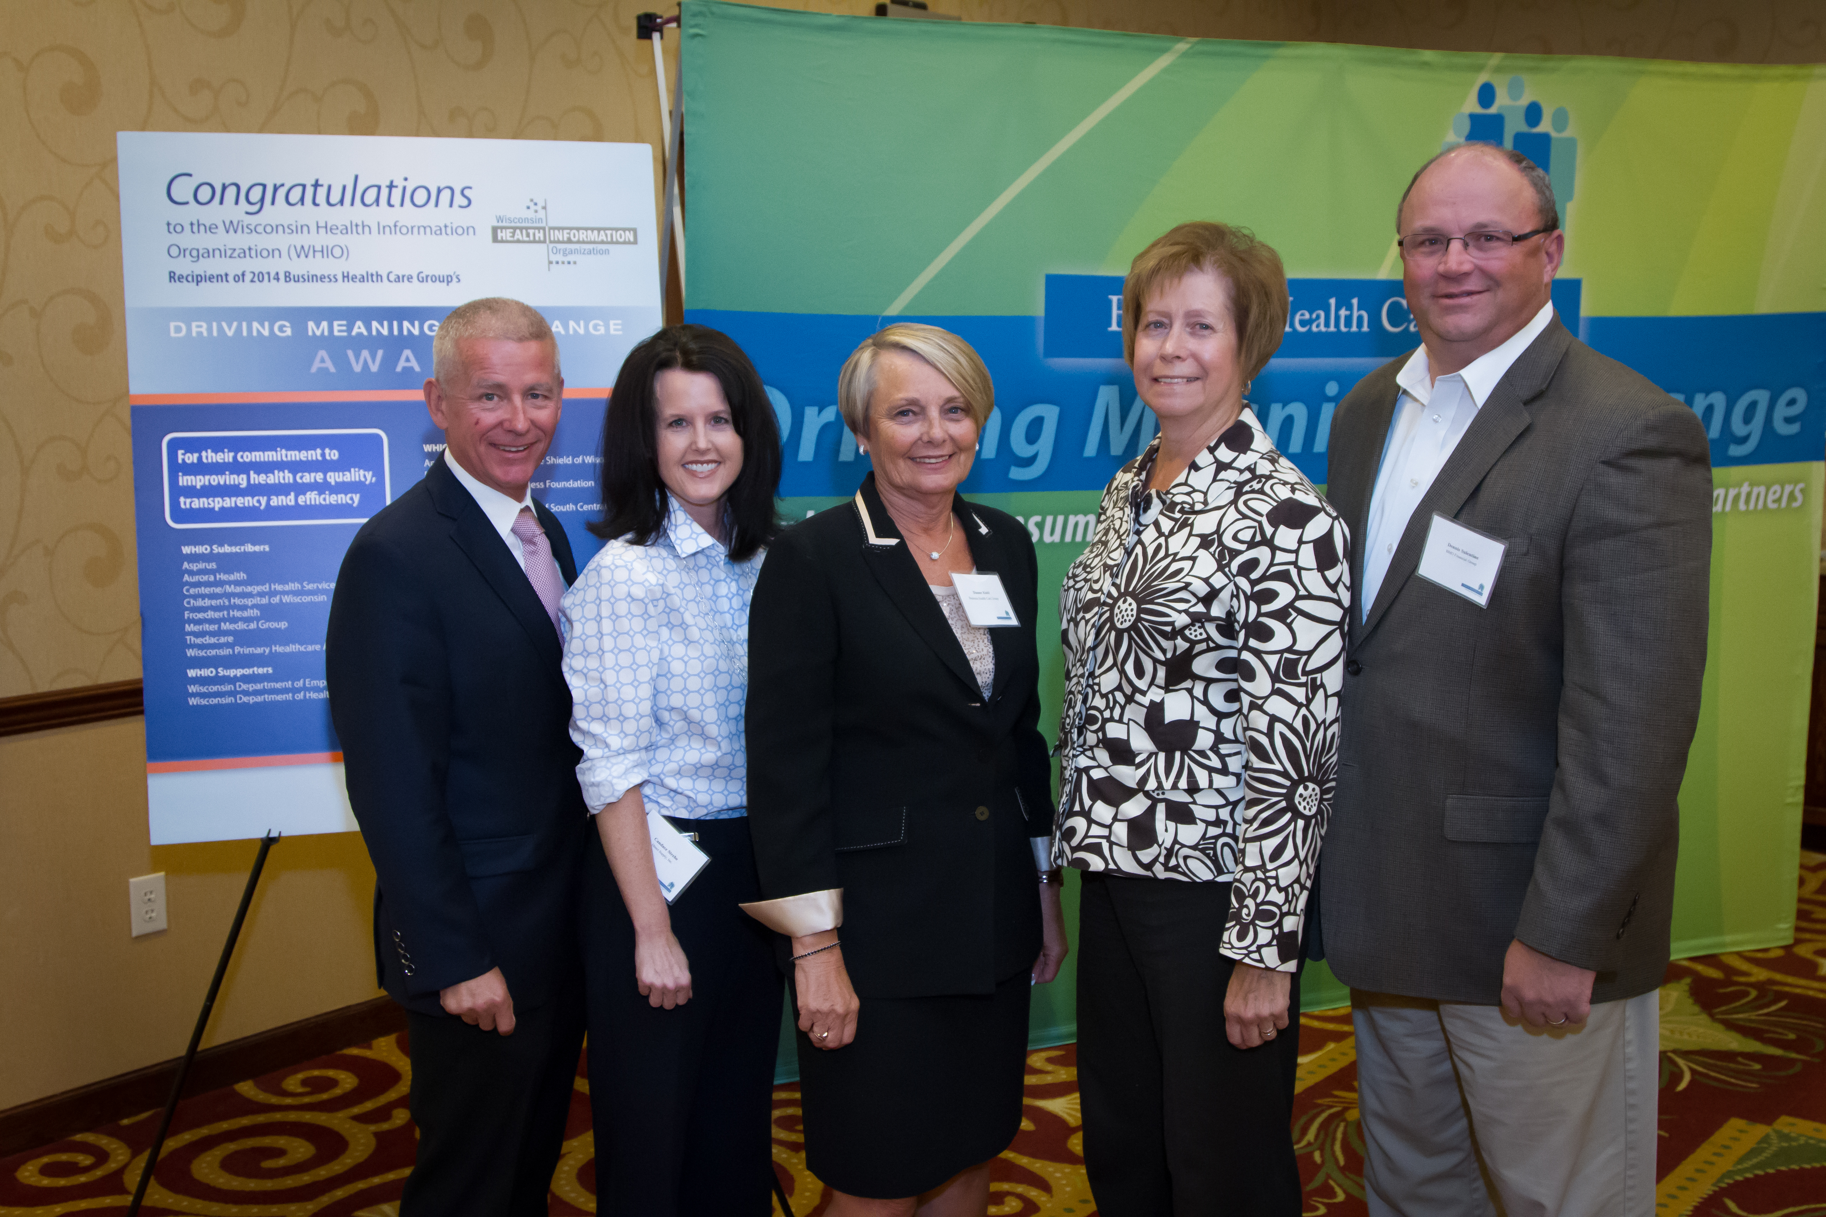
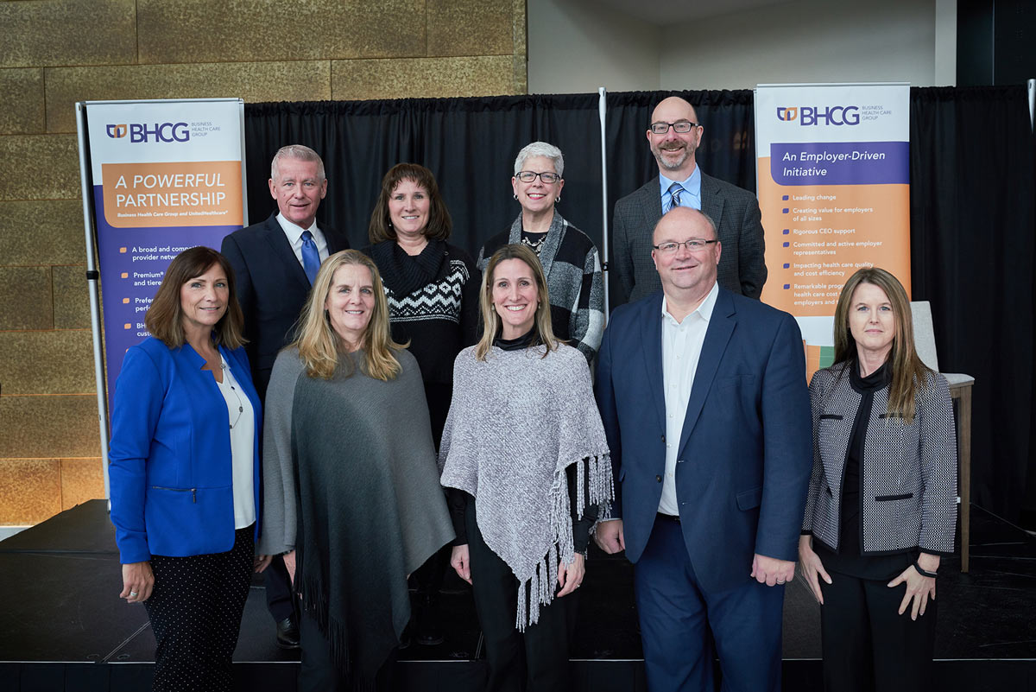
BHCG
Executive Steering Committee Members
Over the years

Slide 12






BHCG Best In Class Employer Solutions
BHCG member employers have access to an ever-growing portfolio of employer solutions:
High performance health plan and claims administration
Pharmacy benefit management
Consumer navigation and care coordination
Advanced benefits analytics
Informed decision-making

Slide 13
Demonstrating Responsible Corporate Citizenship
  Provides direct employer engagement with all major eastern Wisconsin health care systems
  to add value through collaboration
  Influences statewide efforts to positively impact the value of health care in our state
  Supports employers in their efforts to make their employees educated purchasers of health care services
  Holds annual BHCG golf outing, raising more than $200,000 for area nonprofits to date

