Slide 1
BHCG and Centivo: Communication and Change Management Toolkit Template
August 2021

Slide 2
About This Document
The purpose of this document is to provide recommended communication and change management actions and resources you can leverage to launch Centivo, either as your medical plan option or alongside another option. Here’s what is included in the following pages:
Pages 3 - 5 Change Management Guidance
Pages 6 - 7 Goals and Audiences
Pages 8 - 10 Communication Plan
Pages 11 - 12 Key Messages, FAQs and Challenges
Pages 14 - 20 Centivo Communication Support

Slide 3
Guiding Principles for Change
Keep these 4Es in mind as you plan for and roll out the change
Bring the change to life for people and define how it impacts them
Envision
Engage
Involve people to identify needs, take action, and mitigate risks
4Es
Embed
Enable
Ensure the people, process and tools are in place for lasting change
Provide the tools and support needed to build the future

Slide 4
What Successful Change Looks Like
Keep these success characteristics in mind as you plan your efforts
Story
A clearly articulated and compelling story
Leadership
Leaders who actively support and advocate change
Alignment
Aligned people, programs, processes, technology
Capability
Organizational capability
to change
Sustainability
Lasting change
and resiliency

Slide 5
Tips for Managing Change Well
Consider these tips based on experience with hundreds of employers
1
6
Start Early
Create Foundational Communications
2
7
Consider What Else is Going On
Lead with the Honest “Why”
3
8
Get Agreement on Key Messages
Put Employees at the Center of the Story
4
9
Insist Leaders Be Visibly Involved
Go High Tech and High Touch
5
10
Test Approach with Employees
Position the Decision as Final
Bonus
Remember Employees Are More Resilient Than We Think

Slide 6
Communication and Change Goals
Aim toward these goals for a successful rollout and ongoing change management
Message Clearly
Consistently convey key messages from the employer voice that demonstrate the value of the Centivo model to all audiences
Encourage Participation
Encourage employees to consider, select and take full advantage of Centivo
Transition Well
Create transition communications based on the Centivo option you’re incorporating*
Build Knowledge
Use this opportunity to increase employee medical benefits IQ
Increase Trust
Increase understanding of why members should value the PCP relationship and increase comfort with and trust of their PCPs over time
*Employer responsibility

Slide 7
Audiences to Reach
Reach each of these audience groups with your key messages
Members | Leaders | External
Employees* Retirees (pre- and post-65) Spouses/Partners Call Center Staff (who talk with members) Quantum | CEOs Leaders HRBPs Managers | Network Health Providers Media/Press Vendor Partners Advisors
*All benefit eligible, those offered Centivo as only option, those offered Centivo as the only option, those newly eligible (e.g., new hires, turning age 26), members outside of a Centivo network area, HPS

Slide 8
Plan Framework by Phase
Members
Leaders
External
Roll out your communications in phases based on when you are offering Centivo
Phases | Prepare | Engage/Activate | Support
Goals
Themes
Give audiences time to adjust and learn
Reflect the ease of the plan in the enrollment approach
Guide individual members to maximize experience
Lower cost sharing (lower premiums, less out of pocket), better care support more successful company, impact greater good
Better experience with trusted, proven PCPs & high-quality providers
Stories of satisfied members
Cost and quality results in our company
Support, encouragement, and role modeling for employees
Savvy business decision, sustainable cost management
Cost and quality results in Eastern WI
Takes waste and mystery out of the system
Smart community decision

Slide 9
Plan At-A-Glance: Members
♦ = Centivo Can Create, Employer Involved in Tailoring
Members
Leaders
External
Feedback
Prepare (~6 weeks before OE) | Engage/Activate (during OE) | Equip (after OE)
Members
Announcement | Introducing Centivo as a new benefit
OE Handouts With Analogies♦ | Overview of Centivo and how it works
“You’re Enrolled” Communication ♦ | Centivo comm after enrollment
Health Care 101 Campaign | Brief videos & other comms to increase literacy
Slides, Meetings, Webinars ♦ | Webinar just on Centivo offer, times for families
“Activate” Communication ♦ | Centivo comm before plan year
Meet Centivo Video ♦ | Promotional video highlighting key features
Benefit Fair Giveaways ♦ | Giveaways for in-person events
“See PCP & Get Referrals” Communication ♦ | Centivo comm after activation
FAQs ♦ | Answers to anticipated questions
Transition Communication | Showing what’s changing, comparing differences
“Make a Change” Communication ♦ | Centivo comm when course correction needed
Testimonials ♦ | Stories shared in various channels
Oversized Postcard to Homes | Leverage Centivo content to mail home
“Change Your Enrollment” Communication ♦ | Centivo comm when there’s a life event
Quantum Training | Training Quantum on medical records transfer
Live Meetings – like benefit fairs | Centivo live, other vendors online
Testimonials ♦ | Stories shared in various channels
Call Center Training | Training call center staff on the Centivo details
Testimonials ♦ | Stories shared in various channels
Welcome Communications♦ | Activation kit and ID for enrollees
Searchable Provider Directory ♦ | Publicly-available website with directory of network providers on Centivo site with clearly-labeled network lists (link will be embedded in various communications)
NOTES: Centivo allows employees to chose their preferred communication channels for the system-generated communications; retirees may receive their communications by mail.

Slide 10
Plan At-A-Glance: Other Audiences
♦ = Centivo Can Create, Employer Involved in Tailoring
Members
Leaders
External
Feedback
Prepare | Engage/Activate | Equip
Leaders
Business Presentation (CEO, Leaders) | Overview of offer and communication approach
Talking Points about Enroll (All) | Key points to convey in this phase
Business Presentation (CEO, Leaders) | Overview of offer and communication approach
Announcement (All) | Heads up on Centivo before employees
Training Presentation (HR, Managers) | Equipping HR and managers
Talking Points about Equip (All) | Key points to convey in this phase
Talking Points about Prepare (All) | Key points to convey in this phase
US Health Care Cost Map | Infographic illustrating higher relative WI costs
FAQs (All) | Answers to expected questions
External
Educational Guide (Providers) ♦ | Centivo education for providers
Member List (Providers) ♦ | List of members who’ve designed them as PCP
Educational Guide (Providers) ♦ | Centivo education for providers
Press Release (Media) | Announcing Centivo offering for employer
Template Letters/Emails (Providers) ♦ | For welcoming members to their practice
Press Release (Media) | Update on progress & results as appropriate
Announcement (Vendors, Advisors) | Overview for those working with company
Feedback
Pulse Survey and/or Focus Groups (All) | Gathering input from key audiences
Pulse Survey and/or Focus Groups (All) | Gathering input from key audiences

Slide 11
Consistent Key Messages and FAQs
Use the key messages and FAQs in the Word document so you consistently convey the main messages to your various audiences and stay consistent with other WI employers
See separate documents for key messages and FAQs

Slide 12
Addressing the Toughest Challenges
Address the potential challenges and questions by building in solutions in advance
Some Top Challenges | Solution Built into Plan
Most employees have a low level of medical benefits literacy—starting with not knowing what a PCP is or does | Weave in relevant testimonials, analogies and examples they can relate to and that illustrate the Centivo advantages; get to the lowest common denominator of knowledge and define what we’re talking about along the way; highlight key messages and point people to specific details if they want more
As many as 25% of the population will need to change PCPs | Be prepared with messages about the quality of the in-network PCPs and the advantages of the way they are there to help you navigate with the Centivo model; coach members through making the transition in practical ways and emphasize that the model saves time and reduces the hassle of finding specialists
This model differs from the UHC Premium Designation model that we said was very important | Focus on the advantages of the Centivo model versus what’s not good about any other model; emphasize that the current approach is not working and we’re always looking for better ways to deliver health care more affordably
It’s hard to reach spouses/partners | Consider a home mailing and webinars
The PCP “gatekeeper” approach seems like de ja vu…seems like we’re back to the old HMO world | Emphasize that the Centivo model is designed to provide you the right guided care at the right time; it’s not trying to prevent you from receiving care; rather, the focus is on getting you quality care when you need it without wasting your time or money

Slide 13
Centivo Communication Support
Work with the Centivo team to leverage the wide range of materials they can work with you to customize and co-brand; the content is available to you in a designed format or in Word
Centivo Learnings
Require active enrollment for all employees
Host dedicated webinars/meetings about the new offerings
Invite health system representatives to the employee meetings/webinars
Be transparent about why you made the change, and don’t be afraid to “sell” the new plans
Communicate early and often
Showcase total expected costs and how the new option will save them money
Provide separate/standalone materials and communications about the new benefits (with help from Centivo), including a brochure or 1-pager, provider directory, etc.
Privileged and Confidential

Slide 14
Appendix: Centivo Template Communications

Slide 15
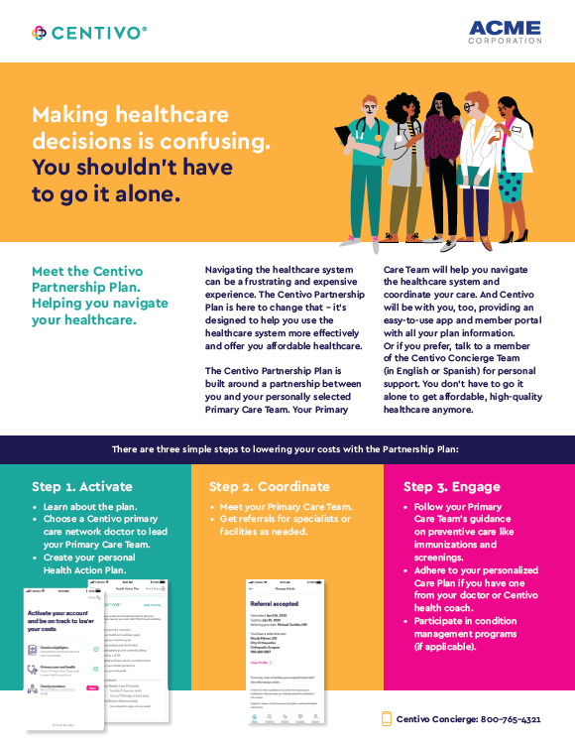
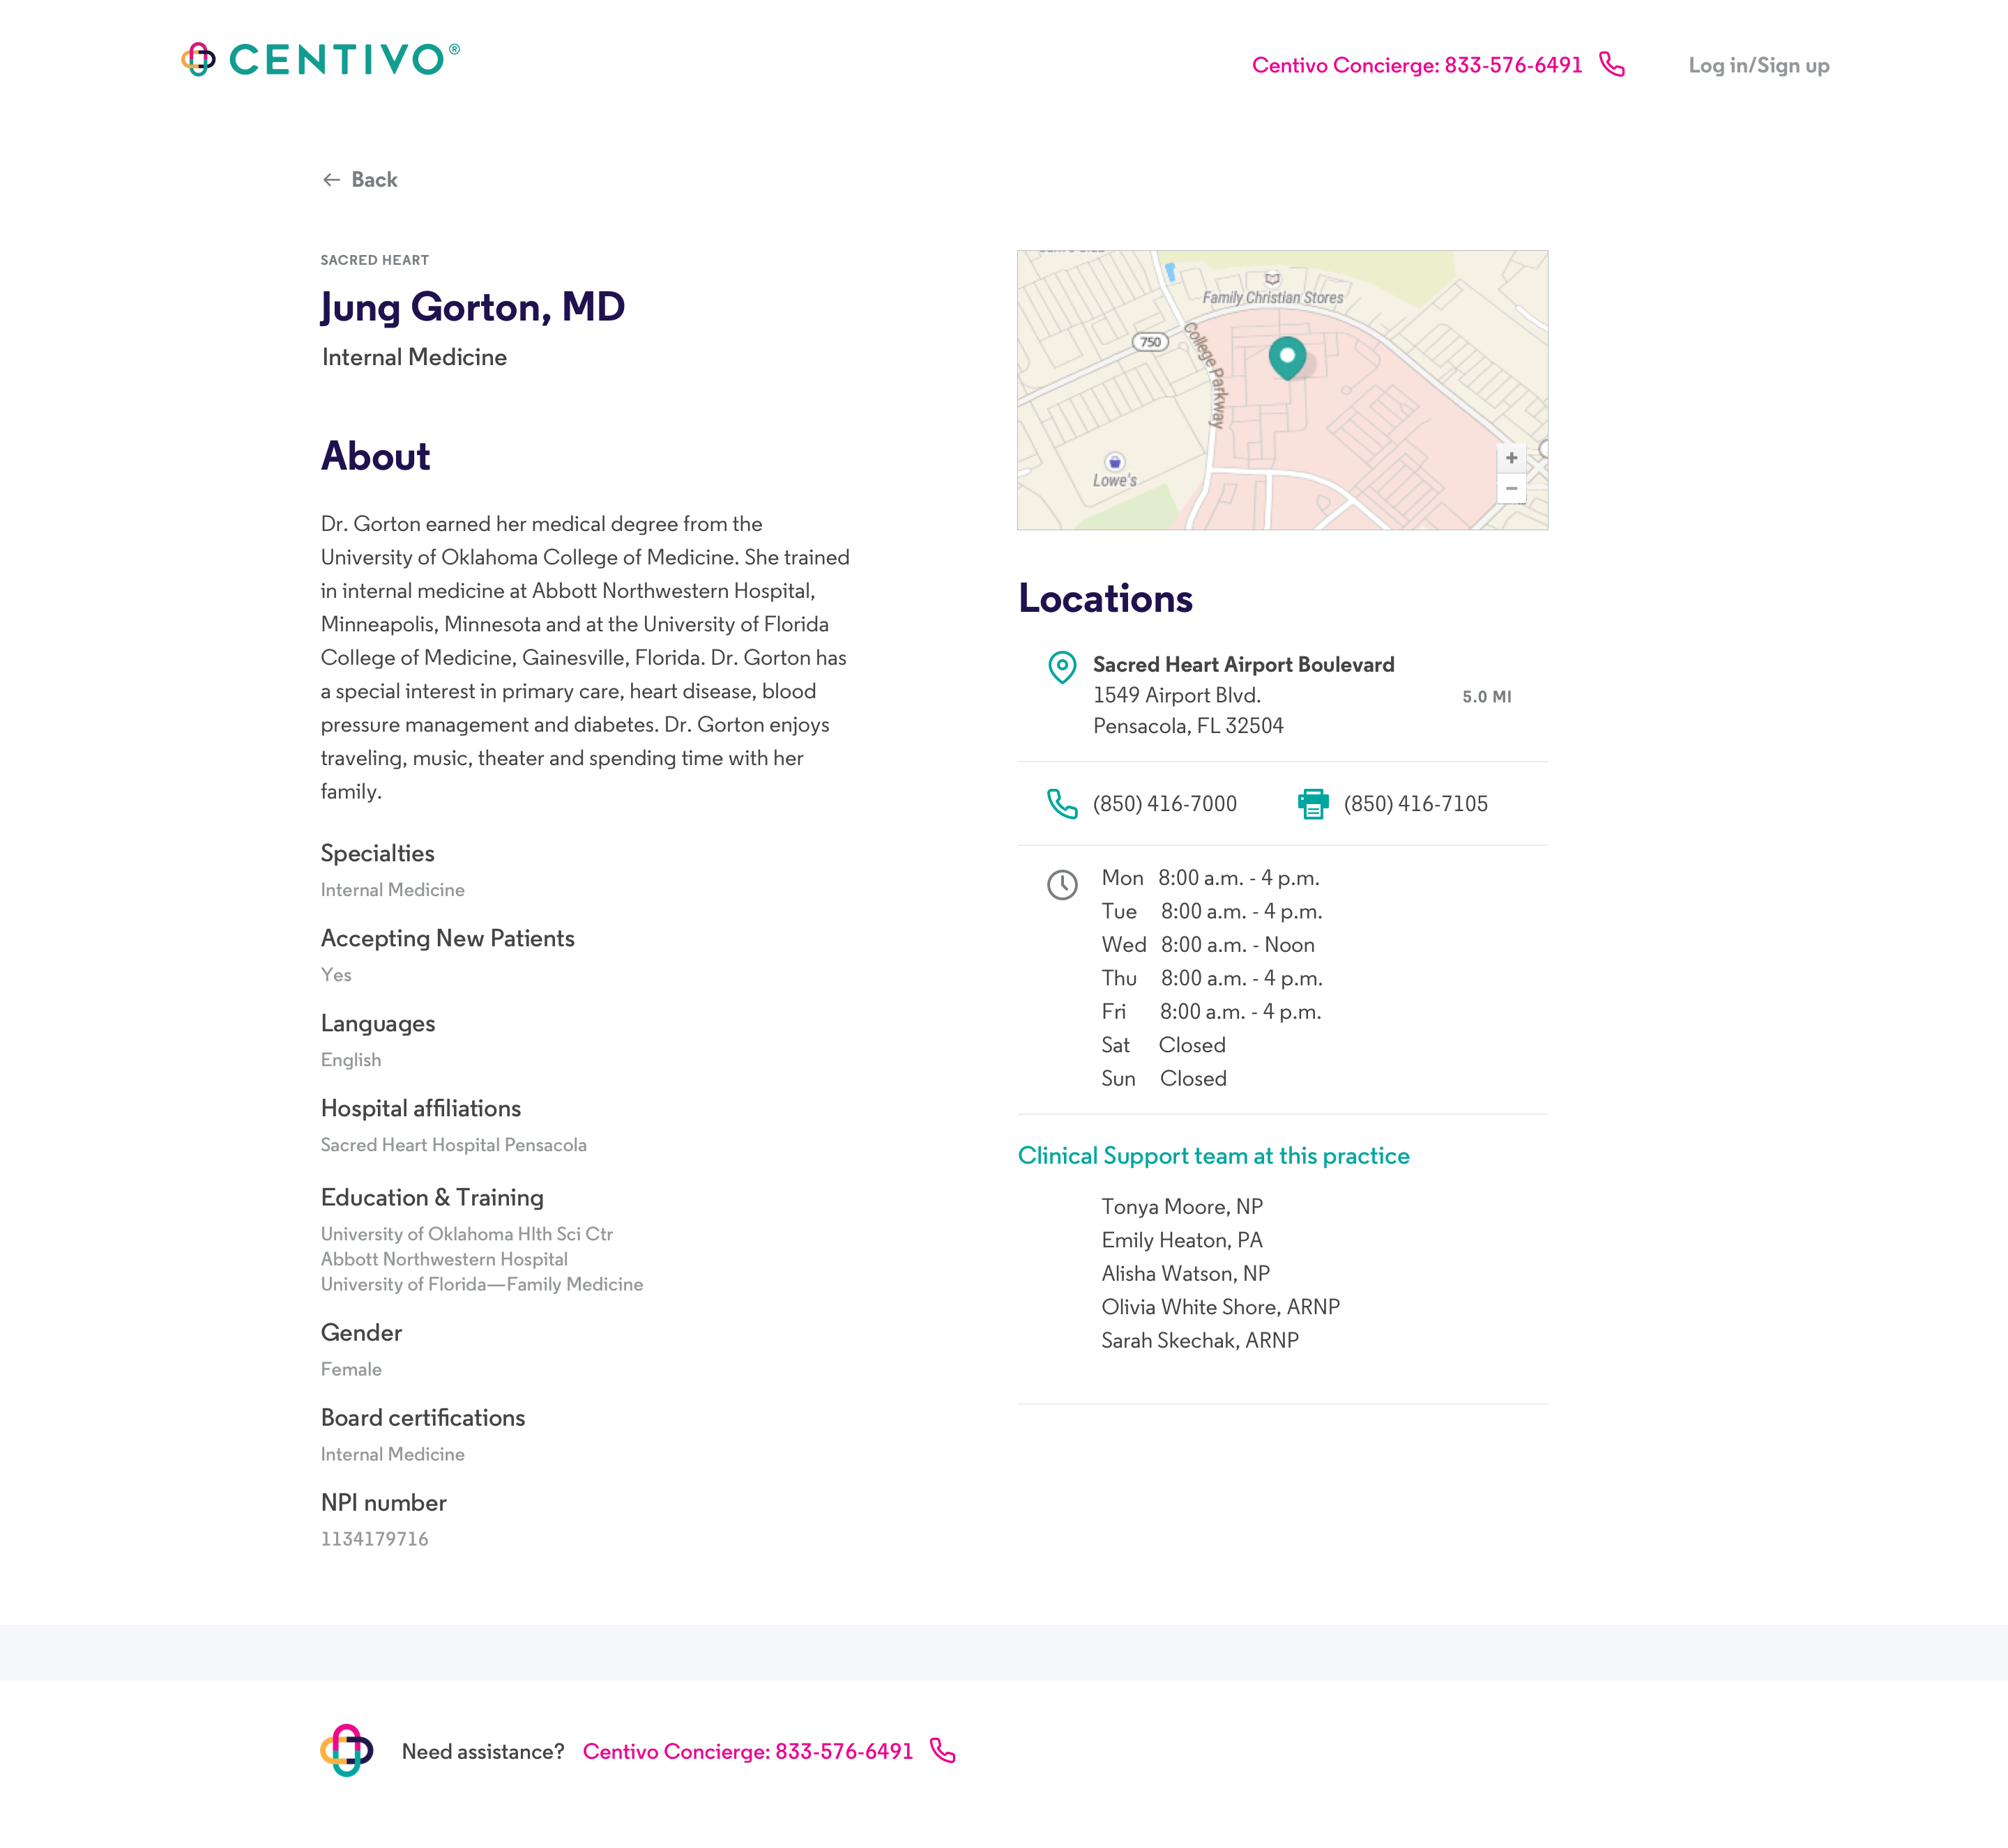
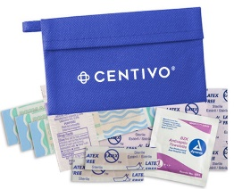
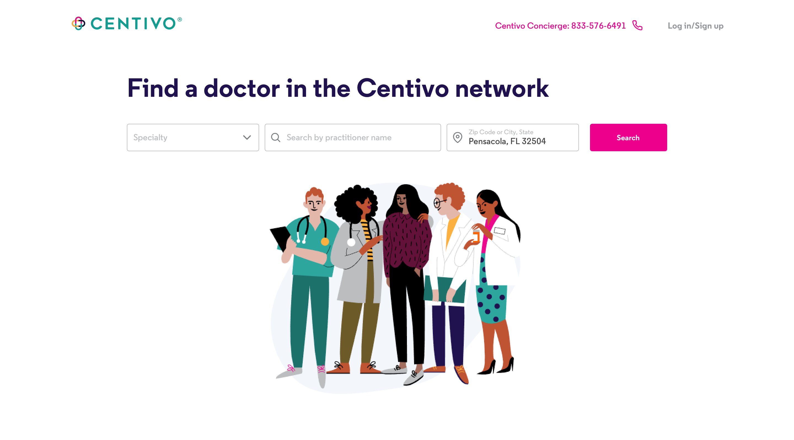
Employee Members: Centivo Communication Support
We make change management easy through open enrollment communication and support
Materials:
Customized to your key messages
Co-branded
On-site / virtual support:
(Virtual) benefit fair staffing
OE meetings & webinar support
Hands-on activation support
OE hand-outs
Slides, meetings & webinars
Searchable provider directory
Benefit fair giveaways
Privileged and Confidential

Slide 16
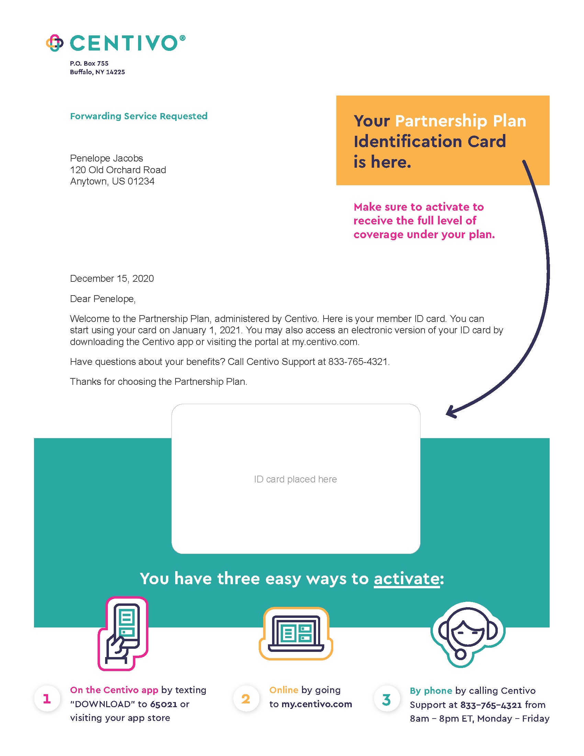
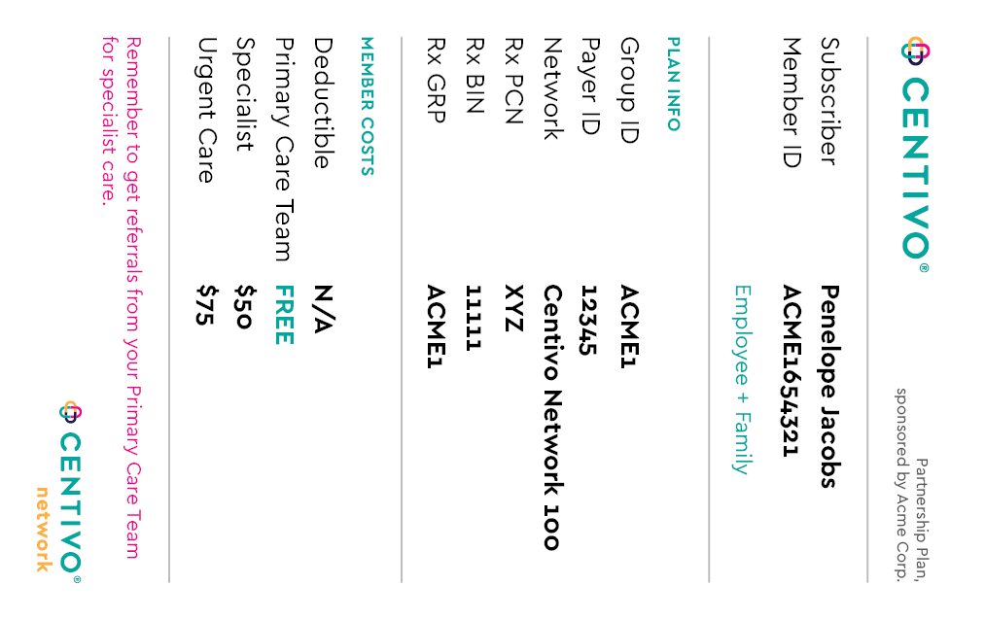
Welcome Communications: Partnership Plan
Inside folder
Magnet
Envelope
Brochure
Spanish Insert
ID card mailer
Privileged and Confidential

Slide 17
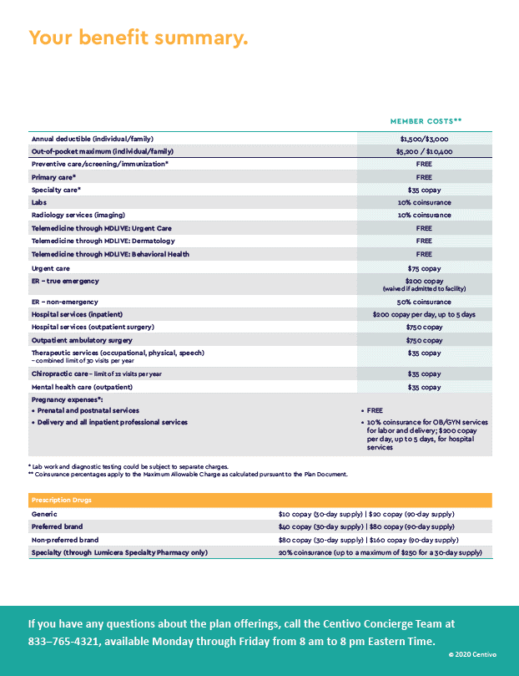
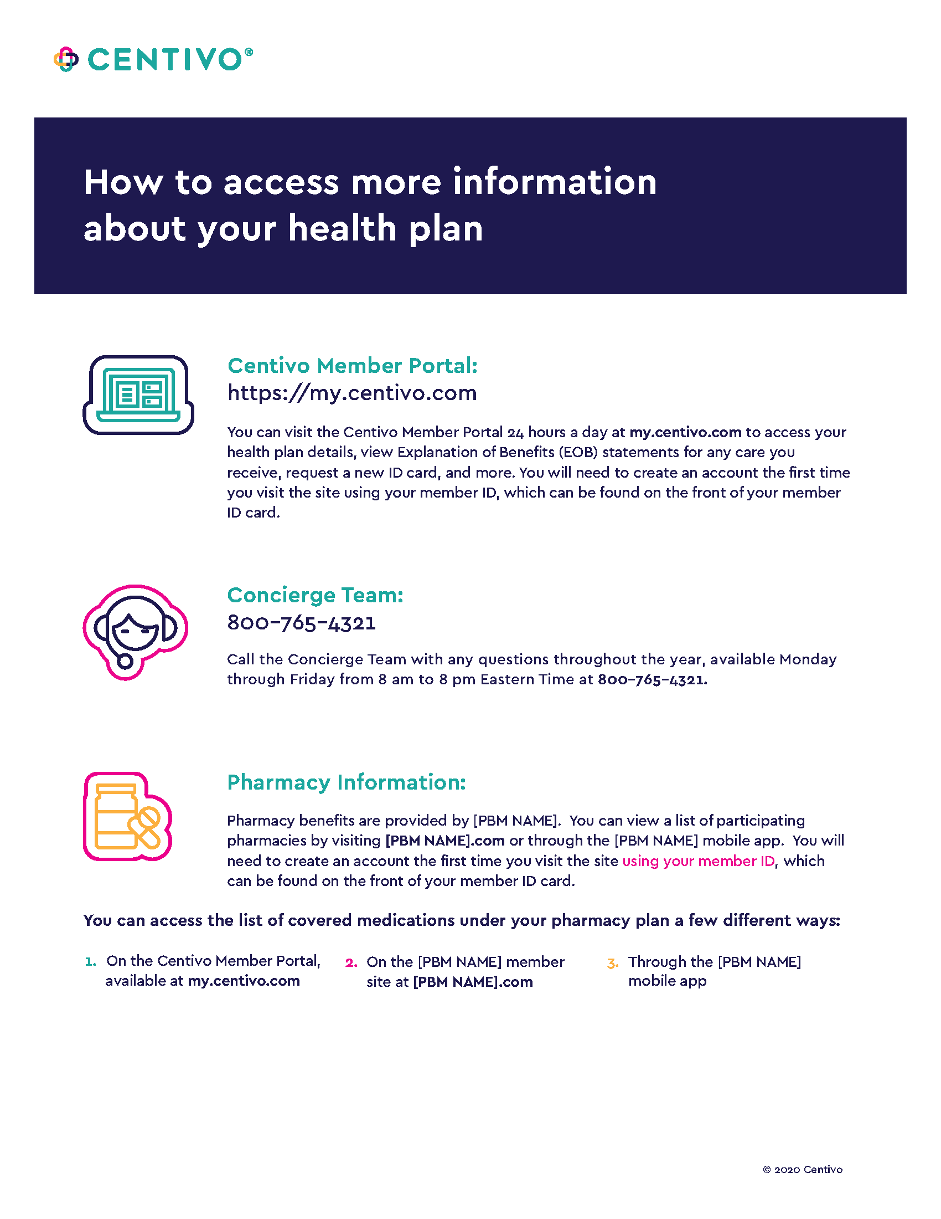
Welcome Communications: Traditional Plans
ID card mailer
Inserts w/ key plan details
Privileged and Confidential

Slide 18
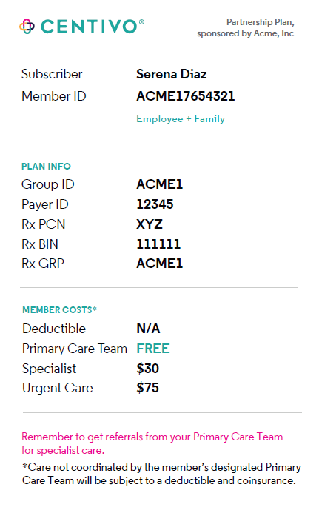
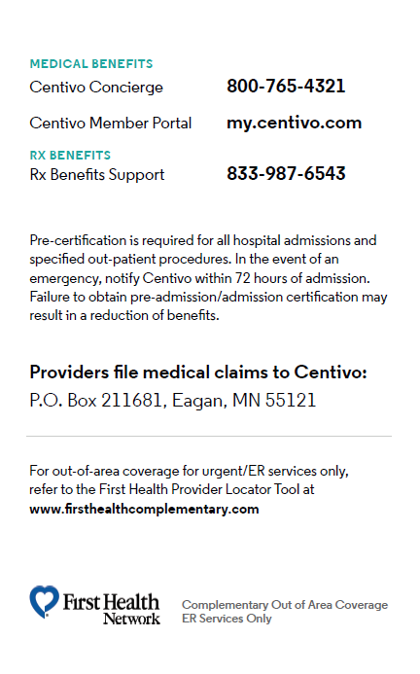
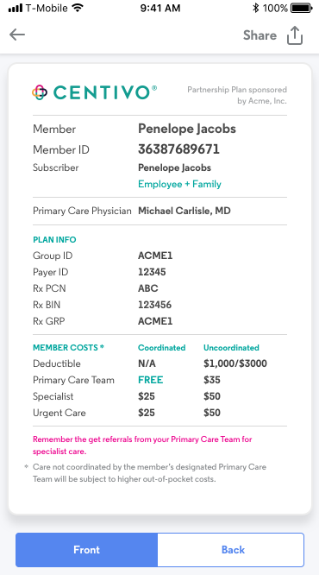
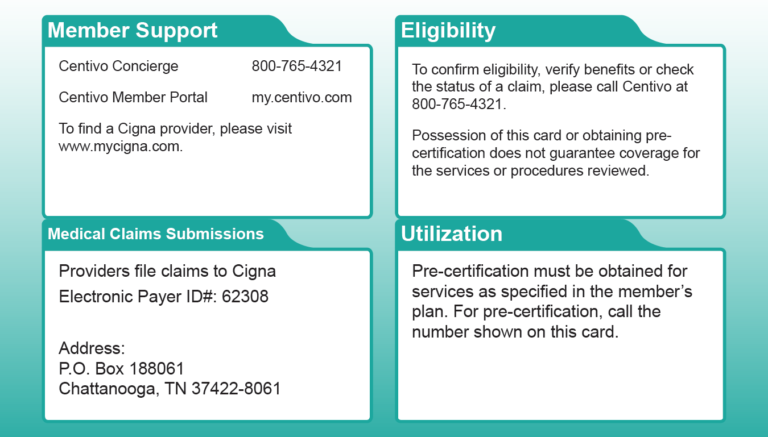
Employee Materials: Centivo ID Card
ID Card – Partnership Plan
ID Card – Traditional Plans
Digital ID Card
Privileged and Confidential

Slide 19
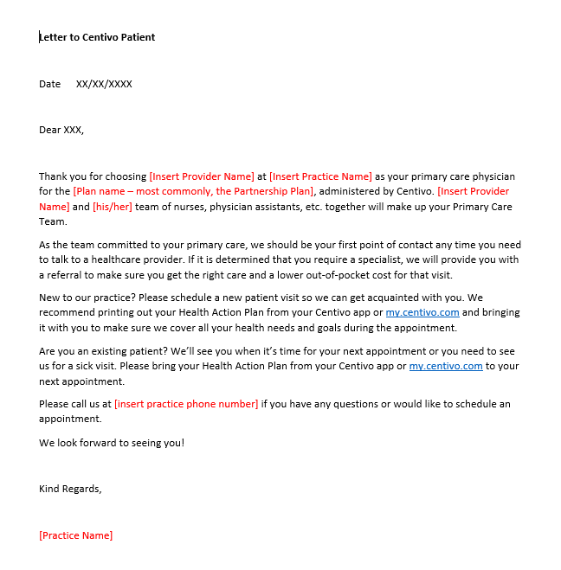
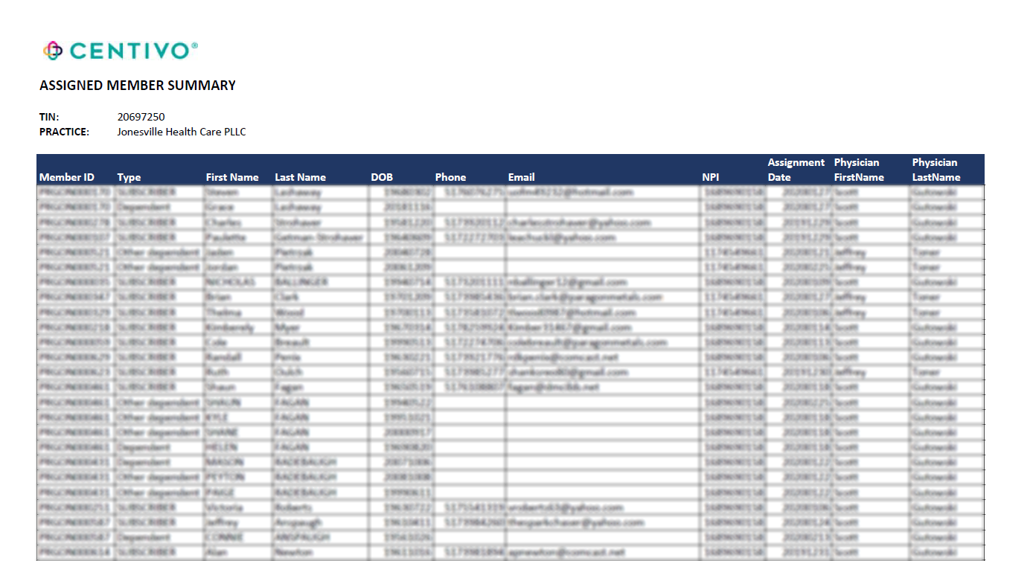
Provider Communication
We send providers:
A list of members who have designated them as their PCP
Template letters/emails that they can send to members to welcome them to their practice
Privileged and Confidential

Slide 20
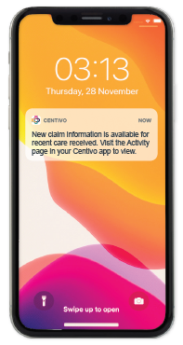
Employee Members: Centivo Plan Experience
Ongoing, year-round communication to help people get the most out of the plan.
Help them do what they need to do when they need to do it:
When they need a course correction
When life circumstances change
After enrollment
Before plan year
After activation
“You’re enrolled”
“Activate”
“See your PCP and get referrals”
“Next time do it differently for lower costs”
“Change your enrollment”
Members choose how they want to hear from us.
Options include: Email, In-app or portal, text message, app push notification, and physical mail.
Privileged and Confidential

