Slide 1
Consolidated Appropriations Act Compliance Broker/Consultant Compensation Disclosure Rules
Employer Session - September 21, 2022

Slide 2
Welcome
Jeffrey Kluever
Executive Director
Business Health Care Group

Slide 3
Today’s Presenters
James Gelfand
President, The ERISA Industry Committee (ERIC)
Darren Fogarty
Executive Director, Committee for Fee-Only Benefits Advisors

Slide 4
September 21, 2022
BHCG Symposium: Consolidated Appropriations Act Compliance Broker/Consultant Compensation Disclosure Rules
James Gelfand, President, ERIC

Slide 5
Introduction to The ERISA Industry Committee
ERIC is the only national association advocating exclusively for large employer plan sponsors that provide health, retirement, paid leave, and other benefits to their nationwide workforces. With member companies that are leaders in every economic sector, ERIC advocates on the federal, state, and local levels for policies that promote flexibility and uniformity in administering their employee benefit plans against a patchwork of conflicting and burdensome rules.
You are likely to engage with ERIC member companies when you:
Drive a car or fill it with gas
Dine out or at home
Use a cellphone
Use a computer
Visit a bank or hotel
Fly on an airplane
Watch T.V.
Benefit from our national defense
Receive or send a package
Go shopping
Use cosmetics
Enjoy a beverage

Slide 6
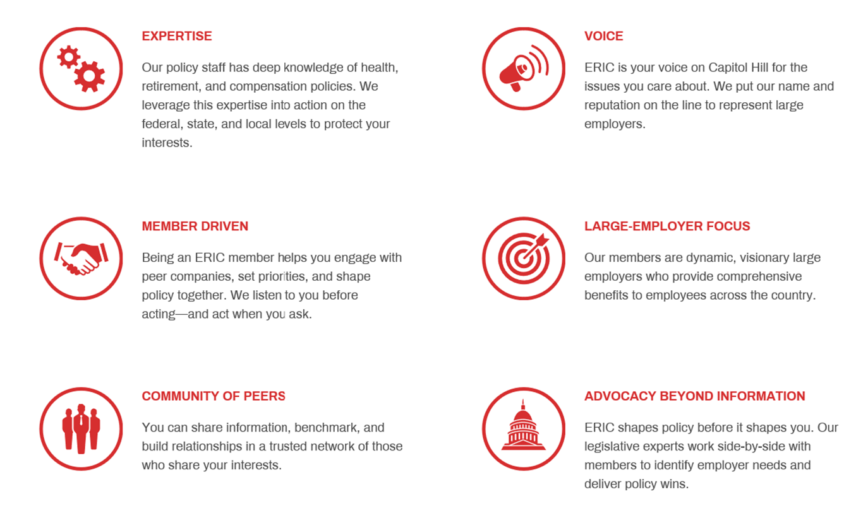
Introduction to The ERISA Industry Committee

Slide 7
Agenda
CAA and its Enactment
Fiduciary Obligations
Sufficient Information
Employer Liability
Re-evaluating Contracts
Conclusion
7

Slide 8
Consolidated Appropriations Act

Slide 9
Origin
Insurance Brokers Get Paid More To Sell More, Fueling High Health Care Costs : Shots - Health News : NPR
“Health Net of California's pitch is not subtle: A smiling woman in a business suit rides a giant $100 bill like it's a surfboard. "Sell more, enroll more, get paid more!" In some cases, its ad says, a broker can "power up" the bonus to $150,000 per employer group”

Slide 10
Origin (cont.)
Congress drafted the Lower Health Care Costs Act to address a series of abuses they saw in the health care system – not just the brokers and consultants, but also employer ownership of data, state APCD demands, PBM opacity, abusive hospital contracts, surprise medical billing, etc.
Some of these provisions were included in the Consolidated Appropriations Act

Slide 11
Why was CAA enacted?
Transparency!
Improve the health care market for health plans and plan sponsors
Better fulfill fiduciary responsibilities

Slide 12
What changed?
CAA included new requirements for disclosure of compensation by brokers and consultants
This includes for services such as:
Medical insurance
Vision
Dental
Plan management
Health specialty vendor administrative support and recordkeeping
Stop-loss insurance
Pharmacy & PBM
Wellness, EAPs, etc
Brokers
This includes help developing, implementing, or assessing:
Plan design
Insurance or insurance selection
Plan management
Specialty vendors
GPOs
Stop-loss
Pharmacy + PBM
Wellness, disease management, medical management, etc.
Consultants

Slide 13
What Changed? (cOnt.)
Remember, this includes your TPAs, vendors helping with compliance assistance, any transparency or data vendors, and anyone helping with plan design or strategy. And remember that an HRA and FSA are considered group health plans
Exception: Only applies if the covered entity expects $1,000 or more in direct/indirect compensation in connection with the plan. And the new rule does not apply to life insurance, disability insurance, etc.
Clarification: If services are subcontracted, the duty is on the contracted entity
This aligns health plan vendor requirements, with those already applied generally to retirement plan vendors

Slide 14
What must be disclosed?
Description of the Services
Clarify when the entity will serve as a fiduciary

Slide 15
What must be disclosed? (Cont.)
Indirect Compensation
Describe arrangements with affiliates or subcontractors, identify what might give rise to indirect compensation and how it will be calculated – including who will pay it, and any other arrangement between the covered entity and the entity paying the indirect compensation
This includes transaction-based compensation like commissions or “finder’s fees”, retention fees, sales bonuses, or fees associated with overrides

Slide 16
What must be disclosed?
Direct Compensation
Commission, fees, etc., including “per claim” or “per visit” fees

Slide 17
What must be disclosed?
Any “Termination Compensation”
What will have to be paid to the covered entity if the contract is terminated, including how any amount paid in advance will be charged and refunded

Slide 18
What must be disclosed? (Cont.)
The manner in which compensation will be collected or received
Conditional Compensation
What would trigger this compensation and how would it be calculated?
Note that some types of compensation might be hard to quantify, in which case the vendor should provide a range and/or formula (example: “persistency bonuses”)
Remember –
this includes non-cash compensation
such as meals, entertainment, gifts, or reward trips!

Slide 19
When are disclosures required?
For any contract that is executed on or after December 27, 2021
Covered entities are required to make this information available “reasonably in advance” of a contract being entered, extended, or renewed
Any changes in the disclosures need to be conveyed as soon as practicable (generally within 60 days)
2021

Slide 20
What must a group health plan do?
YOU are the fiduciary,
so
YOU are responsible for ensuring that these disclosures happen,
and then for evaluating them and considering potential alternatives

Slide 21
What must a group health plan do? (Cont.)
To enforce the provision, contracts entered into without adequate disclosure will be deemed prohibited transactions
There are limited exceptions

Slide 22
What must a group health plan do? (Cont.)
Exceptions that will not be deemed prohibited transactions:
If the information shared with plan sponsor was in error, and the covered entity was acting in good faith, and if they send a correction to plan sponsor within 30 days of discovering the error or omission

Slide 23
What must a group health plan do? (Cont.)
Exceptions that will not be deemed prohibited transactions:
If the plan sponsor did not know that the covered service provider would fail to make the disclosures, and reasonably believed that the required information was disclosed

Slide 24
What must a group health plan do? (Cont.)
Exceptions that will not be deemed prohibited transactions:
If the plan sponsor, when the failure to disclose was discovered, requests in writing that the covered entity furnish the required information

Slide 25
What must a group health plan do? (Cont.)
Exceptions that will not be deemed prohibited transactions:
If the covered entity fails to comply with a written request, and within 90 days, the plan sponsor notifies the Secretary of Labor of this failure

Slide 26
What must a Group health plan do? (Cont.)
Consequences for a prohibited transaction
The plan’s fiduciaries are held responsible, and will be on the hook for a 20 percent penalty (applied to whatever amount is eventually recovered associated with the prohibited transaction)
The covered entity can also be charged with ERISA civil enforcement provisions, and the Secretary of Labor can also seek to impose civil monetary penalties against them

Slide 27
Conclusion
Plan sponsors need to have a process in place, so they can later justify that they sought to ensure compliance, as responsible fiduciaries
Further, plan sponsors need to carefully consider the disclosures. Ask tough questions about the disclosed relationships and indirect compensation. Some interactions might be in the best interest of the vendors, but are they in the best interest of the plan beneficiaries?
Include this in all RFIs and contracts!

Slide 28
Questions?

Slide 29
For the latest on
employee benefits
legislation & regulations
visit
ERIC.org

Slide 30
James Gelfand
President
jgelfand@eric.org

Slide 32
CAA Compliance Broker/Consultant Compensation
Wednesday, September 21st, 2022 | BHCG Symposium
Darren Fogarty | Executive Director

Slide 33
Agenda
Setting the Stage
What Employers Should Demand in a Benefits Professional
What Employers Should Expect in a Disclosure
Follow-up Questions a Prudent Employer Should Ask
Q/A

Slide 34
Setting the Stage
Upfront disclosure
7 years at a non-profit DC thinktank analyzing & advocating fiduciary issues in financial services
4 years at fee-based & fee-only employee benefits consulting firms
Culminated in founding a Committee advocating the importance of direct fee compensation and transparency in the broker/consultant relationship

Slide 35
What Employers Should Demand in a Benefits Professional
Compensation disclosure is the bar that must now be met, but it should be understood as the minimum threshold for compliance.
The CAA presents a unique opportunity for plan sponsors to scrutinize broker/consultant business practices for transparency in other ways, too.
Doing so not only demonstrates prudence and process, thereby inoculating one’s company against future DOL audits; it is also consistent with the spirit of ERISA’s new CAA amendments.

Slide 36
What Employers Should Demand in a Benefits Professional
Transparency, by itself, is no guarantee a broker/consultant will be adept at helping you ensure reasonable health plan expenses from other vendors.
Plan sponsors need someone who is skilled and ethical. The “Gold Box” is not too much to ask for – or to aim at.
Who are you currently working with?
Y-Axis
×
×
Competency
(Skill, Expertise)
×
X-Axis
Transparency
(Ethics, Alignment)

Slide 37
What Employers Should Expect in a Disclosure
Should be brief. 2-3 pages max.
Should not contain vague legalese or noncommittal language.
Should state the compensation clearly. Ideally, in dollars and cents.*
Is an opportunity to “press pause” and discuss the business relationship.
* Even though brokers/consultants are not required to by law, per the Department of Labor’s December 30, 2021 Field Assistance Bulletin, No. 2021-03. See Q5 on page 5.

Slide 38
Follow-up Questions a Prudent Employer Should Ask
Here are open-ended questions to ascertain broker/consultant competency & transparency:
How do you assist me in meeting my fiduciary obligation to my health plan members to pay only fair and reasonable expenses – to you, to our insurance carrier, and to all our third-party vendors?
Are you and your firm financially rewarded or penalized when our company’s health plan’s net expenses decrease? Why is that?
What specific experience does your firm have in reducing (not just “managing”) healthcare costs while expanding or improving benefit offerings.
How do you ensure that you – and all our third-party vendors – fully and meaningfully disclose compensation to my company, so that I may comply with the Consolidated Appropriations Act?
What does “transparency” in this business relationship look like to you?
Can you give me a past example where you or your firm recognized and mitigated/eliminated a client conflict of interest?

Slide 39
Let’s Open the Discussion Up
CAA has cracked wide open the discussion on broker/consultant compensation.
Employers – especially self-funded ones – have the responsibility & opportunity to re-evaluate how their service providers are bringing them value, and at what cost.
This is consistent with the greater healthcare price transparency movement.
We can’t let this opportunity go to waste. Let’s get these conversations started.
* For more information or to have further discussion on these issues, or others, reach out to Darren Fogarty at Darren@TheFiduciaryInstitute.org or on LinkedIn.

Slide 40
Questions?

Slide 41
Thank You
For more information about BHCG programs and membership, please contact:
Jeffrey Kluever
262-875-3312 X1
jkluever@bhcgwi.org

