Slide 1
Delivering Value Series Symposium – Optimizing Onsite & Near-Site Clinics
July 13, 2022

Slide 2
Agenda
Opening Remarks
Jeffrey Kluever, BHCG Executive Director
General Overview
Dave Osterndorf, BHCG Strategic Consultant & Chief Actuary, Centivo
Onsite/Near-Site Clinic Optimization
Jihye Tahk, General Market Manager, Centivo
Health Systems Perspective
Ashok Rai, M.D., President and CEO, Prevea Health
Donna Owens, Vice President Wisconsin Employer Solutions Ascension
Employer Perspective
Janet Lucas-Taylor, Senior Director, Employee Benefits Northwestern Mutual
Panel Discussion & Q & A

Slide 3
The High-Performance PCP-Guided Model
An engaged business community & progressive health plan partnering closely with accountable, high-value providers
Member engagement with the PCP
Plan design that incentivizes high-value care
PCP taking on full responsibility for patient
Value-based payment model
A new model that provides high-quality, cost-effective care
with a focus on right care at the right place and time

Slide 4
Potential for Dramatic Savings
The Bottom Line First
 | Primary Care Physicians (PCPs) | All Specialist Procedures | PCPs + Specialist Procedures
Total Annual Cost | $810M | $681M | $1.49B
Annual Savings by Improving Performance to 50th %-ile or above or Steering Pts to Providers at the 50th %-ile or above | $324.7M (40%) | $57.65M (8.5%%) | $382.35B (25.7%)

Slide 5
Supercharging Onsite/Near-Site Clinics
From:
To:
Employees
Using onsite/near-site clinics for acute health care needs
Establishing/growing working relationships with providers/PCPs
Strong providers of episodic care
Operating on a cost-plus model
Specialty referrals driven by relationship or history
Effective holistic patient managers
Health outcomes-focused model
Specialty referrals driven by data and analytics from the Physician Value Study
Onsite/Near-Site Clinics
Assessing onsite clinic performance based on convenient access and employee productivity
Managing onsite clinics separate from the health plan
Limited impact on “medical homelessness”
Assessing onsite clinic performance based on appropriateness of care, in addition to impact on productivity
Integrating onsite clinics into the health plan
A proactive solution for medically homeless
Employers

Slide 6
Onsite/Near-Site Clinic Optimization Within the Model
Built into the high-performance health plan
PCP activation and employee engagement strategy
Care coordination technology
Data exchange capabilities to support patient management

Slide 7
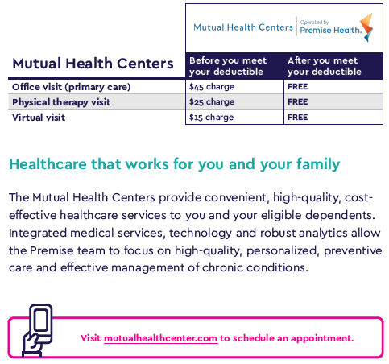
Best Practices Learned #1: Member Incentives and Communication
Employee financial incentives aligned with clinic strategy
Tailored employee communication
Promotion within member portal and app
Will our company clinic be in the Centivo Network?
Your company clinic will be part of the High Performance plan. You can select a clinician from your company clinic as your PCP.
What are the fees for our company clinic?
The fees for your company clinic are $45 for a physician visit, $15 for a virtual visit and $25 for physical therapy. Please note once you have reached your deductible if you have selected the High Performance plan all services at your company clinic will be free. If you have selected either the HSA Saver or HSA Select plans co-insurance will apply.

Slide 8
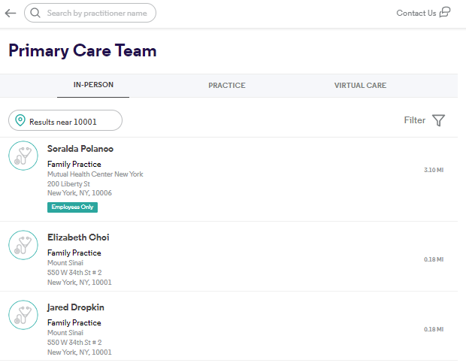
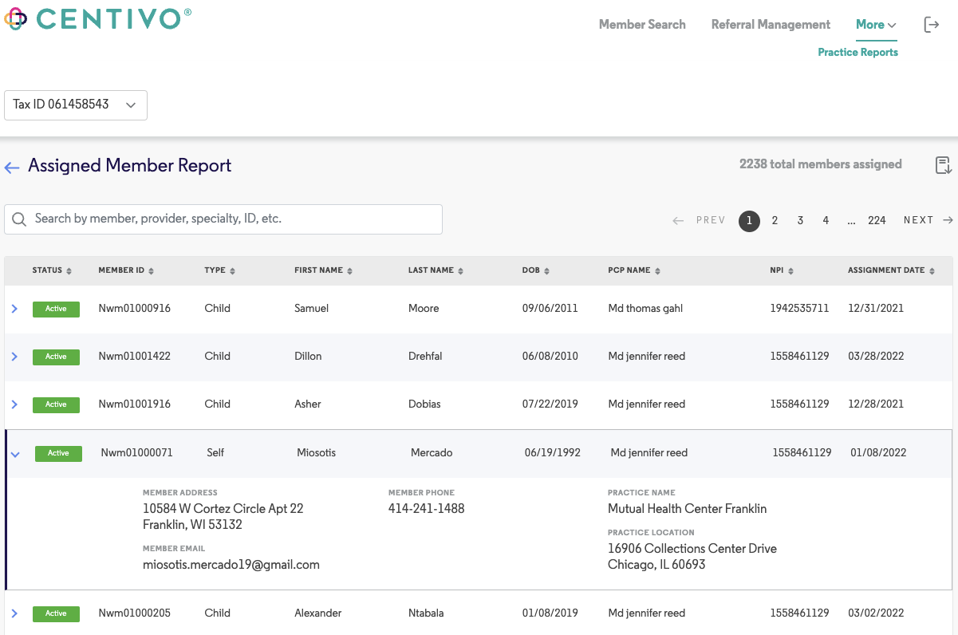
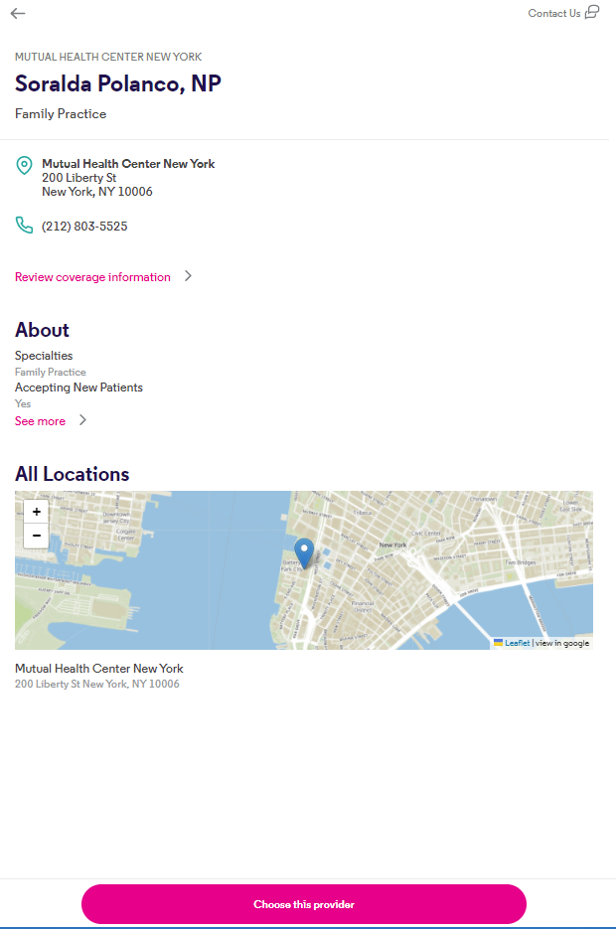
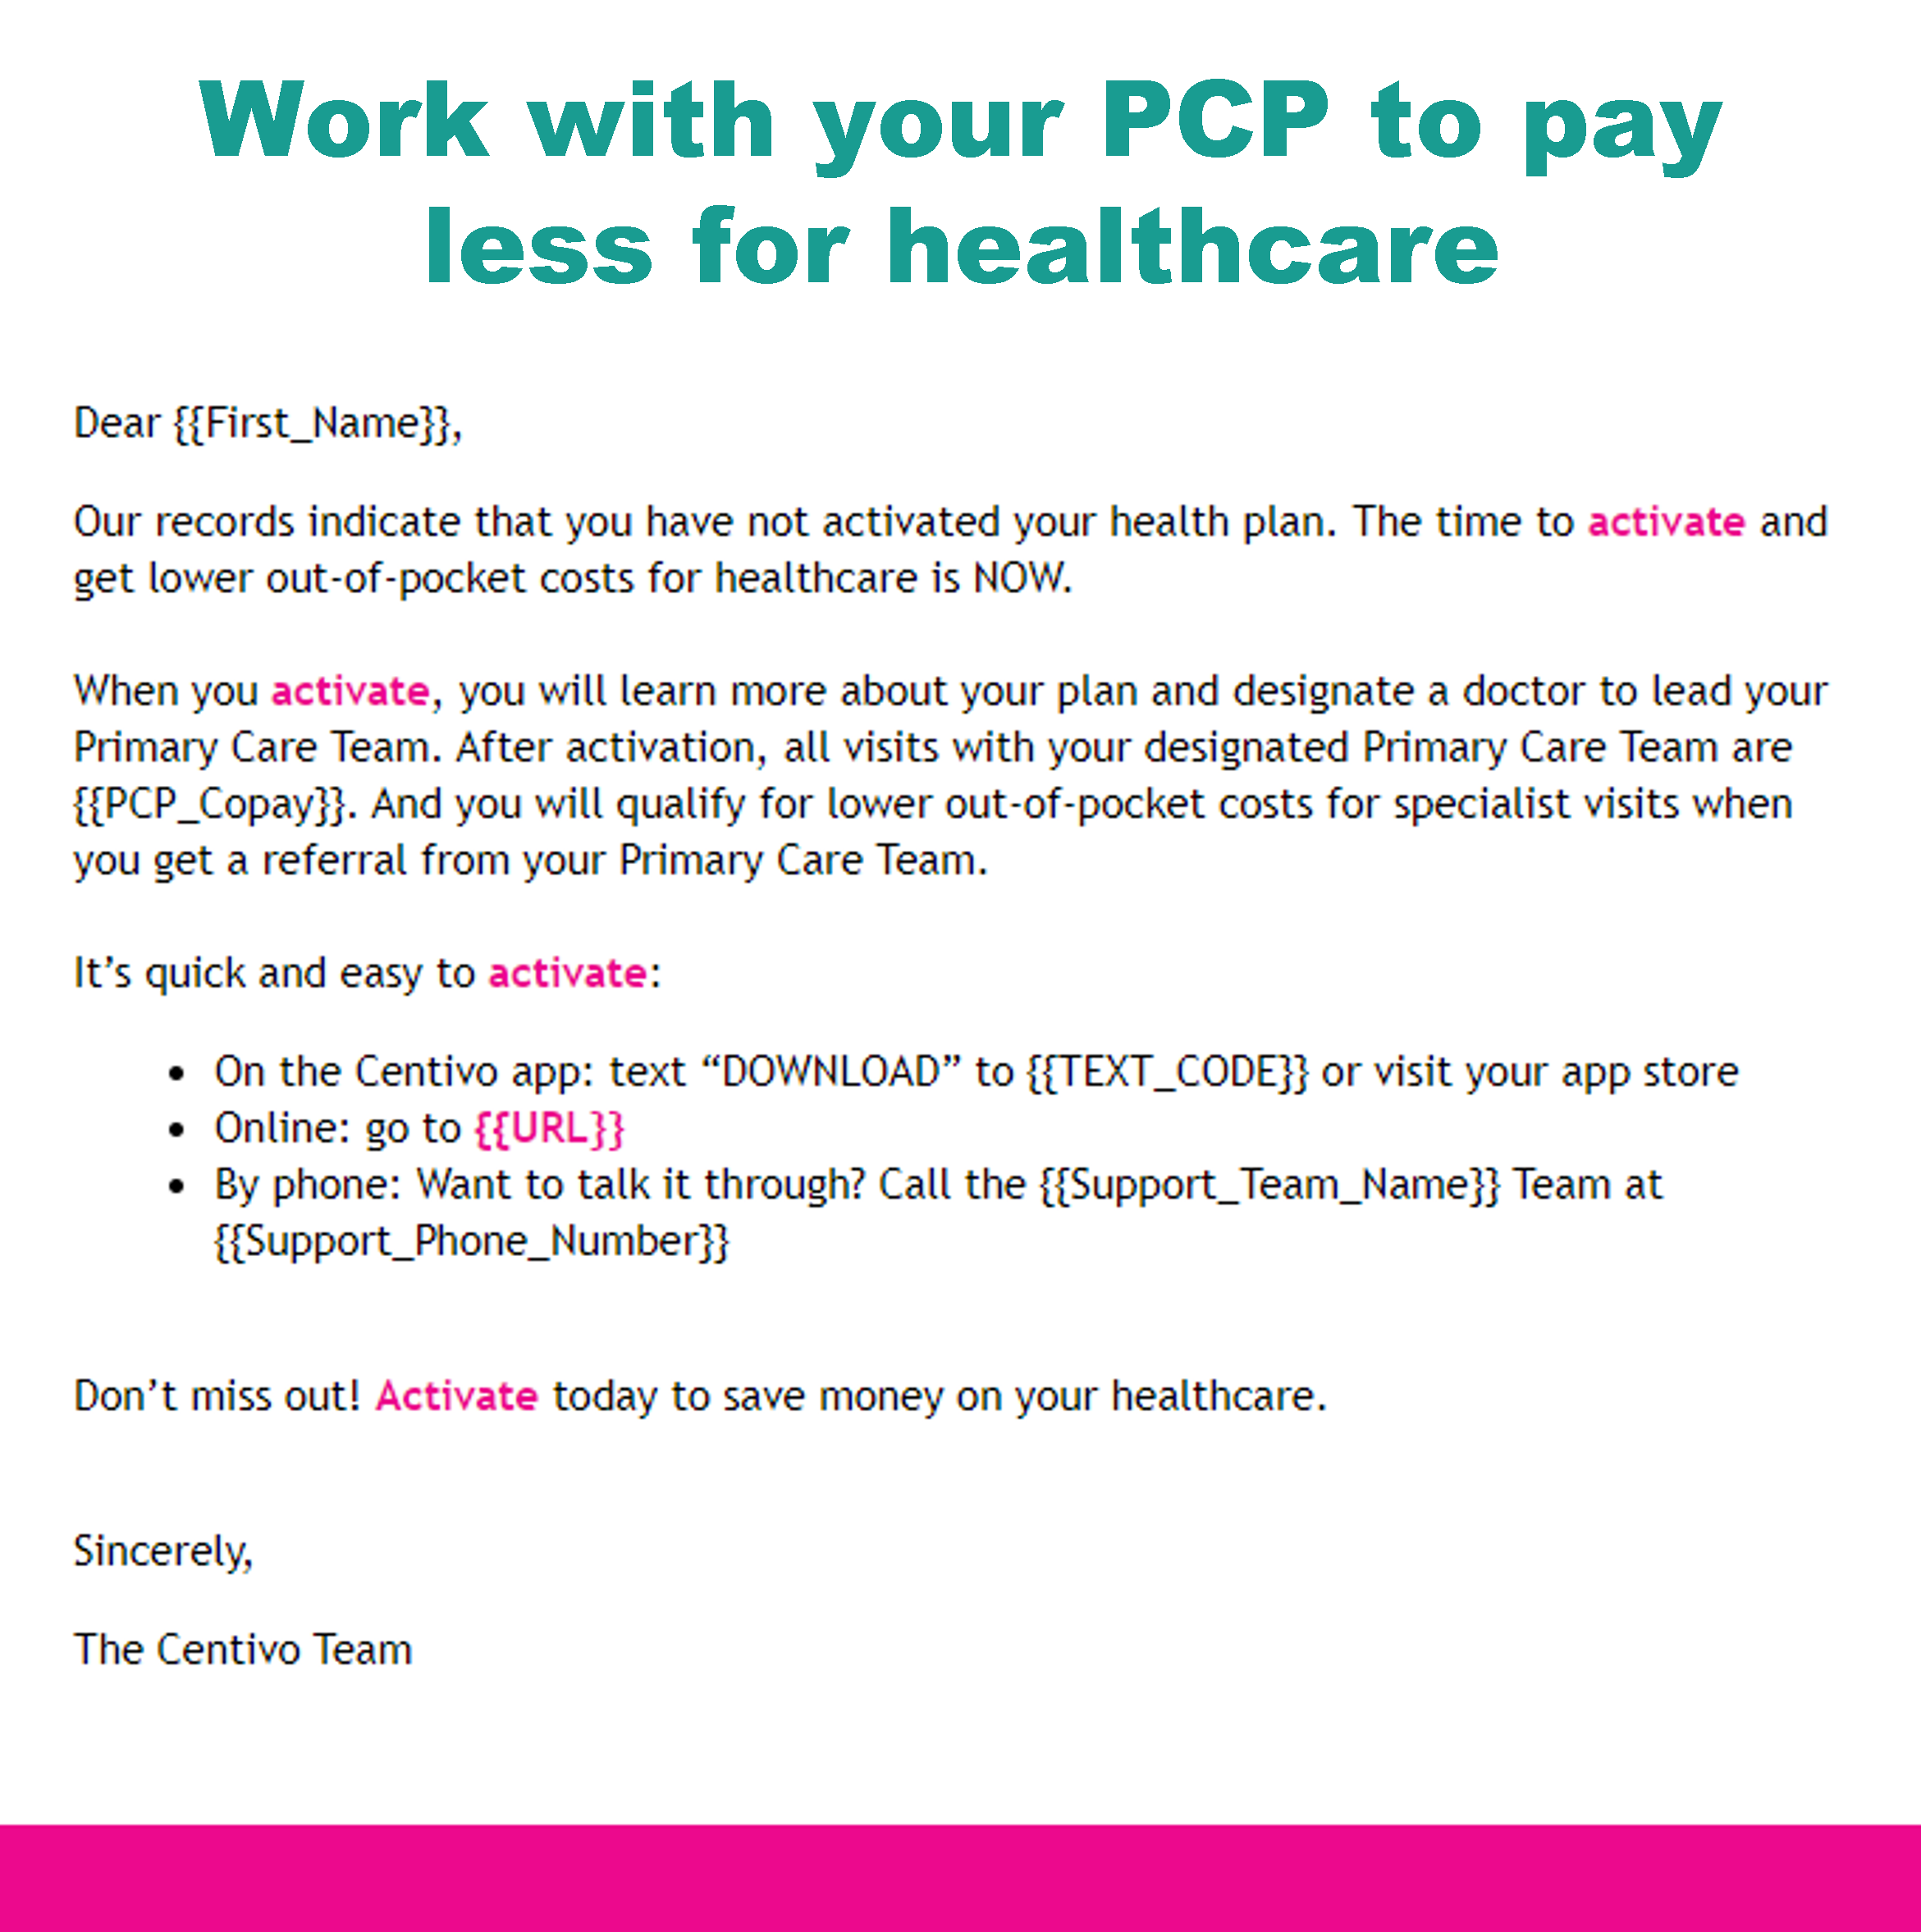
Best Practices Learned #2: PCP Engagement and Accountability
Clinic PCP promotion in member activation
Personalized outreach to those who have not yet activated or scheduled PCP appointment

Slide 9
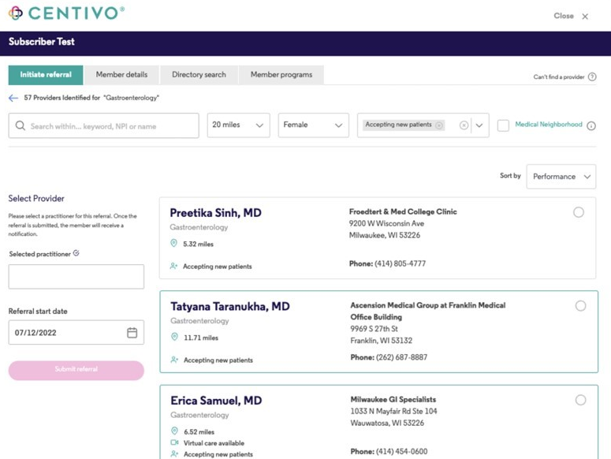
Best Practices Learned #3: Data-Driven Referrals
Medical neighborhood curation
Curation based on Physician Value Study 2.0
Ability to utilize other supplemental quality data

Slide 10
Questions?

Slide 11
Thank You!
For more information about BHCG membership and/or onsite/near-site clinic optimization, please contact:
Jeffrey Kluever
262-875-3312 X1
jkluever@bhcgwi.org

