Slide 1
Creating a Market for Value
Harnessing Purchasing Power of Employers
Wisconsin Collaborative for Healthcare Quality
November 14, 2019

Slide 2
Agenda: Bree bundle for joint replacement
Disrupting healthcare delivery, purchasing and payment
Pre-Bree: VM and standard best practice pathways
  Structure: Marketplace Collaborative
  Process: Toyota Production System
Bree establishes State-wide quality standards
Providers, employers, and plans use standards for production, purchasing and payment of healthcare
Results and challenges

Slide 3

The need for a collaborative model
Three inefficiencies in the healthcare supply chain
1. Inefficient process for producing quality
3. Inefficient process for purchasing quality
2. Inefficient process for paying for quality
Affordability requires structure for correcting all three.

Slide 4


An inefficient market structure for quality
No connection: buyer, seller, information, choice
Health plans define quality and price
high-variation business process
Providers
high-variation clinical process
Employers
outsource healthcare
purchasing and payment

Slide 5
A more efficient market structure for quality
Connecting buyer, seller, information, choice
Providers and employers define quality and price
Participate in design of efficient, effective clinical process
Participate in design of efficient, effective business process
Use market-relevant information to inform contracting and reimbursement
Health plans
Secondary administrative support

Slide 6
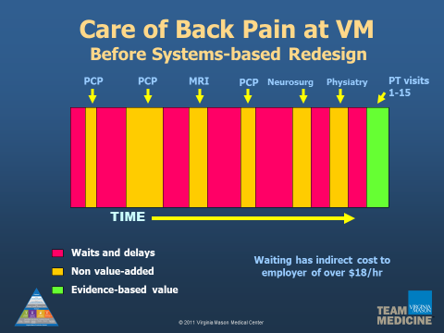
Applying the Toyota Production System
Improving a patient care pathway

Slide 7
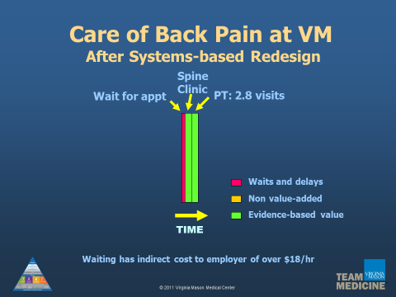
Applying the Toyota Production System
Improving a patient care pathway

Slide 8
Employers set the agenda
Highest direct + indirect costs for employed population
Screening and prevention
Back pain
Joint pain
Headache
Upper respiratory infection
Breast symptoms
Diabetes
Depression/anxiety
Asthma
Abdominal pain
Chest pain
Bladder infection
Dyspepsia (indigestion)
Hypertension
Hypercholesterolemia
Hip or knee replacement*
Spinal fusion surgery*
Coronary artery surgery*
Bariatric surgery*
* Bree’s surgical priorities

Slide 9
Employers define quality
Market-relevant standards replace claims data
Clinical content determines direct cost
Evidence-based care: technical content
Patient experience: emotional content
Pace determines indirect cost
3. Rapid access
4. Rapid return to function
Business process determines sustainability
5. Affordable price for employer and provider

Slide 10

Washington State’s Bree Collaborative
Created by legislature in 2011
Sets voluntary clinical standards that
purchasers can use in contracting*
Bree produces bundled payment models
for surgeries: joint replacement, spine, CABG, obesity
Design teams include employers, providers, health plans and quality organizations
* Washington’s Health Care Authority is a purchaser that uses Bree’s clinical standards to contract for joint replacement surgery

Slide 11
Employers managing healthcare supply chain
Collaborative design of clinical and business process
Choosing clinical condition of highest priority
Defining evidence-based clinical content
Choosing market-relevant metrics
Designing tools to manage business process
  Direct reporting of quality metrics
  Warranties
  Selection of best providers with RFP
  Direct contracting
  Creating option for prospective fixed price

Slide 12
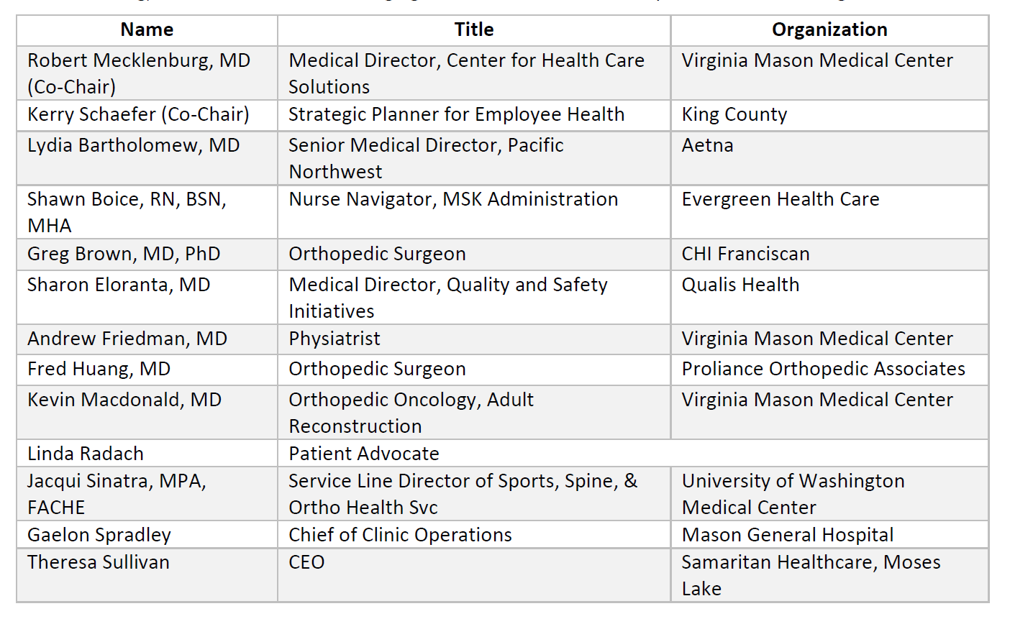
Bree design team for joint replacement

Slide 13
Designing value-based bundles
Appropriateness, fitness, safety and return to function
Appropriateness: do I need surgery?
  Document disability despite non-surgical care
  Correlate disability with objective clinical findings such as imaging
  Use shared decision-making to judge risks/benefits of treatment options
Fitness for surgery: am I in the best shape for surgery?
  Document adherence to 13 patient fitness standards
  Collaborative conference to resolve variations from clinical standard
Best practice surgery: is the surgery safe?
  Meet 6 requirements to avoid surgery-related complications
  Surgeons and facilities meet minimum volume standards
Return to function: did the surgery work?
  Report patient-reported outcomes to confirm return to function

Slide 14

Evidence table: a tool to reduce variation
Appraised citations replace opinion with evidence

Slide 15
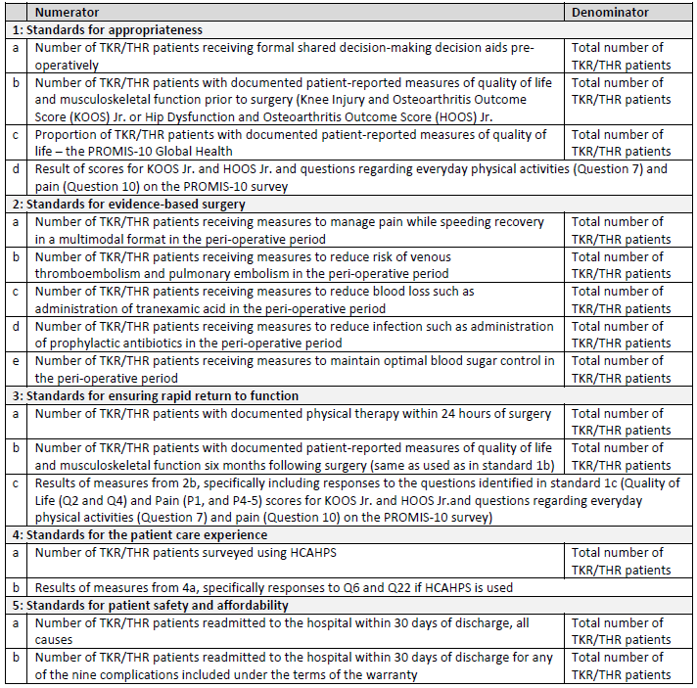
Market-relevant quality metrics
Providers report directly to employers
1. Appropriateness
Patient-reported disability
2. Evidence-based surgery
Medicare safety measures
3. Rapid return to function
Patient-reported disability
4. Patient experience
Medicare standard survey
5. Affordability
Readmission rate

Slide 16
Prospective fixed payment and warranty
Cost becomes predicable for employers
Fixed price includes preop and postop elements
Warranty precludes reimbursement for readmissions due to avoidable complications within risk windows
Within 7 days post hospital discharge | Within 30 days post hospital discharge | Within 90 days post hospital discharge
Acute myocardial infarction Pneumonia Sepsis/septicemia | Pulmonary embolism Surgical site bleeding Wound infection | Infection involving implant Mechanical complications

Slide 17
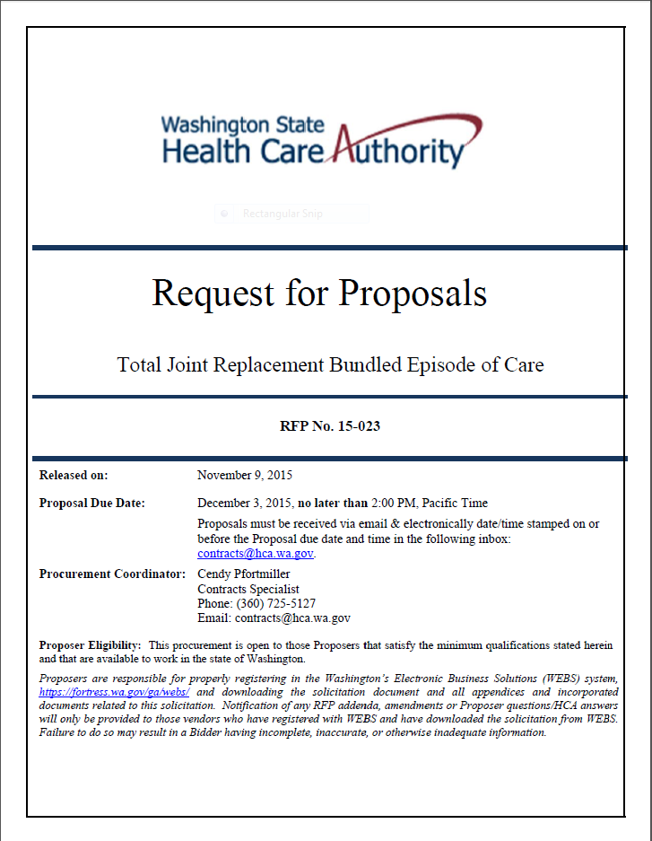
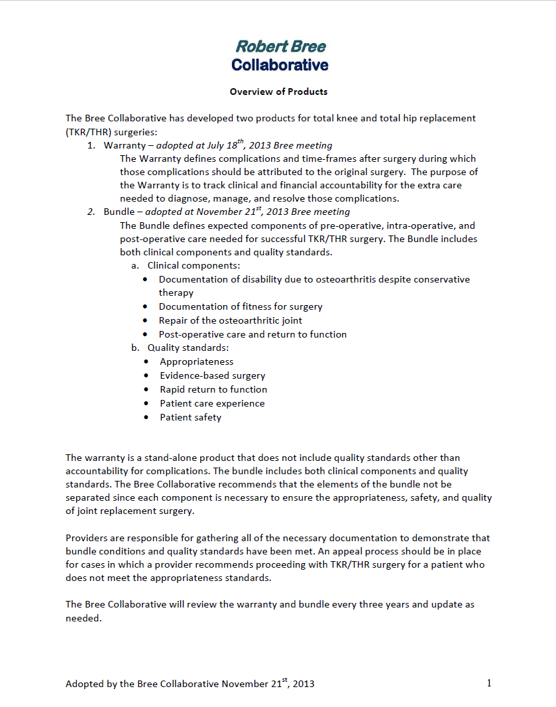
Taking Bree standards to market
Quality standard becomes a purchasing standard

Slide 18
Delivering the Bree bundle
Translating the “what” into “how"
Design through the customer’s experience
Internal leadership: direction, alignment, motivation
External leadership: mutual support/accountability
Standardization of evidence-based care
25 five-day improvement events in 3 years
Measurement and reporting of non-claims data
Continuous learning/improvement with employer

Slide 19
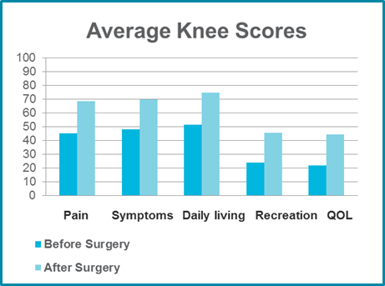
Return to function: the ultimate outcome
Knee Osteoarthritis Outcome Score

Slide 20

Employer reports results
Joint replacement
“For each of these procedures, the state saved more than 15% compared to surgeries performed outside the center of excellence.
Almost 90% of members rated their experience with the program as a 9 or greater (out of 10).
…Zero post-operative events.”

Slide 21
The obstacle is the path.
-Zen aphorism

