Slide 1



Health Insurance Options
for Part-Time, Low-Income,
or Transitioning Employees and Their Families
Medicaid and Marketplace Overview

Slide 2



Introduction
Joy Tapper
Executive Director of Milwaukee Health Care Partnership
2

Slide 3
Mission
The Milwaukee Health Care Partnership is a public/private consortium dedicated to improving health care access for low-income, underserved populations in Milwaukee County, with the aim of contributing to improved -
health outcomes,
reducing disparities,
and lowering the total cost of care.
Notes:
Joy – Review fundamentals

Slide 4
Core Functions
Launched in 2007, core functions include -
Assess & build awareness of community needs
Develop & implement a community-wide plan and collaborative improvement initiatives
Evaluate and inform state and local health care policies and practices
Secure public & private funding for priority initiatives
Measure & report outcomes
Serve as a clearing house
“A forum for communication and collaboration among key stakeholders”
Notes:
#6 impt. given the scope of need, pace of change, number of initiatives and turnover of leadership

Slide 5
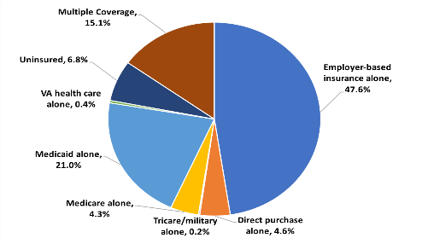
MHCP Priority - Coverage and Enrollment
Goal: Secure and retain adequate and affordable coverage for all, with focus on low-income populations.
“Health insurance coverage is the gateway to health care access and health”
Objectives:
Reduce uninsured rate
Strategies
Enroll those eligible in Medicaid & prevent “churn”
Promote enrollment in Marketplace and other insurance options
Inform Policy and Regulation

Slide 6
Uninsured in Milwaukee County, 2013-2017
Pre- ACA
12.6%
Post - ACA
7.2%
The uninsured rate has decreased by 42%, and across all income groups since 2013.
117,311
67,807
6
Uninsured Rate: Special Edition Milwaukee County Coverage Report  April 2019
Source: U.S. Census, American Community Survey (ACS) 2013, 2017, most recently available data

Slide 7
Uninsured in Milwaukee County - 2017
In 2017, 7,204 children remained uninsured
7
Source: U.S. Census, American Community Survey (ACS) 2017, most recently available data
Uninsured Rate: Special Edition Milwaukee County Coverage Report  April 2019

Slide 8
Uninsured in Milwaukee County - 2017
Percentage of Uninsured who are employed
Uninsured (non-institutionalized population) | 59,614
Employed Uninsured | 41,772
Uninsured who are employed | 70%
Source: U.S. Census, American Community Survey (ACS) 2017, most recently available data
8
Uninsured Rate: Special Edition Milwaukee County Coverage Report  April 2019

Slide 9
Milwaukee Enrollment Network (MKEN)
Established in 2007, Expanded in 2013
+100 organizations
+160 “Enrollment Assisters”
Strategies
  Consumer and Mobilizer Outreach and Education
  Enrollment Assister Capacity Building
  Direct Insurance Enrollment Assistance and Renewal
  Outcomes Measurement and Network Management
Target Populations
  Part-Time or Other Employees not Eligible for Benefits
  Employees with High Cost Employer-Based Insurance Benefit Expense
  Low Income Employees’ Family Members: Spouse, Pregnant Woman and Children
  Transitioning Employees
    Early Retirees
    Individuals Impacted by Lay-offs
Notes:
Core initiative to achieve our coverage goal is building and sustaining the MKEN
Multi-sector collaborative made up of >100 health care and social agencies
Assister Continuing ED = VA benefits, SSI eligibility, Immigrant eligibility (public charge rule)

Slide 10

Introduction
Caroline Gomez-Tom, MSW
former Program Manager of MKEN and CWI Navigator Program
10

Slide 11
Outline
Patient Protection and Affordable Care Act (ACA) overview
Identify types of uninsured and underinsured employees
Provide overview of health insurance options
Explain how employee can learn more about their options
11

Slide 12
The Patient Protection and the Affordable Care Act
The Affordable Care Act (also known as the ACA, Obamacare, healthcare.gov, the Marketplace) is still the law of the land
Affordable insurance options remain available for CY2019 and there will be more options in Wisconsin for 2020
People should continue to enroll in insurance that is best for their families, including coverage and financial help that is available through the Marketplace
New for 2019: Tax penalty no longer in effect for not having health insurance
12

Slide 13

Background of ACA and Health Insurance Marketplace Enrollment
Only 5.4 percent of people in Wisconsin went uninsured in 2017, down from 9.4 percent in 2010.
About 308,000 people remain uninsured in the State.
7.2 percent of people in Milwaukee are uninsured (about 68,000 people)
13

Slide 14
What did the ACA do?
Eliminated barriers to health insurance for people with pre-existing conditions
Created the Health Insurance Marketplace (healthcare.gov)
Expanded Medicaid in many states (“Partial Expansion” in Wisconsin)
Allowed for young adults can stay on their parents' coverage until the age of 26
Provides financial assistance to pay for health insurance for eligible people
Include a set of essential health benefits that all plans need to cover
Required everyone to have insurance*
*People are still required to have insurance but starting in 2019 there will not be a tax penalty for someone without insurance.
14

Slide 15
But why is health insurance important?
Maintaining your health (cheaper now than later)
Less expensive rate for services
Medical bills for accidents
May have to pay a tax penalty
Unexpected sickness
More timely care (better health outcomes)
Peace of mind
15

Slide 16
Why Should Employers Care About Non-Employer Based Insurance Options?
Promote healthy workforce (for today and tomorrow)
Enhance productivity
Provide access to expanded/additional benefits – prevention, early intervention services
Avoid additional employer costs
Be a good corporate citizen – health and well-being of the community!
16

Slide 17


Types of Employees Who May Not Qualify or Afford
Employer-Sponsored Coverage
Low Wage Earners with “Unaffordable” Premiums
Part-Time or
Limited-Term Employees
If the monthly cost for employer-based insurance is over the 9.89% of an employee’s household income, it is considered “unaffordable”
They may be eligible for Marketplace coverage
In some cases, part-time or seasonal workers do not qualify for employer-based insurance benefits.
They may be eligible for Medicaid or Marketplace coverage
17

Slide 18


Types of Employees Who May Not Qualify for or Afford Employer-Sponsored Coverage
Individuals Affected by
Lay-Offs or Early Retirees
Family Members
Someone who leaves employment before they are Medicare-eligible may qualify for a more affordable health insurance option other than COBRA.
Family members who do not qualify for the employer-sponsored coverage may be eligible for Medicaid or Marketplace coverage.
In many cases, minors and adult children may be eligible for more affordable options other than the employer-sponsored plan.
18

Slide 19
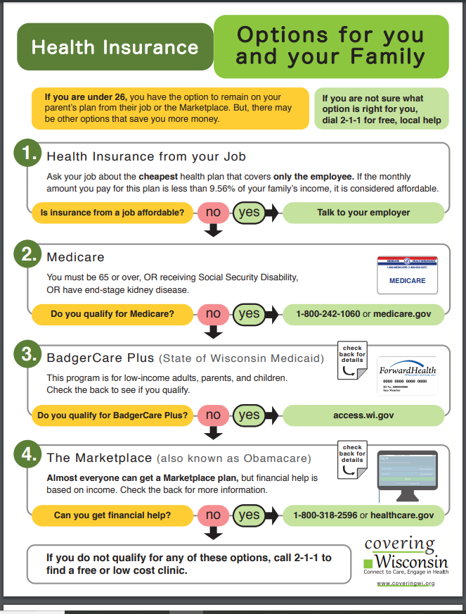
Health Insurance Options
19

Slide 20
Employer-Sponsored Insurance “Affordability” Test
Most employees who are offered employer-sponsored coverage will be content with their coverage; however, if the employer-based plan is considered “unaffordable” under the ACA, they may have other options:
The affordability test is based on the cheapest, qualified health plan offered to the employee (single plan)
If the employer-based plan costs more than 9.89%*, the consumer can qualify for Marketplace coverage with financial assistance
If the single plan is less than 9.89%, the consumer cannot get financial assistance in the Marketplace. This is true even if the family plan would be too expensive compared to the affordability percentage.
*The affordability percentage will be 9.78% the household’s income for 2020 plans.
20

Slide 21
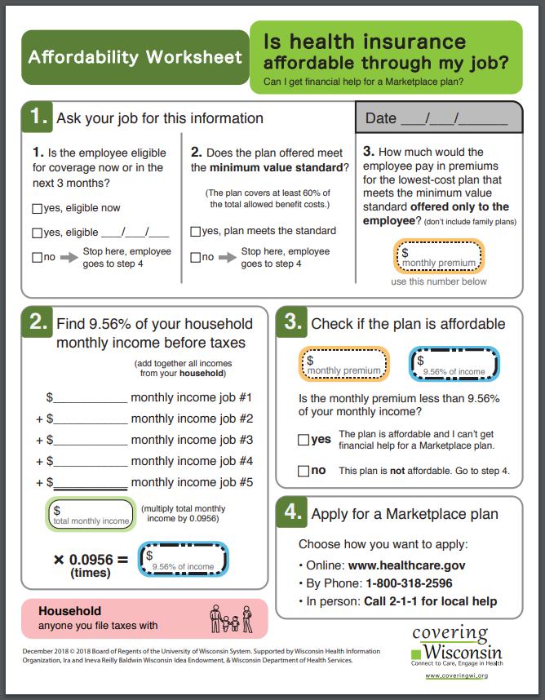
Health Insurance From Your Job
To help assess employer plan affordability use:
Use the Affordability Worksheet (coveringwi.org/learn)
Employer Coverage Tool (healthcare.gov)
Covering Wisconsin Navigators can help a consumer understand the form
21

Slide 22

Medicare
You qualify for Medicare if you are:
  65 or over
  OR
  Have end-stage kidney disease
  OR
  Receive Social Security Disability Insurance (SSDI)
  (24-month waiting period)
  To sign up: Call 1-800-242-1060 or go to medicare.gov
22

Slide 23



Wisconsin Medicaid Programs - BadgerCare Plus
Low-cost or free health insurance, provided by the State of Wisconsin (aka. known as Medicaid, CHIP or by the ForwardHealth card)
This program is for low-income adults, parents with dependent children, and children
People can sign up at any time at access.wi.gov
Can also sign up for FoodShare and WI Shares (childcare assistance) at the same time
In-person
Over the phone
Online
23

Slide 24

Other Wisconsin Medicaid Programs
Standard Medicaid (aka. Title 19) - for people who are Elderly, Blind, or Disabled or those who receive SSI
Medicaid Purchase Plan
Wisconsin Well Woman Program
Family Planning Only Services
Katie Beckett
Family Care
Enrollment assisters can help you get to the right plan!
24

Slide 25

Medicaid and Children
Many young children can qualify for Wisconsin Medicaid (BadgerCare Plus) even if a parent has access to an employer-sponsored health plan.
There are some exceptions if the employer pays at least 80% of the monthly premium of the health insurance plan and the child is not in an exempt category from this rule.
The best way to find out if someone is eligible is to apply and work with an enrollment assister to simplify the process.
25

Slide 26
Medicaid Coverage and Renewals
Benefits are comprehensive: http://www.dhs.wisconsin.gov/publications/p0/p00079.pdf (page 60 and 61)
People need to renew every 12 months by providing updated income information.
26

Slide 27
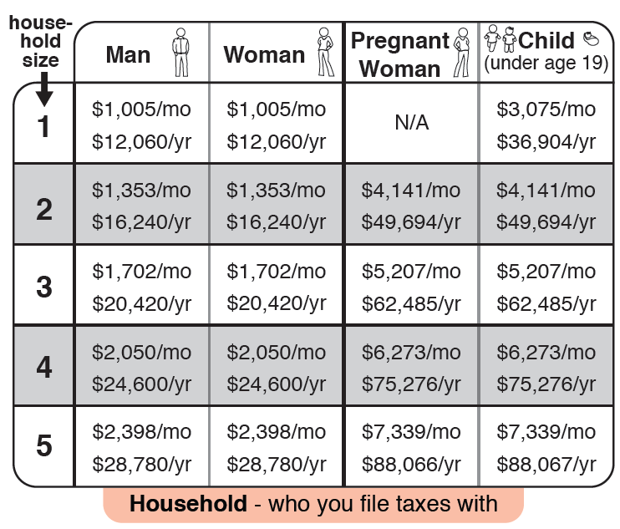
Medicaid / BadgerCare Plus Eligibility
300% Federal Poverty Level | 300% FPL | 300% FPL No premiums
200% Federal Poverty Level | Premiums start at 200%
100% Federal Poverty Level |  |  | 100% FPL No premiums | 100% FPL No premiums
 | CHILDREN (under age 19) Youth exiting foster care up to age 26, no income limit | PREGNANT WOMEN | PARENTS/ CARETAKER RELATIVES | ADULTS WITHOUT DEPENDENT CHILDREN
27

Slide 28

Health Insurance Options for Immigrants
Lawfully present individuals may have some options*
Children born in the U.S. may be able to get insurance, even if their parents cannot
Coverage available to undocumented immigrants:
  BadgerCare Plus Prenatal
  BadgerCare Plus Emergency Services
*Changes in immigration regulations make it even more important to seek assistance
28

Slide 29
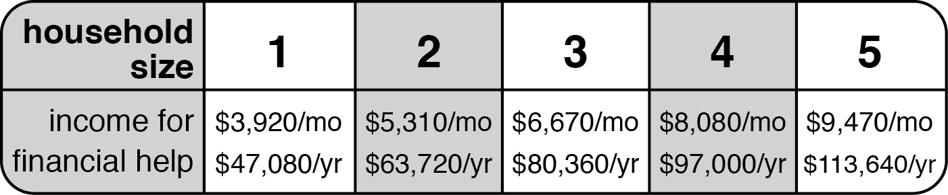
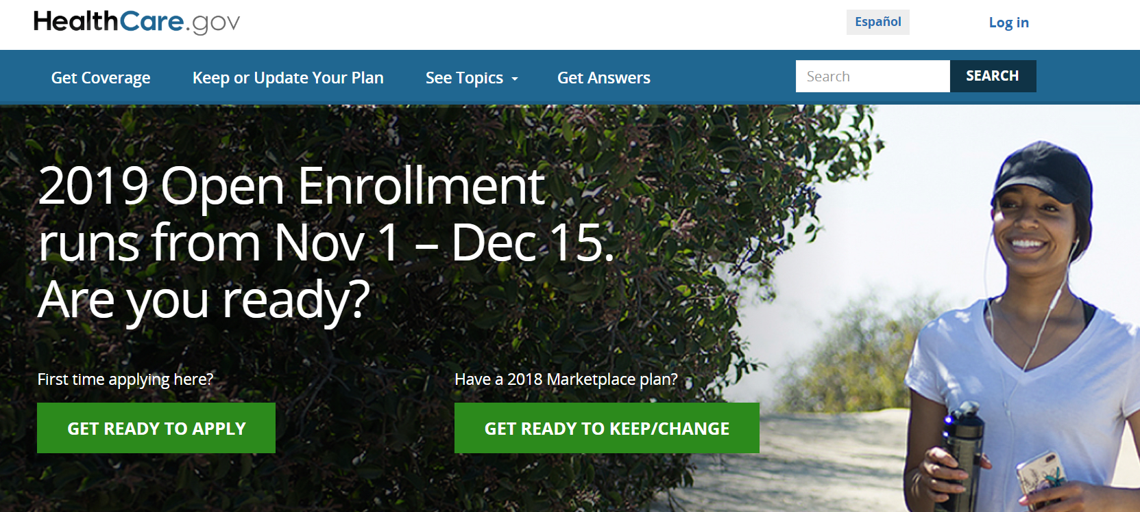
Health Insurance Marketplace
Almost everyone can get a Marketplace plan, but financial help is based on income
Call center is 24 hours/day in over 150 languages

Slide 30

Health Insurance Marketplace
Open Enrollment is November 1 – December 15
Special Enrollment Periods (SEP) are available after a qualifying event

Slide 31


Health Insurance Costs
Premium Tax Credits (PTCs) are available for individuals with income between 100-400% FPL selecting any plan type.
$12,144-$48,576 for an individual
Family of four: $25,104-$100,416
Cost-sharing assistance is available for individuals with income between 100-250% FPL . Assistance will be applied only when a silver level plan is purchased.
  $30,360 for an individual
  $60,260 for a family of four
31
Notes:
In 2015 and subsequent years, amount of max out-of-pocket limit will adjust to account for changes in the cost of private insurance compared to 2013. HHS will announce limit annually. Max for family plan will always be double the individual plan limit.
For 2014, certain employer plans with “separately administered” benefits do not have to fully comply
By 2015, all plans (except grandfathered) must comply

Slide 32
Insurance Options for Young Adults
Young adult children aging out of parent’s employer-sponsored coverage may have several options to consider:
If employed, their own employer coverage
COBRA
Health Insurance Marketplace, healthcare.gov
Wisconsin Medicaid
32
Notes:
In 2015 and subsequent years, amount of max out-of-pocket limit will adjust to account for changes in the cost of private insurance compared to 2013. HHS will announce limit annually. Max for family plan will always be double the individual plan limit.
For 2014, certain employer plans with “separately administered” benefits do not have to fully comply
By 2015, all plans (except grandfathered) must comply

Slide 33

In-Person Enrollment Assistance
Call 2-1-1 or text zip code to 898-211 for free, local enrollment assistance

Slide 34
Types of Enrollment Assisters
Types of Assistance | Description
Navigators | BadgerCare and Marketplace Receive federal funding
Agents and Brokers | Marketplace and Medicare Can serve many counties Help with consumers with complicated medical needs Paid by commission from insurance companies
Certified Application Counselors (CAC) | BadgerCare and Marketplace Connected to a health system, federally qualified health center, or community-based organization Some CAC entities may only serve their patients
34

Slide 35
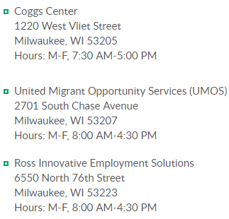
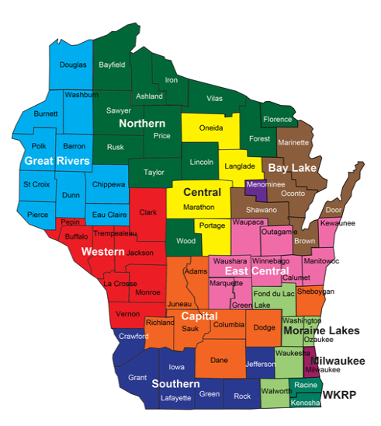
Types of Enrollment Assisters
Types of Assistance | Description
Income Maintenance (IM) Worker (IM Agency) | BadgerCare, Foodshare, and other public benefits
35

Slide 36
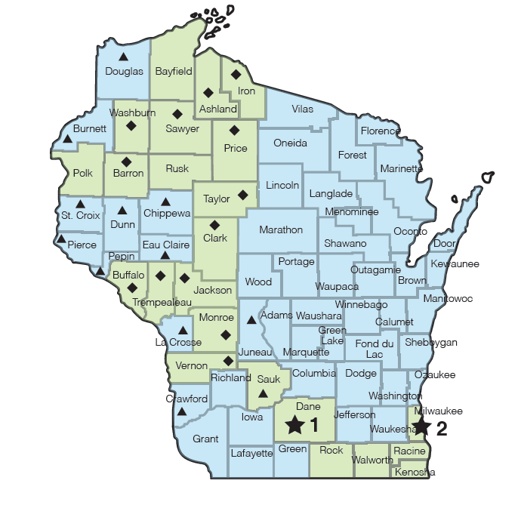
Wisconsin Navigator Collaborative
Appointments:
Green – in-person
Blue – over-the-phone
Madison: 608-261-1455
Milwaukee: 414-270-4677
36

Slide 37
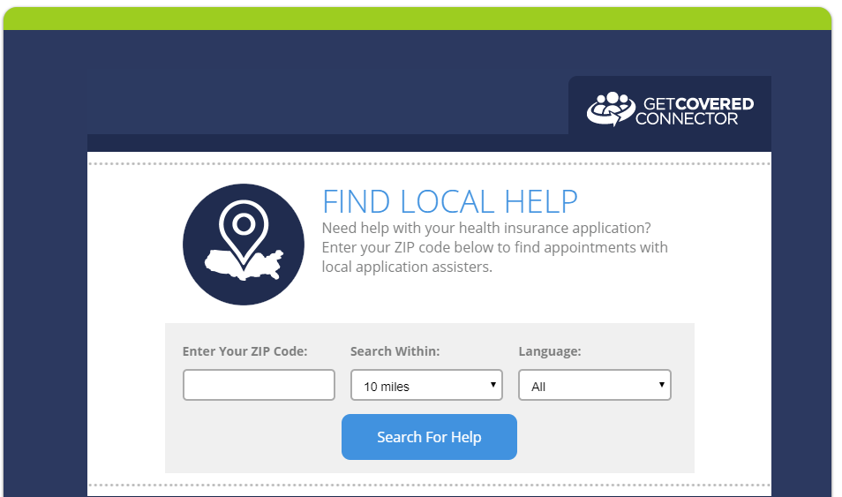
Health Insurance Connector Tool
coveringwi.org/enroll
Help someone book an appointment today!
37

Slide 38
Example 1: Monica and Family
Monica is a full-time employee at Company ABC.
Monica is a mother of two boys ages 9 and 12, making them a household of three.
Monica’s household annual gross income is $22,000.
Company ABC offers her a single health insurance plan of $216/month. The company does not offer family plans.
What options might Monica be able to consider?

Slide 39
Example 1: Monica and Family
1. Since children are not eligible for a family plan, they might be eligible for Medicaid or Marketplace. Based on their household income, the children will most likely be eligible for Medicaid.
2. Since Monica’s cost of a single health insurance plan in over the 9.89% affordability test, she could shop on the Marketplace and potentially qualify for financial assistance. Her annual income is a little too high for her to qualify for Medicaid herself, but her children could qualify.
$216 X 12 = $2,592 a year, $2,592/$22,000 X 100 = 11.78%
3. To help Monica decide, her HR department could connect her to an “enrollment assister” (e.g. Navigator, CAC) to review options by calling 2-1-1

Slide 40
Example 2: Jeremy
Jeremy is an early retiree who works part-time at Small Business USA (SBUSA).
Jeremy receives social security but is 63 and does not qualify for Medicare.
Jeremy is single and his household annual gross income is $35,000.
SBUSA offers a single health insurance plan to full-time workers, but not for part-time workers at this time.
What options might Jeremy be able to consider?

Slide 41
Example 1: Monica and Family
1. Jeremy is not eligible for employer coverage since he is part-time, and he is also not eligible for Medicare since is not 65 years or older.
2. Jeremy could be eligible for Medicaid, but his income is over the eligibility limit for a single adult.
3. He will most likely be eligible for Marketplace health insurance with financial assistance that will lower his monthly insurance cost.
4. To help with the online application process, Jeremy can reach out to an enrollment assister by calling 2-1-1.

Slide 42
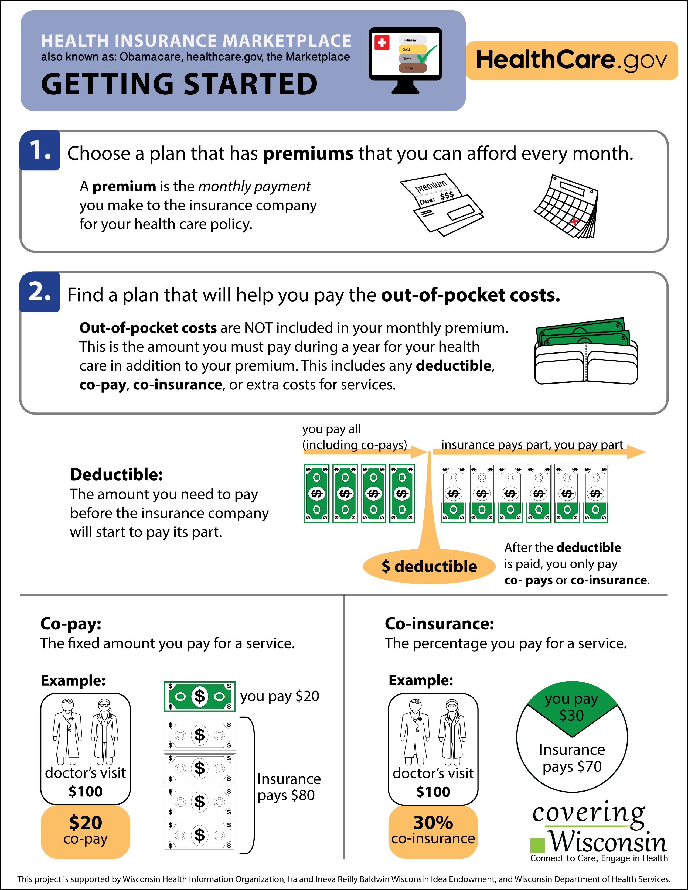
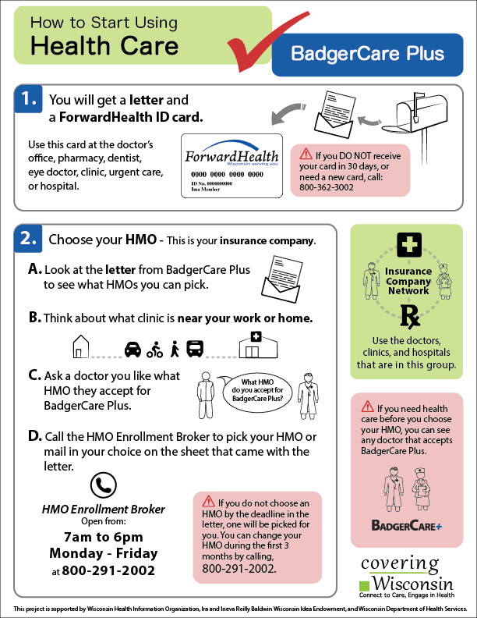
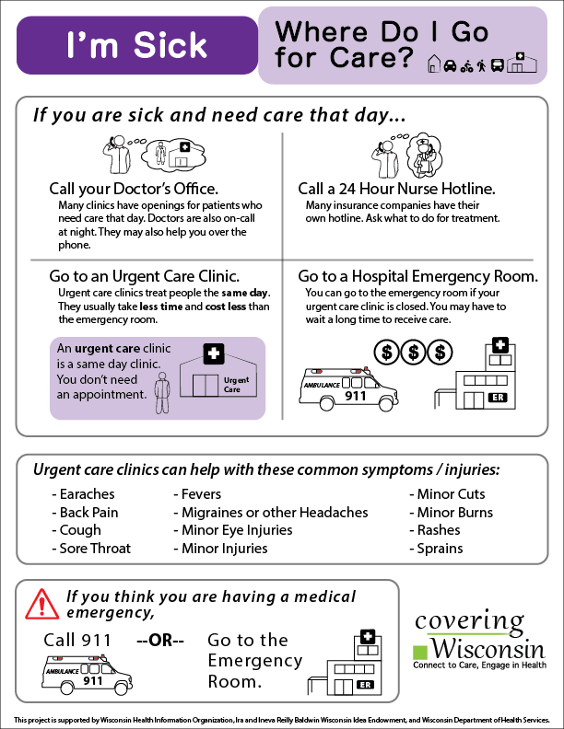
Health Insurance Literacy Resources
Marketplace Enrollment
Understanding the Marketplace and the enrollment process
BadgerCare Plus
Explains what will happen when someone enrolls in BadgerCare and how to use their health care
General Audience
Using health insurance
coveringwi.org/learn
42

Slide 43
Next Steps
Identify what types of employees may be uninsured or qualify for more affordable health insurance coverage
Connect them to enrollment assisters who can help them review their options and apply for coverage:
  Wisconsin Health Insurance Connector Tool coveringwi.org/enroll
  Covering Wisconsin Health Insurance Navigators 414-270-4677
  Call 2-1-1 to find local enrollment assister

Slide 44

44

