Slide 2
Today’s Agenda
8:00-8:30 | Registration/Breakfast
8:30-8:35 | Welcome
8:35-8:50 | BHCG Year in Review
8:50-9:00 | Leading Change, Creating Value Award
9:00-9:30 | BHCG Strategic Plan
9:30-9:40 | Networking & Exhibit Break
9:40-9:50 | Measuring Our Success – By the Numbers
9:50-10:20 | Advisory Panel: UnitedHealthcare Premium® Designation/Tier 1 Programs
10:20-10:50 | Advisory Panel: Navitus Health Solutions
10:50-11:00 | Recognition, Drawing & Closing Remarks

Slide 3

Sponsors/Exhibitors

Slide 4
Year in Review:
Continuing Results and Emerging Solutions

Slide 5
UnitedHealthcare:
Medical Administrator Partnership
Three-year extension signed in 2018 (through 2021)
  Preferred pricing, credits and performance guarantees
  Vendor management and administrative oversight
  Exclusive access to innovative programs and solutions
BHCG-dedicated/enhanced customer service and designated clinical team
  Regionally based, single point of contact

Slide 6
UnitedHealthcare:
Promoting High Value Providers
Helping employers identify high value providers to
  Impact health care costs
  Improve health and outcomes
UnitedHealth Premium® designation program
  Identify quality, cost-effective physicians
  Supports BHCG-exclusive benefit tiering opportunity
BHCG Member Company Impact
Premium Utilization Tiered: 43.6% vs. Premium Utilization Non-Tiered: 36.2% | Every 1% increase in Premium Utilization = $610,059 in reduced costs for all of BHCG

Slide 7
Business Health Care Group –
Historical Results
Allowed PMPM Comparison
$426.00
$430.15
$406.68
$383.37
$399.67
2018 is estimated based on existing BHCG customers’ Covered claims incurred and paid through December 2018 with estimated completion, based on BHCG’s historical completion.
UnitedHealthcare
Effective 1/1/2016

Slide 8
Emerging Issue: ERISA Compliance –
What Does It Mean to Be a Fiduciary?
ERISA requires fiduciaries to discharge their duties with respect to employee benefit plans:
  Solely in the interest of plan participants and their beneficiaries;
  For the exclusive purpose of providing plan benefits, or for defraying reasonable expenses of plan administration;
  With the care, skill, prudence and diligence that a prudent person in similar circumstances would use;
Greater participant cost-sharing in contemporary plan designs increases focus on employer decisions, especially regarding:
  Vendors;
  Rx program operations

Slide 9
Navitus Health Solutions
Transformative pharmacy benefit management aligned
with employer needs
  100% pass-through of all rebates and revenue
  Lowest net cost in the industry
Available to BHCG member employers
  Stand alone memberships locally & nationally
Preferred pricing/performance guarantees
  Optional services included as standard
  Data sharing

Slide 10
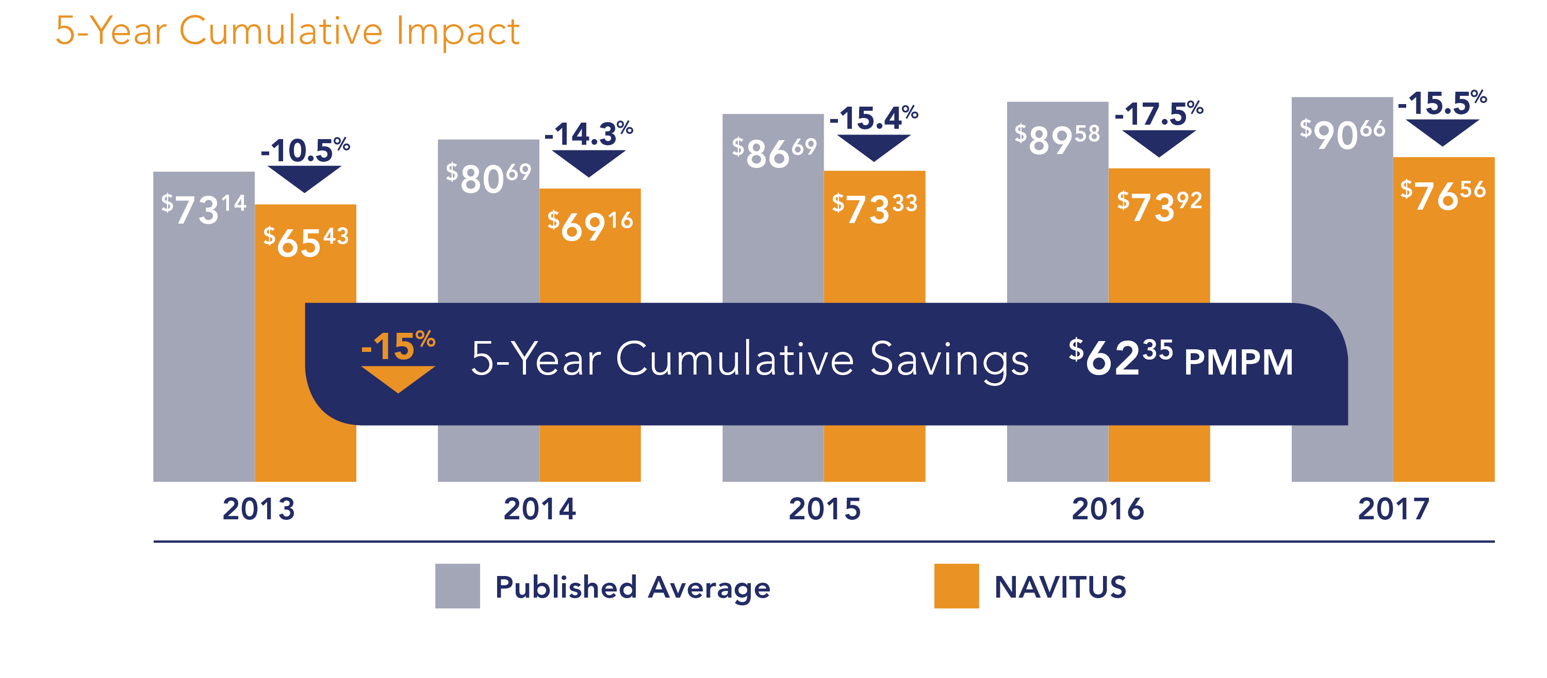
Navitus Health Solutions:
Industry-Leading PMPM

Slide 11
Consumer Engagement Support

Slide 12
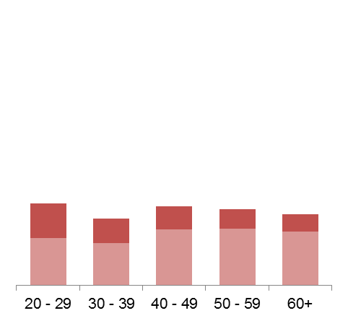
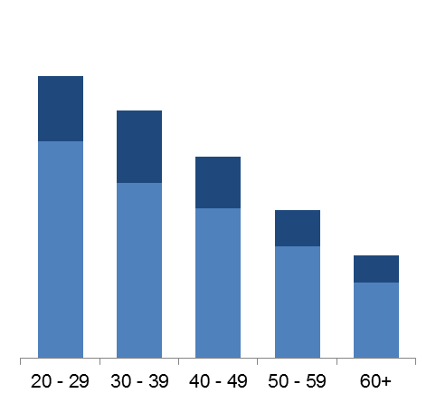
Business Health Care Group –
Medically Homeless in Eastern Wisconsin
54%
48%
Continuously Enrolled Adults (4/16 – 3/18)
Percent with 0-1 PCP visits, with no wellness visits
39%
29%
20%
20%
19%
18%
17%
16%
1 PCP visits
0 PCP visits
Males
Females
Males over age 40,
30% of them had
0 or only 1 PCP visit
* Adults = Subscribers + Spouse. Excludes dependents.
** PCP visits: Office visits where the provider specialty is Family Medicine, Internal Medicine, Pediatrics, Ob/Gyn, Nurse Practitioner, or Physician Assistants. Excludes office visits with $0 eligible spend. Excludes members with wellness visits from other physician specialties (ex. Endocrinology)

Slide 13
Consumer Engagement Support:
Engagement Solutions Campaigns
Multi-media marketing and communication strategies
  Premium designation/tiering communications to drive utilization to high value providers
    Video, print, electronic media, microsite
  Change management toolkit to transform employees into
  active consumers
  Coming in 2019
    Medically homeless campaign to encourage PCP relationships
    Pharmacy benefits change management campaign (Navitus)

Slide 14




Consumer Engagement Support:
Workplace Opioid Awareness/Prevention Communication Toolkit
BHCG members
  Downloadable and
  customizable
Multi-media materials,
including
  worksite posters
  table tents
  PPT modules
  window clings
  online graphics
Community-at-large worksite
posters for employers

Slide 15
What’s Ahead?
Strategic Planning

Slide 16

Quantum Health:
Consumer Health Care Advocacy
Care and medical management
Advocacy and customer service
  Members and providers
BHCG preferred rate and
dedicated services

Slide 17

Physician Data Study:
Identifying the Best Providers
Studying the quality and cost effectiveness
of eastern WI physicians
GNS Healthcare uses AI learning processes
Coordination with health systems
Spring Learning Event

Slide 18
Strengthening Our Voice

Slide 19
2018 & 2019
New BHCG Member Employers
2018
2019
Associated Banc-Corp.
Goodwill Industries of North Central Wisconsin, Inc.
Goodwill Industries of Southeastern Wisconsin, Inc.
Kohler Co., Inc.
Reinhart Boerner Van Deuren S.C.
Sendik’s Food Markets
Creative Technologies LP
NPS Corporation

Slide 20
2019
New BHCG Pharmacy Member Employers
2019
Baird
City of Kenosha
Masters Gallery Foods
Paragon Development Systems
Sargento Foods

Slide 21

Supporting Community Health
Offering free BHCG membership to all Federally Qualified Health Centers in eastern Wisconsin

Slide 22
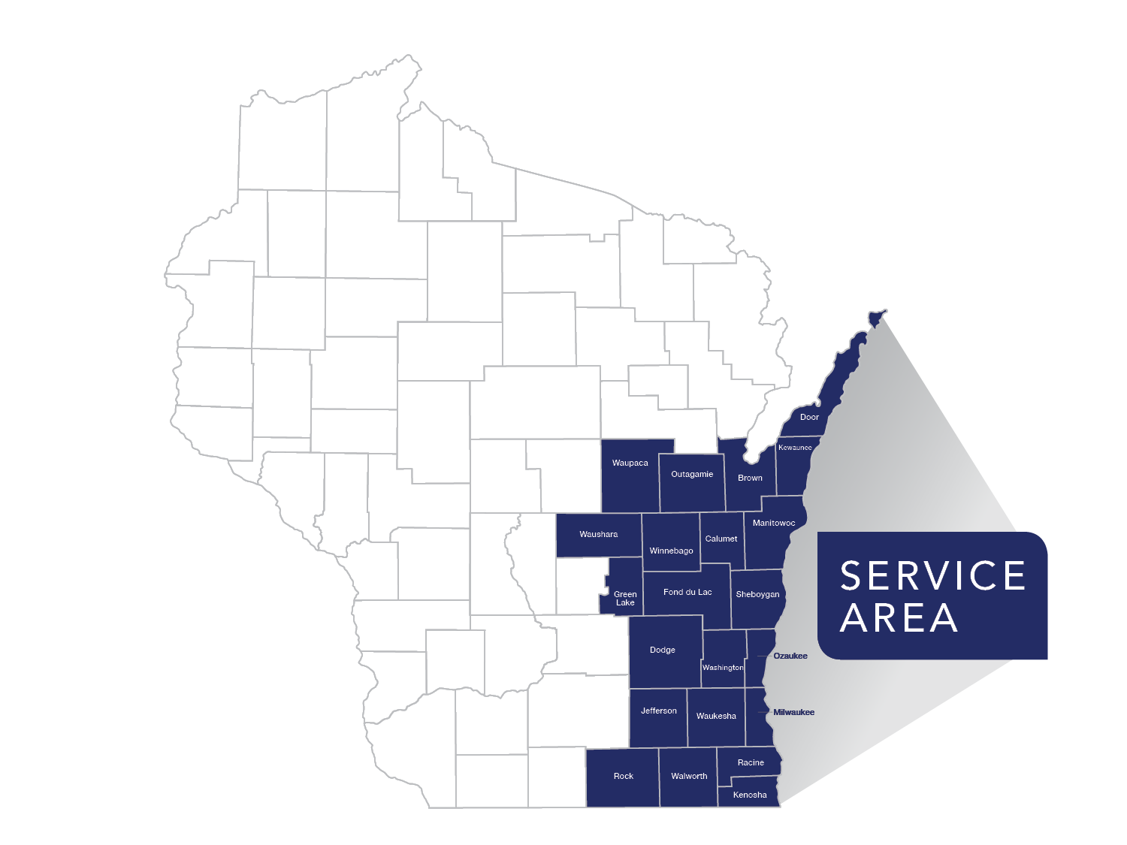
Did You Know?
All BHCG-related services and products are optional
BHCG’s service area: 22 counties in eastern WI
  Membership exceeds 200,000 covered lives

Slide 23

Join Us!
A growing portfolio of employer solutions
Significant support from member employers
Active involvement of employer representatives drives BHCG success
Community initiative

Slide 24
Leading Change, Creating Value Award

Slide 25

Leading Change, Creating Value Award
Congratulations to:
Accepting the award:
Cindy Kazan,
Vice President, Advancement

