Slide 1
Measuring Our Success – By the Numbers

Slide 2
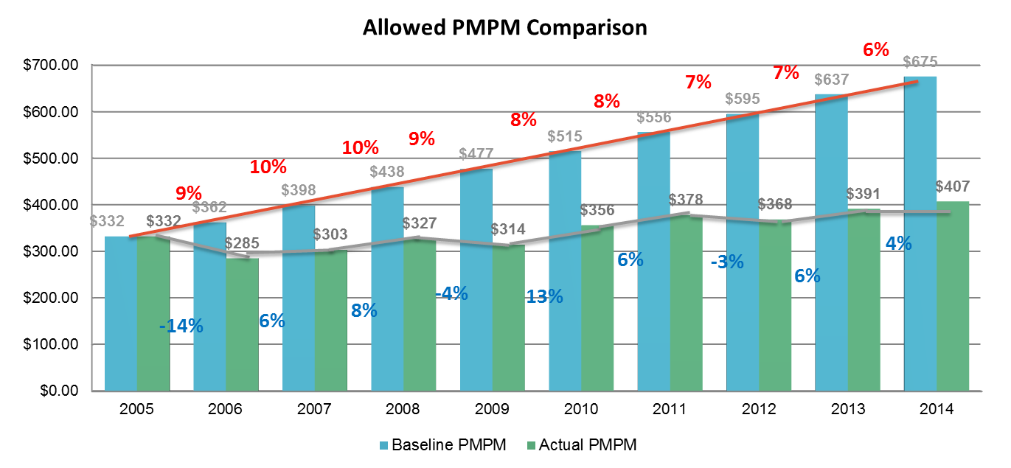
Business Health Care Group – Historical Results Total ASO Employers – Medical Allowed PMPM Cost
$426
$400
$430
$383
2015*
2016
2017
2018
1/2016 BHCG effective with UHC
Notes:
Baseline costs in 2005 include only those 14 companies where 2005 data was received. These 14 groups represented 88% of the 2006 membership and 74% of the total groups.
Source: Third-party validation of Total ASO Group PMPMs. Core ASO Group trends calculated by Humana. Includes medical costs only, not pharmacy costs
*2015 estimated. Pulled from BHCG website.

Slide 3
Business Health Care Group – Historical Results
BHCG Covered PMPM 2015 - 2018
$466
Estimated costs based on the lowest consultant net trend*
$426
$436
$448
$234 Million
Three-year savings for beating the lowest consultant trend
Prior to UHC
Effective with UHC 1/1/2016
*Annual consultant survey of 5 of the largest consulting groups
2015 estimated. Pulled from BHCG website.
2016 = (2016 Covered PMPM * 128,470 average members in 2016 * 12 months) – (Estimated spend of $436.22 * 128,470 average members in 2017 * 12 months)
= (2017 Covered PMPM * 130,439 average members in 2017 * 12 months) – (Estimated spend of $447.57 * 130,439 average members in 2017 * 12 months)
2018 = (2018 Estimated Covered PMPM * 170,358 average members in 2018 * 12 months) – (Estimated spend of $462.78 * 170,358 average members in 2018 * 12 months)
2018 is estimated based on existing BHCG customers’ Covered claims incurred and paid through December 2018 with estimated completion, based on BHCG’s historical completion.

Slide 4
Premium Utilization – Total Population
Premium Care Provider Utilization
Improve to 45.0%
$5.5 Million
Annual savings if each BHCG group achieved at least 45.0% Premium Care Utilization
2018 is estimated based on existing BHCG customers’ Covered claims incurred and paid through December 2018 with estimated completion, based on BHCG’s historical completion.

Slide 5
Business Health Care Group – Total Population
Members with high use of Premium Care Physicians cost 14% less
Premium Tier 1
Use of Premium Care Physicians – High vs. Low
Low Use = Members with less than 75% of all eligible charges for Premium Care providers
Highly Use = Members with 75% or more of all eligible charges for Premium Care providers
Analysis includes Continuously Enrolled members, excludes dependents, excludes claimants with $100K+ in medical spend

Slide 6
Business Health Care Group – Consumer Activation Index
Consumer Activation Index - % of Membership
Activation Level | Below Average | Average | Above Average | Highly Activated
2017 | 34.0% | 24.6% | 24.4% | 17.0%
2018 | 31.7% | 24.9% | 25.8% | 17.7%
Premium use | 12% | 37% | 58% | 72%
Consumer Activation Includes
Wellness visits
Use of Premium Care MDs
EBM compliance
Clinical engagement
Consumer tools
Limited to continuously enrolled members

