Slide 1


BHCG and UnitedHealthcare
February 20, 2019

Slide 2







Your VHP Team
Cece Hopkins
Director Coalition Strategies
UnitedHealthcare
Kyle Kellner
Sr. Health Analytic Consultants
UnitedHealthcare
David Smith
Director of VHP Affordability and Solutions UnitedHealthcare
Dr. Bruce Weiss
Cathy Swanson Girsch
Chief Medical Officer UnitedHealthcare
Engagement Solutions Consultant
UnitedHealthcare
Shelly Merrill
Client Management Consultant, Client Services
and Implementation

Slide 3

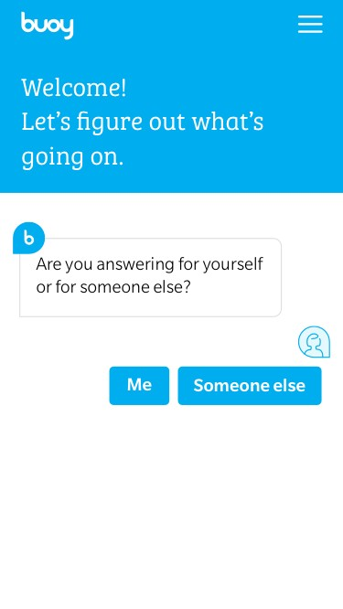
Buoy Health
Optum Ventures investment Q1 2018
Symptom Checker + Provider Finder with Price Transparency
Working with Rally to integrate for Q1 2019
Working to integrate into Optum Bank Mobile Wallet app
1
Patient enters symptoms and demographics
Buoy’s machine-learning algorithm interviews the patient
2
3
Buoy triages the patient to the perfect (i.e. customizable) next step
If necessary, Buoy sends information ahead to the physician
4

Slide 4
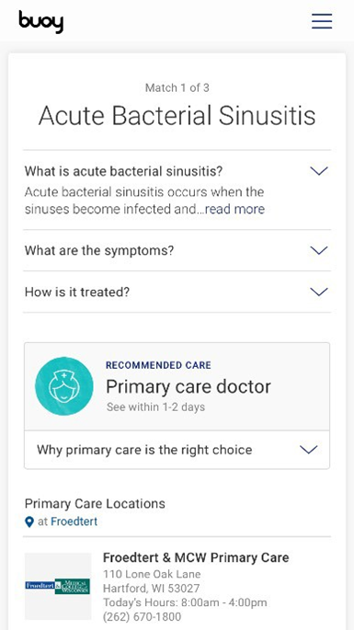
Buoy Health
1
Patient enters symptoms and demographics
Buoy’s machine-learning algorithm interviews the patient
2
3
Buoy triages the patient to the perfect (i.e. customizable) next step
If necessary, Buoy sends information ahead to the physician
4
Notes:
Going to sync up with health4me app to find and list premium then in network providers, as well as pull pricing data from the transparency tool (my care cost estimator).

Slide 5



Buoy Health Offerings
Buoy
Leads
Buoy
Concierge
Partnerships:
For employees who Googling their symptoms
Identify and guide employees through Buoy’s direct-to-consumer site
Additional Engagement
For employer’s portal, Slack or Microsoft Messenger
Help guide employees to the right type of care in your narrow network
Cost savings Utilization rates NPS
WHO
WHA T
KPI
and many more
Through Google
Through Employer’s Digital Asset
sore throat

Slide 6

LetsGetChecked
Optum Ventures investment March 2018
Lab test in a box:
Member orders a lab kit via LetsGetChecked.com, which will be authorized by a LetsGetChecked physician. An anonymized kit with a barcode is sent out.
Patient collects their own sample, whether that be finger prick, stool (for colorectal cancer), or swab
Kit is mailed directly to INN lab
After the lab processes the sample, the corresponding result will be reviewed by a LetsGetChecked physician and the company’s nursing support team.
For positive or out of range results, patients will get a call from the team to discuss treatment options. Only after a consultation will the results be released to the patient’s dashboard.
Patient can login to a dashboard to track shipment status, see lab value results, and request a call from the clinical team.
Currently 34 different tests available that fall into 4 categories:
Now available for partnership
3 to 1 savings opportunity
Can be used for biometric testing
Convenient for members
6
Notes:
We looked across a typical commercial population at the cost savings using normalized pricing of different lab bundles if you were to obviate the visits (pre-visit and post-visit). The impact was the most conservative view of the savings because it doesn’t include any other spend that is happening on patients for lab work (e.g. marketing to get them in, issues down the line from lack of testing, etc). The savings here was 6% of all visit costs across the population (E&M), which can be applied to employer’s population.
To make this easy to visualize, we also looked at normalized pricing within a typical bundle for the lab tests they do today. Usually the visit component of the bundle is ~$100-150 each time depending on the type of visit. For LGC, the physician process is $5.
Using lets get checked, a remote member could easily complete their biometric screening with a PCP visit. Another use, members could order the kit, and have their labs done before the PCP, sending the results to the PCP in advance of their annual wellness visit.

Slide 7
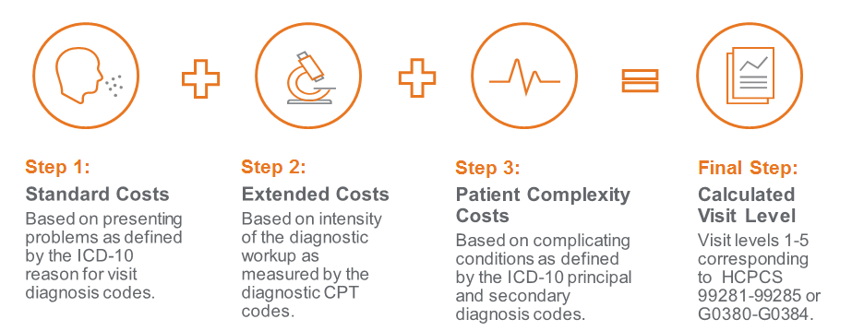
EDC Analyzer Tool
Effective 3/1/18
What it is:
The EDC Analyzer Tool is an Optum tool that reviews Emergency Department CPT codes and compares them to the level of care billed and the care provided to ensure the services match. Claim payments are reduced if it shows the level of care billed is not in line with the services provided. This is a pre-payment edit with a unique remark code.
Background:
Emergency Departments (ED) facility claims include an evaluation and management (E/M) CPT code in the range 99281-99285 to reflect the level of the ED visit and resource use by the facility.
  99284, 99285, G0383 and G0384 indicate high severity
UnitedHealthcare has identified an increased trend where high severity level 4 and 5 E/M codes are submitted with diagnoses that do not support the level 4 and 5.
Reason for Implementing:
Emphasis on correct coding (not medical necessity) for emergency department facility claims to ensure accurate payments that reflect the appropriate E/M level of the ED visit
To learn more about this tool, please visit www.EDCAnalyzer.com.
7
Notes:
Anthem decided not to pay these at all, got sued, and has now amended their policy to be more in line with ours.

Slide 8
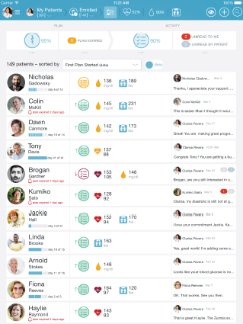
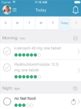
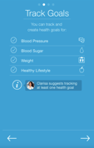
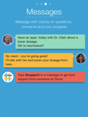

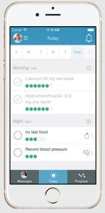
Case and Disease Management Modernization
Digital Dashboard Enhancement to DM/CM. Focus on behavior change, coaching and digital tools.
New care model looks at the whole person, providing one-to-one support through the care continuum.
Digital engagement provides tailored outreach and intervention as well as ongoing communication and tools.
Registered Nurse view
Employee and Dependents View
Currently in pilot, expected Q1 2019
8
Notes:
At the moment it will be a separate app, think of it as texting with the nurse. So if a member is awake at 11pm and has a nurse question they can use this app, and the nurse will respond within 24 hours. It’s a 2nd method of communications, the member can still just call, or call and use the app.
This was referred to as PHS 3.0, and the Diabetes and Chronic Condition Evolution Pilot. The CM/DM Modernization is the moniker they are sticking with, for now.
The pilot clients are: Phase 1 Five clients are Duke Energy, City of Austin, Bristol Meyers Squibb, CAN Financial, and Lowes Corp. Phase 2 clients are Southwest Airlines, Walgreens and Georgia Department of Community Health.

Slide 9
Case and Disease Management Modernization
Digital care platform features
Member
dashboard:
Desktop and mobile
Trackers
Real-time analytics
Monitoring:
Based on care plans
Employee vitals
Lifestyle changes
Communication:
Secure messaging:
Seamless interaction
Response within 24 hours
Simple activities to follow-up, e.g., research
Action plans:
Set goals and targets
Monitor setup
9
Notes:
Digital care allows for:
Employee and coach dashboards.
Communication.
Monitoring.
Action plans.

Slide 10
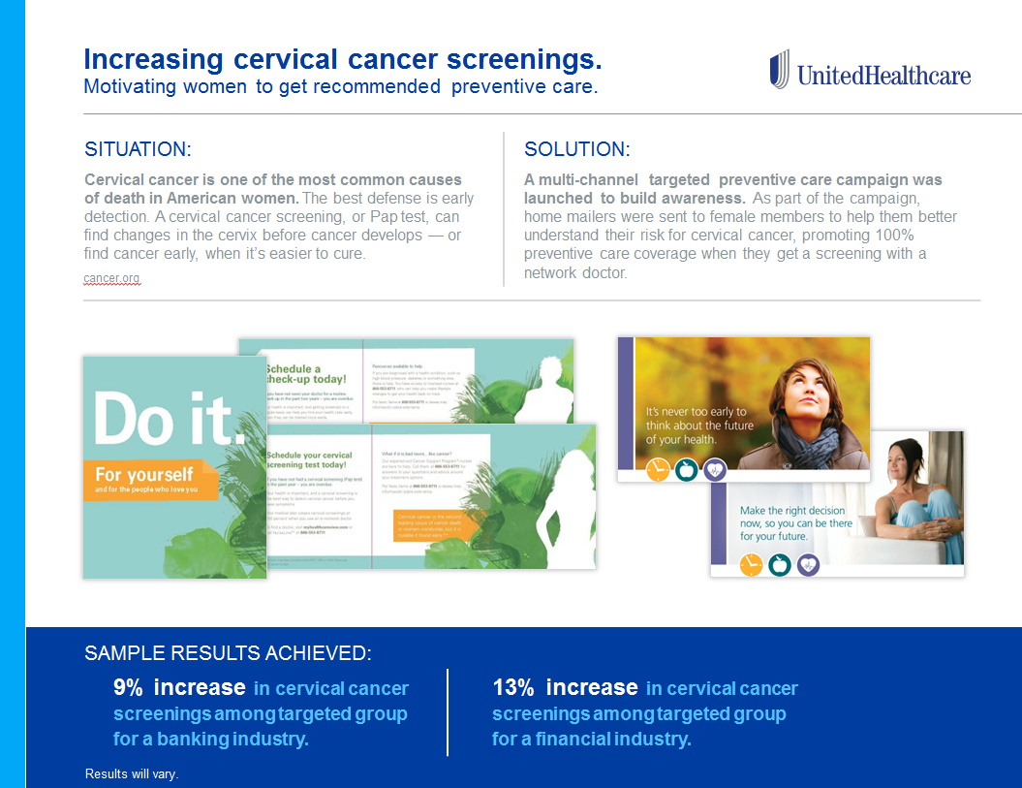
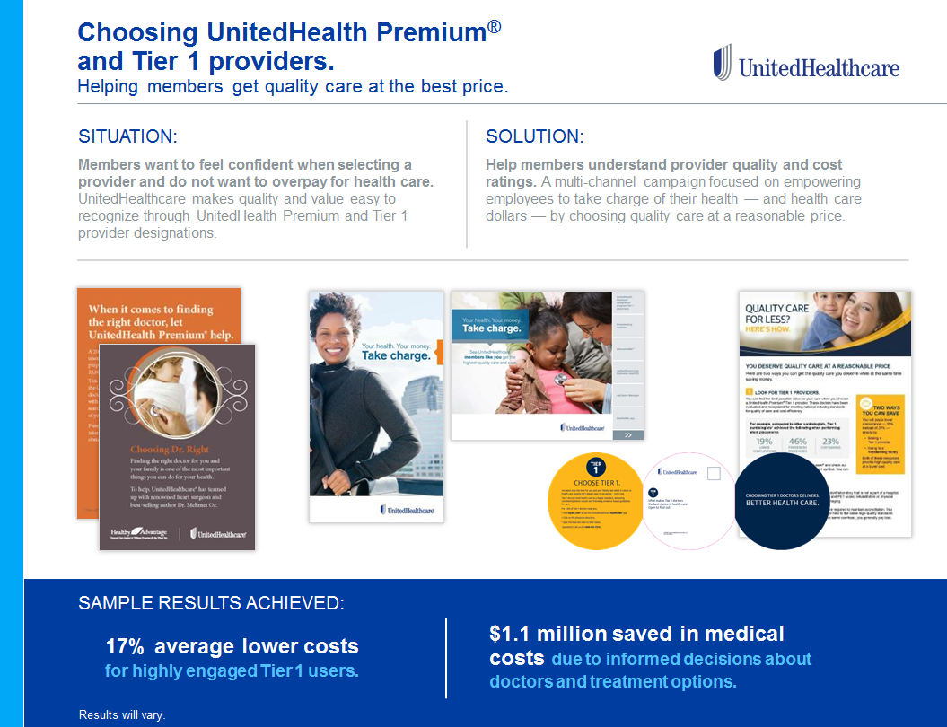
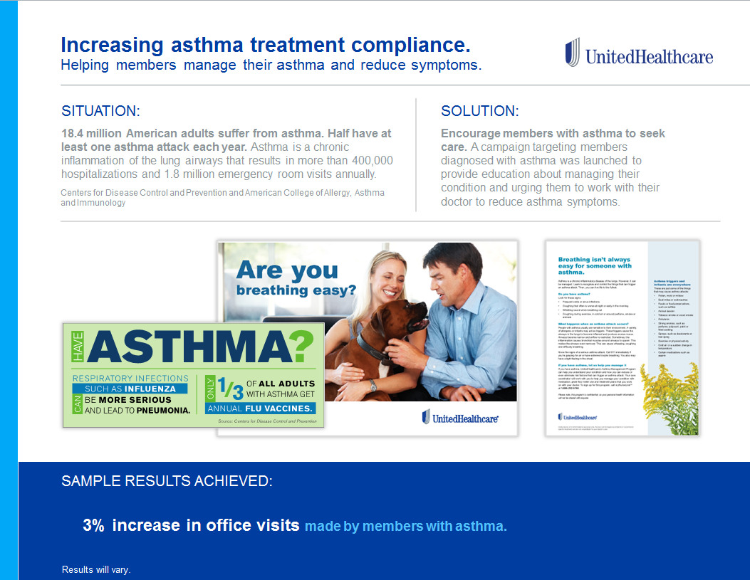
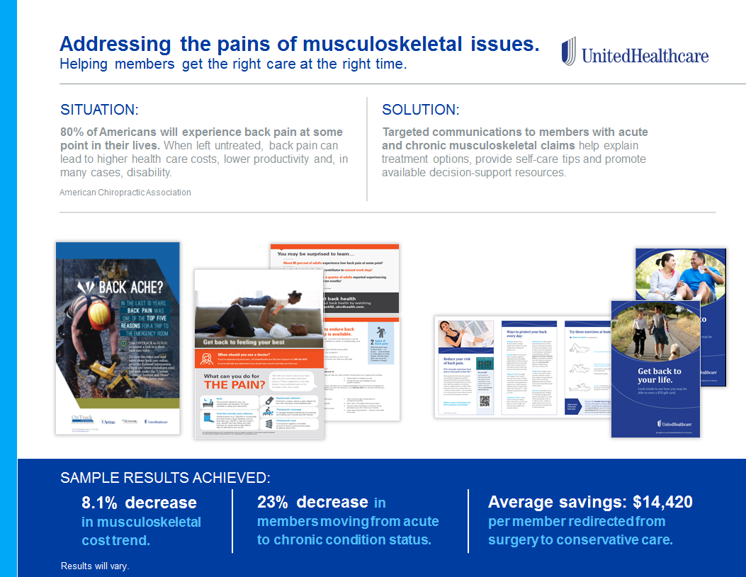
Engagement Solutions
New Success Stories Deck Available
10

Slide 11

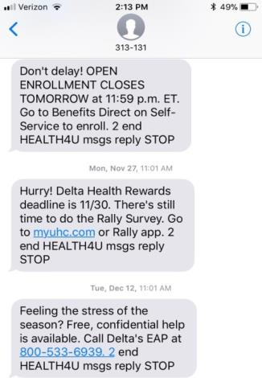
Digital solutions:
Text messages
UHC Legal has approved the use of medical eligibility files for text messaging. Members will have the option to opt out.
We can now proactively text members about important benefit reminders throughout the year.
Low cost alternative to mailers, with a 95% read response rate.
69% of
consumers say
personalized “in
the moment
information
(IMI)” would be
valuable to them.*
Moving forward:
Requires 8 week lead time to create campaign(s)
Costs: Year-long text campaign = $1,200 - $2,000 plus $100 per messaging campaign
  One-time text to receive message = $800 - $1,000 plus $100 per messaging campaign
*Source: 2017 Consumer Health Mindset Survey, Aon Hewitt, NBGH, Kantar Futures; 1) Work Redefined: MetLife’s 15th Annual U.S. Employee Benefit Trends Study

Slide 12


Certainty in an
Business Health Care Group
UnitedHealthcare Global: Overview
February 20, 2019

Slide 13

Global Marketplace
To help people live healthier lives and help make the health
system work better for everyone.

Slide 14

Business Platforms
Our complementary but distinct businesses enable comprehensive solutions for our customers.
Largest health benefits company in the U.S.
Provides broad access to high-quality,
cost-effective benefits programs
Offers programs that are accessible while in
the U.S. and outside and are available for:
  Commercial groups and individuals
  Retiree markets
  Government assistance markets
  Military and veteran markets
  Global expatriate and traveler markets
A leading information and technology-enabled health services business
Delivers integrated, intelligent solutions that work to modernize the health system and improve overall
population health:
  Technology solutions
  Intelligence and decision support tools
  Health management and interventions
  Administrative and financial services
  Pharmacy solutions
FOUNDATIONAL COMPETENCIES
Clinical Insight
Technology
Data & Information
Notes:
Complementary but distinct business platforms
Primary NAV: Global Marketplace
Secondary NAV:
Core Idea: The core businesses of UnitedHealth Group include UnitedHealthcare and Optum, two complimentary but distinct businesses that enable comprehensive solutions for our customers.
________________________________________________________
UnitedHealthcare is the largest health benefits company in the U.S. with expertise serving multiple segments of the marketplace with high-quality, cost effective, comprehensive benefits programs available for:
Commercial groups and individuals
Retiree markets
Government assistance markets
Military and veteran markets
Global expatriate and traveler markets
Optum is a leading information and technology-enabled health services business that delivers integrated, intelligent solutions that work to modernize the health system and improve overall population health:
Technology solutions
Intelligence and decision support
Health management and interventions
Administrative and financial services
Pharmacy solutions
As you choose UnitedHealthcare Global to partner with, all of the resources of UnitedHealth Group become a fully integrated part of the solution we build with you.

Slide 15
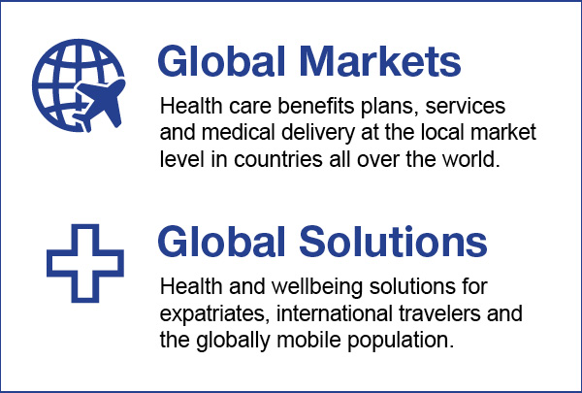
Global Presence
Our Global division serves over 4 million consumers, in over 130 countries and will generate an estimated $7.5B in revenues in 2018 from our comprehensive operations.
Around the world we offer:
Fully compliant insurance and benefits coverage
Hospital and clinic networks (owned and leased)
Physicians and care providers we employ or contract with
Operations centers, technology centers and clinical hubs
Two distinct business units within our Global division:
Global Markets
Global Solutions
Health care benefits plans, services and medical delivery at the local market level
in countries all over the world.
Health and wellbeing solutions for expatriates, international travelers and the globally
mobile population.
1,000,000+ Network providers worldwide
UHC Global Around the World
150,000 providers outside the U.S. including more than
15,000 hospitals and clinics
We serve nearly 35% of Fortune 100 and nearly
20% of Fortune 500 businesses around the world
Notes:
Global Presence
Primary NAV: Global Marketplace
Secondary NAV:
Core Idea: Our Global division serves over 4 million consumers, in over 130 countries and generates over $7.5 billion in revenues from our comprehensive operations.
________________________________________________________
We bring you:
Fully compliant insurance and benefits coverages for the local countries we operate in
Hospital and clinic networks we own or lease around the world
Physicians and care providers we employ or contract with
Operations centers, technology centers and clinical hubs located around the world
We have a worldwide network of over one million providers, including over 150,000 providers and 15,000 hospitals and clinics outside the U.S.
UnitedHealthcare Global is uniquely positioned to create a solution for you that no other partner could.
We’ve demonstrated this across our current client base consisting of nearly 35% of Fortune 100 and nearly 20% of Fortune 500 businesses who currently have employees we serve around the world.

Slide 16
Single-sourced solutions, globally integrated
Efficient, end-to-end care that safeguards well-being and productivity
Expatriate Insurance
Expatriates
Inpatriates
TCNs
U.S. Networks &
Administrative Services
Services for
Non-U.S. Insurers
Administration and Access
to U.S. Networks
TRAVEL INSURANCE
GLOBAL ASSISTANCE
EXPATRIATE INSURANCE
EXPATRIATE INSURANCE
GLOBAL ASSISTANCE
Travel Insurance
Business Travel
Individual Travel
GLOBAL MEDICAL
GLOBAL ASSISTANCE
GLOBAL RISK
Global Assistance
Assistance & Evacuation
Medical Intelligence
Travel Assistance
Repatriation of Remains
Global Medical
Medical Supplies and Equipment
Onshore/Offshore Medics and Clinics
GLOBAL RISK
U.S. NETWORKS &
ADMINISTRATIVE SERVICES
Global Risk
Security and Medical Intelligence
Crisis Management & Critical Incident Support
Security Response Center
Security Operations
Security and Political Evacuations
Travel Tracking and Intelligence Alerts
Notes:
Single Source Solution
Primary NAV: Our Solutions
Secondary NAV:
Core Idea: UnitedHealthcare Global is unique in its ability to offer the breadth of services to support the globally mobile population, including expatriate and travel insurance, global assistance and risk, U.S. Networks and Administrative Services, and Global Medical solutions.
________________________________________________________
We are the company fully capable of being your single-source partner, through efficient, end-to-end care that safeguards well-being and productivity. Whether your needs include…
Global Insurance - Medical care access including expatriate insurance and U.S. inpatriate insurance, Travel Insurance - business travel insurance and individual travel medical insurance
Global Assistance - On-the-ground assistance services including evacuations, medical intelligence, and emergency response
Global Risk – security intelligence, crisis management, critical incident support, security operations
U.S. Networks & Administrative Services – administration for and access to the U.S. health system for foreign nationals
Global Medical - Remote medical care provisioning including medical supplies and equipment, offshore medical solutions, and on-site medics and clinics
UnitedHealthcare Global has years of experience working with top companies to customize these capabilities into the most appropriate and comprehensive solutions for the health, safety and wellbeing of global workers.

Slide 17

Why UHCG #1:
Insurance + Assistance Integration
Insurance integration with assistance drives better outcomes
We are unique in providing expatriate and business travel medical insurance, assistance, and risk all from one company. This model reduces gaps in communications across vendors and maximizes financials based on aligned incentives.
Evacuation decisions are driven by clinical
team outlining the patient needs.
Health Logistics and operations teams assess
robust network of air ambulance partners to
solicit bids from quality vetted providers.
Market based approach ensures quality needs
are met, then cost savings are pursued.
25
$
%*
75
Average savings on
evacuation services
# of Physician advisors
around the globe
Proactive Quality Assessment on ~125 air ambulance partners
““Source: UHC Global internal data, 04/2017
Notes:
Insurance, Assistance, and Risk together
Primary NAV: Better Cost Control
Secondary NAV: Integrated Solutions
Core Idea: Integrating insurance, risk, and assistance together reduces gaps in communications, allows use of a common set of quality information, and creates a single aligned goal of the highest quality patient outcomes. This approach yields optimal clinical outcomes and can generate cost savings.
________________________________________________________
Our teams are constantly monitoring global healthcare situations and we regularly update our quality and risk information to ensure that when we need to deliver assistance, we understand the options to support informed decision making.
We maintain a global network of over 250 air ambulance providers, ~125 of which we have detailed quality and performance details.
When a clinician determines there is a current or future healthcare need that can not be met in a localized facility, our teams collaborate to outline the best case scenarios, including soliciting multiple bids for transport. The clinicians outline the necessary timeframes and medical support to ensure patient safety. Our Health Logistics and Intelligence team provide insight into local care capabilities, and the operational teams work to meet the needs outlined to deliver the best possible health outcomes. Cost savings typically do occur, but patient safety and wellbeing is the paramount concern when selecting the provider to move a patient to a new medical facility. We typically solicit multiple evacuation bids among our panel of providers, vetting the alternatives that can best meet the clinical and timing needs outlined by the clinical team. In ~30% of cases, we utilize the highest bid as it represents the best alternative to meet the clinical needs of the patient. Across all of the evacuations we perform, we achieved savings of 25% vs. the highest cost bid based on our approach to solicit multiple bids ($2.1M saved across 179 air evacuation episodes). Both of these figures demonstrate the value of our integrated approach, pairing insurance and assistance together allows us to ensure high quality outcomes, and the alignment of our incentives regularly produces cost savings on evacuations.

Slide 18
Why UHCG #2:
Domestic and Global Benefits
Value of selecting UHC for domestic and global is underscored by a consistent emphasis on clinical insight, technology and data and information to empower individuals and promote quality.
Administrative Processes
Clinical
Common eligibility formatting
Common ID card format
Integration of Account
Management teams
Emphasis on compliance
Streamlined administration
Single vendor to hold accountable
Common care and disease management programs
Continuity of medical records
Optum programs including EAP
Optum Rx
Clinical Insight
Technology
Data and Information
Emphasis on Quality
Technology
Use of evidence based guidelines to
drive care decision making
Network built on quality measurements
and rigorous screening
Premium Designation in U.S.
Lack of network disruptions when shifting
between domestic and global policies
Common member tools
  Myuhc.com
  Health4Me app
  Rally
Common platforms allow for
information sharing
Health Plan Manager
Consolidating domestic and global benefits with UHC allows our enterprise
to enable consultative strategic planning and ensure seamless program experiences.
Notes:
Domestic and Global Benefits
Primary NAV: Better Experience
Secondary NAV: Value of UHC - Better together
Core Idea: Common approaches, processes, and programs across domestic and global programs create value for clients that select UHC for both domestic and global benefit programs.
________________________________________________________
At UHC, domestic and global businesses share a common emphasis on core tenets of clinical insight, technology, and data and information to empower individuals and promote quality health experiences, regardless of the location.
We offer many common administrative processes, including common ID card formats, eligibility formatting and integration of our account management teams, all with a goal of streamlining the administrative process for our clients.
Our emphasis on quality, demonstrated through our network, care and disease management programs, OptumRx, and wellness and behavioral programs allow for a more consistent, high-quality experience for employees.
We offer several common member tools including our member portal, app, and wellness solution (Rally), and internally our clinical and data programs are aligned to allow for data and information sharing to identify trends and opportunities for health interventions.

Slide 19
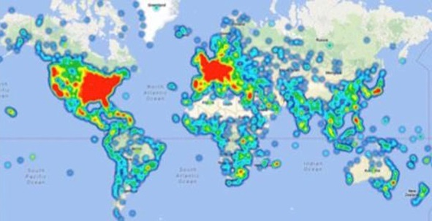

Why UHCG #3:
Global Network
Global Network built to support Quality
The best clinical outcomes are supported by high-quality networks with appropriate and efficient cost structures.
UnitedHealthcare Global Network
1,000,000+ providers worldwide
Nearly 560 medical Centers of Excellence
150 approved air ambulance providers
400 major cities with security personnel
150,000 providers outside the U.S., including more than 15,000 hospitals and clinics
Global Direct
Payment Rate*
8
3
%
Annual Global Case Volume
38,000+ emergency assistance cases
350 medical evacuations and repatriations
22,000 security operations
100+ charter aircraft extraction missions
10
0
%
Direct payment on member requested payments**
Source: UHC Global Internal data, 06/2017
*Direct Payment rate are based on International inpatient claims on a dollar spent basis
**UHC Global can administer all member payment request, though some providers may only accept member direct payments. 100% for covered services, excluding 'do not use' providers, OFAC sanctioned countries, and countries with payment restrictions or other legal restrictions
Notes:
Global Network Built on Quality
Primary NAV: Better Cost Control
Secondary NAV: Network Quality
Core Idea: We have built our network that focuses on high quality providers. We negotiate aggressive cost efficiencies and payment structures and invest in processes and systems to provide a high quality network, that is cost effective, and permits routine direct payment to providers and facilities for medical care.
________________________________________________________
The best clinicians and clinical management protocols rely on high quality networks with appropriate and efficient cost structures.
We continually make strategic decisions on whether to buy and own hospital systems or contract with them depending on the most cost effective way to ensure the highest quality care. Unlike any other partner you might choose, we currently own hospital systems in select countries outside of the U.S. and where we have not chosen to acquire the hospitals we have negotiated quality and efficiency terms for the benefit of care for your employees.
The worldwide network we’ve developed includes:
1,000,000+ providers worldwide
150,000 providers outside the U.S., including more than 15,000 hospitals and clinics
More than medical 550 Centers of Excellence
125 approved air ambulance providers
250 major cities with security personnel:
We have experienced annual global case volume of:
36,000 emergency assistance cases
1,500 medical transports
22,000 security operations
100+ charter aircraft extraction missions
We’ve negotiated aggressive cost efficiencies and payment structures with these providers and facilities so that when your individuals are directed into this network through our clinical management processes, you can be assured that the costs of care will be:
Reasonable and customary for the local market
Medically necessary
These cost savings measures with our providers and facilities are a result of continuous negotiation and network development efforts on our part.
Lastly, when a member contacts us to request a guarantee or payment for a provider (whether in or out of network) we can offer direct payment to the provider in 100% of these situations (100% for covered services, excluding 'do not use' providers, excluding OFAC sanctioned countries, and excluding countries with payment restrictions).
. Overall, we settle 83% of provider payments on international claims directly (international inpatient claims on a spend basis). The 17% difference is when someone sees an out of network provider and does not request a direct payment in advance, or they chose to pay the provider directly and submit for reimbursement.

Slide 20
Global Value Proposition
Focusing the vast resources of UnitedHealth Group on the specific needs of global employers and employees,
we offer broad capabilities that work together to deliver single-sourced solutions which are globally integrated, enabling optimized outcomes.
Single-Source Solutions
WHICH
ARE
Globally Integrated
ENABLING
Optimized Outcomes
The only single-source provider
of health care, security and insurance solutions in the
global employee benefits and services market
The single-source capabilities
are connected, coordinated
and strengthened by the governance of worldwide operational processes and
global clinical protocols
Together, our integrated solutions and high-tech customer service optimize client and member outcomes
Notes:
Value Proposition – UnitedHealthcare Global
Primary NAV: Global Marketplace
Secondary NAV:
Core Idea: We recognize that in today’s competitive environment, business growth relies heavily on a productive global workforce. Focusing the vast resources of UnitedHealth Group on the specific needs of global employers and employees, we offer broad capabilities that work together to deliver single-sourced solutions which are globally integrated, enabling optimized outcomes.
____________________________________________________
Our teams will work together with yours, keeping the clinical and safety needs of the patient foremost in the decision making and delivery of our 24/7 assistance and evacuation services. As your single source partner, you can be assured that all components of your benefits program will be in compliance in the U.S. and around the world.
UnitedHealthcare Global brings programs together in ways that no other organization can. From access to an expansive global health care network to enhanced case assessment, coordination and management, our integration strategy leverages the strengths and capabilities in ways that are not possible through separate vendors.
This single-sourced, globally integrated approach yields optimal clinical, operational, and financial, outcomes including risk-mitigation strategies that save lives, minimize property damage and facilitate recovery as well as cost savings through reduction in duplicate coverages.

Slide 21




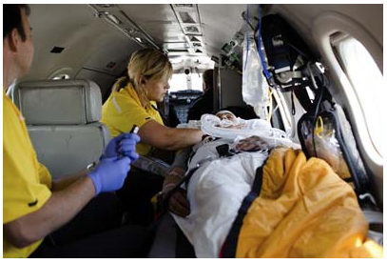
Global Insurance Product Offerings
UHCG Product | Discount to standard or underwritten rates
Expatriate CORE | 5% discount to underwritten rates
Expatriate Small Group 2-25 | 10% discount to standard pre-priced rates
Business Travel Medical CORE | 10% discount to standard pre-priced rates
Business Travel Medical CORE Plus | 10% discount to standard pre-priced rates

Slide 22
Global Benefits Scorecard –
Global Insurance: | Yes | No | Vendor
1. Expatriate, Inpatriate and Third Country National Benefits
- Medical, Dental, Vision, Rx, Life / AD&D, LTD
2. Business Travel Protection:
- Business Travel Medical
- Medical, Security, Political and Natural Disaster Evacuation
3. Business Travel Accident
Medical Assistance: | Yes | No | Vendor
1. Medical Intelligence
2. Travel Medical Support
3. Medical Evacuation
4. Repatriation
5. Medical Consulting
Security Assistance: | Yes | No | Vendor
1. Security Intelligence
2. Security, Political and Natural Disaster Evacuation
3. Security Operations
4. Crisis Management and Critical Incident Support
Travel Risk Management: | Yes | No | Vendor
1. Travel Tracking
2. Intelligence Alerts
3. Airline Risk Ratings
Ancillary Assistance Services: | Yes | No | Vendor
1. Ground Transport
2. Executive Protection
3. Aircraft Guarding
4. Defensive driving training
5. Event Management
Global Health and Well-Being Solutions: | Yes | No | Vendor
1. International Employee Assistance Program
2. Health Risk Assessment
3. Biometric Screenings
4. Global Wellness (other)
Global Medical: | Yes | No | Vendor
1. Onsite clinics / medics
2. Medical consultation / training
3. Localization Services
4. Medical Supplies and Equipment
Other Global Benefit Offerings: | Yes | No | Vendor
Foreign Voluntary Workers Compensation
Multinational Pooling
Local Placement(s)
Duty of Care / ICE / Black Swan Planning
Pre-Assignment Assistance / Fit For Duty
e-Second Opinion / Telehealth
Retirement and Pension solutions (DB vs. DC)
Cultural training / language support
Global tax support
Cost of Living Adjustments (COLA)
Clinical Insight
Technology
Data & Information
Notes:
Setting the Stage - UHG Size and Scale
Primary NAV: Global Marketplace
Secondary NAV:
Core Idea: UnitedHealthcare Global is a part of the UnitedHealth Group family of businesses which seeks to help people live healthier lives and to make the health system work better for everyone.
________________________________________________________
UnitedHealth Group’s breadth of operations employs over 260,000 people; 70,000 of them outside the U.S., spanning over 130 countries and projecting $200 billion in revenues for 2017.
Our employees continually demonstrate their commitment to the communities we serve through generous volunteerism and charitable support. Each year, UnitedHealth Group’s employees donate more than 1.25 million volunteer hours and supported more than 21,000 charities and nonprofit organizations worldwide.
We have earned recognition from reputable independent organizations, including Fortune and Newsweek magazines and as a member of the Dow Jones Industrial Average.
For the last six years, UnitedHealth Group has ranked Number 1 on Fortune’s list of the “World’s Most Admired Companies” in the Insurance and Managed Care sector overall, and has ranked Number 1 in its sector for innovation for 7 straight years.
Collectively, our health care–dedicated operations support the health and wellbeing of millions of people worldwide. Our ability to improve the lives of these people comes from leveraging our core competencies:
Clinical care insights
Technology
Data and information

Slide 23
Why UnitedHealthcare Global
One global vendor relationship to manage: Global Insurance, BTM, Assistance / Security, etc.
Single number for all member needs
Network site audit process
Rigorous clinical programs rooted in MCG guidelines
Market-leading Rx Programs
Member tools, resources, and personal outreach programs to drive ongoing engagement
Congruency with UnitedHealthcare domestic networks and programs
Quality+ Efficiency
1,000,000+ providers worldwide
Nearly 560 medical Centers of Excellence
150 approved air ambulance providers
400 major cities with security personnel
150,000 providers outside the U.S. including more than 15,000 hospitals and clinics
Global Network
72% reduction in costly, sometimes unnecessary evacuations over a four-year period
96% of medical claims paid directly to providers globally
9.4 out of 10 clients expressed overall satisfaction with implementation
$12-15 PMPM reduction in medical cost through active Rx Management
60% more likely to engage in clinical program through pharmacy
Results
Notes:
Reasons to Choose UnitedHealthcare Global
Primary NAV: Better Cost Control
Secondary NAV:
Core Idea: UnitedHealthcare Global delivers quality through worldwide operational processes, global clinical protocols, and a vetted global network. We support a broad spectrum of clients’ needs, delivering efficiency through a single relationship. This enables us to deliver results that matter to our clients and help people live healthier lives.
______________________________________________________
UnitedHealthcare Global strives to deliver quality and efficiency, which generate positive results for our clients.
Our quality is demonstrated through:
Our global reach of providers both in the U.S. and around the globe.
Extensive network site audit process
Strong clinical reputation, backed by rigorous clinical programs, rooted in MCG guidelines and evidenced based care
Market leading and innovative Rx programs, member tools, and personal outreach programs to drive engagement
We provide efficiency for our clients through:
Offering a single vendor relationship to manage
Streamlined reporting
A simple member approach, one number to call for any member support questions or care needs
Congruency with UnitedHealthcare domestic (Employer & Individual) networks and programs
Our model is highly integrated, and is designed to deliver results. We achieve strong financial results, helping achieve cost management through innovative member engagement programs, effectively managing Rx spend, and aggressive clinical management programs. Some notable results include:
PMPM decrease of 1.5%
95% health assessment completion rate
~21 visits to Rally website/year
$12–15 PMPM reduction in medical cost through active Rx management
45% more likely to engage in clinical program through pharmacy

Slide 24
Premium Quality Care Outcomes

Slide 25
UnitedHealth Premium
Quality of Care and Outcomes
Quality measured first. Assessed using national standardized measures from organizations such as the National Quality Forum (NQF) and the National Committee for Quality Assurance (NCQA).
Preventive care | Cancer screening and other indicated screening interventions.
Evidence-based care | Follows evidence-based guidelines for use of medications and diagnostic tests.
Chronic disease care | Monitoring for control, progression and complications.
Patient safety | Avoiding duplicate testing or adverse drug interactions.
Sequencing of care | Diagnostic tests and procedures, treatment and monitoring.
Effectiveness of procedures | Lack of failed therapy and complications.
                Fairfield County, Connecticut
                Greater Milwaukee, Wisconsin
                Northeast Wisconsin
                Northern Illinois
                Raleigh/Triangle, North Carolina
                Rhode Island
Highest Quality Markets
(Over 90% of Eligible Physicians)
Notes:
Quality: 83% of eligible network physicians meet the quality portion of the Premium program evaluation. Individual markets range from 57% to 91% of physicians meeting quality. The market with the highest percentage (91%) are listed

Slide 26
UnitedHealth Premium
Quality Results and Outcomes - OB/GYN
CARE VARIATION
Quality Measure Type and Source Examples
Global Cesarean
Preventive Care: National Committee for Quality Assurance (NCQA) endorsed preventive measures for chlamydia screening.
Evidence-Based Care: NCQA endorsed measure regarding non-recommended cervical cancer screening in adolescents.
Chronic Disease Care: Pharmacy Quality Alliance endorsed measures for medication prescribing and adherence for diabetics.
Patient Safety: Expert panel measures assessing whether or not a patient had a complication such as hemorrhage, pneumonia, and/or wound infection post hysterectomy or C-section.
Sequencing of Care: NCQA endorsed measures for prenatal and post-partum care.
Effectiveness of Procedures: Expert panel endorsed measure regarding major restudies post excision of ovary or ovarian duct.
  Premium Care Physicians
  with global cesarean
  delivery procedure episodes had:
16%
  lower average complication rates than others who are not Premium care.
2018 UnitedHealthcare Network (Par) Commercial Claims analysis for 16 specialties and 169 markets. Rates are based on historical information and are not a guarantee of future outcomes. Average savings per patient/episode based only on claims for conditions and procedures directly used in the determination of physician designations.

Slide 27
UnitedHealth Premium
Quality Results and Outcomes - Cardiology
CARE VARIATION
Quality Measure Type and Source Examples
Stents
Chronic disease care: NCQA endorsed measure regarding statin therapy for patients with cardiovascular disease.
Patient Safety: NQF endorsed medication safety monitoring measures to ensure that patients are not taking medications that are contraindicated by another condition, such as elderly patients with chronic kidney disease avoiding NSAIDs.
Sequencing of Care: NQF endorsed measure for beta-blocker usage to ensure patients are on a beta-blocker for 6 months after a hospitalization for acute myocardial infarction.
Effectiveness of Procedures: Expert panel measure measuring whether patients had a redo procedure following coronary artery catheterization with drug stent.
  Premium Care Physicians
  with cardiology stent procedure episodes had:
10%
17%
  lower average complication rates.
  fewer average
  redo procedures.
Savings estimates based on 2018 UnitedHealthcare Network (Par) Commercial Claims analysis for 16 specialties and 169 markets. Figures are based on book-of-business results and represent the national average expected cost differential between Premium Care Physicians and non-Premium Care Physicians for entire episodes of care. Actual savings achieved will vary by customer depending on geographic availability and customer-specific service mix. All figures and estimated savings represent historical performance and are not a guarantee of future savings.

Slide 28
UnitedHealth Premium
Quality Results and Outcomes - Orthopedics
CARE VARIATION
Knee replacement
Hip replacement
Lumbar fusion
  Premium Care Physicians
  with orthopedic procedure episodes had:
  Premium Care Physicians
  with orthopedic procedure episodes had:
  Premium Care Physicians
  with orthopedic procedure episodes had:
12%
41%
24%
32%
18%
25%
  lower average complication rates
  fewer average
  redo procedures
  lower average complication rates
  fewer average
  redo procedures
  lower average complication rates
  fewer average
  redo procedures
Quality Measure Type and Source Examples
Sequencing of Care: Expert panel endorsed measure for knee replacement includes measure to determine if the procedure was performed within 30 days of the initial diagnosis (to avoid rush to surgery), as well as physical therapy post-surgery.
Effectiveness of Procedures: Expert panel endorsed measures for decompression of a herniated disk include measures for appropriate timing of pre-surgical imaging, physical therapy as well as whether or not the patient had a redo procedure or post-surgical complications (hemorrhage, pneumonia, mechanical, wound infection, pulmonary embolism, or iatrogenic complications).
Savings estimates based on 2018 UnitedHealthcare Network (Par) Commercial Claims analysis for 16 specialties and 169 markets. Figures are based on book-of-business results and represent the national average expected cost differential between Premium Care Physicians and non-Premium Care Physicians for entire episodes of care. Actual savings achieved will vary by customer depending on geographic availability and customer-specific service mix. All figures and estimated savings represent historical performance and are not a guarantee of future savings.

Slide 29
Quest Diagnostics
UnitedHealthcare Establishes Long-term Strategic Partnership with Quest Diagnostics
May 24, 2018
Beginning Jan. 1, 2019, Quest will be participating as a national provider of laboratory services for all UnitedHealthcare plan participants
Partnership will include broad range of value-based programs, rewarding high quality, easily accessible laboratory services at the best value and real-time data sharing to drive more personalized care support

Slide 30
Questions

